Slide 1
International Monetary System
and
Safe Assets
Markus K. Brunnermeier
Sebastian Merkel
Princeton Initiative 2024 2024-09-06
- Work in Progress! -

Slide 2
Motivation
Is the International Monetary System/Global Financial Architecture inherently distortionary?
Do the rich insure the poor or the other way around?
If so, why? How?
Who can run stimulus programs? Who is forced to run austerity programs?
What role do Safe Assets play?
Who enjoys Exorbitant Privilege to Issue Safe Asset?
Can government spend without taxation? How much?
What are Safe Assets and its service flow?
Flight-to-safety phenomenon (negative $β$)
Is there a complementarity btw safe asset and bubbly asset?

Slide 3
Motivation
Is the International Monetary System/Global Financial Architecture inherently distortionary?
What role do Safe Assets play?
What are Safe Assets and its service flow?
Flight-to-safety phenomenon (negative $β$)
Is issuing a Safe Asset an Exorbitant Privilege? When can it be a burden?
Who can run stimulus programs? Who is forced to run austerity programs?
When do exchange rate distortions outweigh funding advantages?
What does it depend on? Size of the country? Home bias?
Is FX intervention “manipulative” or stabilizing? (Provide rationale for it)
Notes:
Is there a complementarity btw safe asset and bubbly asset?
Can government spend without taxation? How much?
Debt sustainability analysis and “Debt Laffer Curve”

Slide 4
Safe Asset: Issuance Privilege vs. Burden
At normal times: lower $r$ possibly $<g$
At times of elevation risk:
Flight-to-Safety issuance benefits $↑$ interest rate $r ↓$
Exchange rate $↑$ export/import $↓$
What does it depend on?
Fraction on world safe asset share (relative to country size)
(1) price stickiness (form of) (2) home goods bias (3) elasticity of substitution btw. home & foreign goods

Slide 5
FX Interventions: Preview
Safe asset providing country
Holds a common “stock” of foreign bond
Increases its holdings in an elevated risk environment
Is not manipulative but stabilizing, as the country shares privilege/“Bubble mining” revenue (helps to keep interest rate low)
Switzerland has larger incentive to share privilege than US
As it helps to stabilize its output gap more
Conjecture: Buying foreign equity shares adds risk
$β$ of safe asset is less negative

Slide 6
What’s is a Safe Asset Service Flow?
Based on BruMerSan 2024 “Safe Assets”
Safe asset = good friend
Idiosyncratic risk: provides partial insurance through re-trading
A
B
…
…
…
0
0
Portfolio of
Safe asset
Cash flow asset
A
B
CF
CF
0
0
shocks
CF
CF
0
0
CF
CF
shocks

Slide 7
What’s is a Safe Asset Service Flow?
Based on BruMerSan 2024 “Safe Assets”
Safe asset = good friend
Idiosyncratic risk: provides partial insurance through re-trading
A
B
…
…
…
0
0
A
B
CF
CF
0
0
CF
CF
0
0
CF
CF

Slide 8
What’s a Safe Asset? Exorbitant Privilege rises in Recessions
Safe asset = good friend
Idiosyncratic risk: provides partial insurance through re-trading
Aggregate risk: appreciates in value in bad times (negative $β$)
A
B
…
…
…
0
0
In recessions:
Risk is higher
Service flow is more valuable
Cash flows are lower (depends on fiscal policy)
A
B
CF
CF
0
0
CF
CF
0
0
CF
CF

Slide 9
What’s a Safe Asset?
Good friend (relative to own net worth return $dr_{t}^{n^{i}}$) $Cov_{t}\left[SDF_{t}^{j}, dr_{t}^{safe}− dr_{t}^{n^{i}}\right]≥ 0$
Idiosyncratic risk
Aggregate risk $β≤0$ – appreciates in times of high risk
Provides service flow (+ cash flow) in incomplete market settings
$$\frac{ℬ_{t}}{℘_{t}}=E_{t}\left[PV_{ξ^{∗∗}}(\text{primary} \text{surpluses})\right] +E_{t}\left[PV_{ξ^{∗∗}}(\text{service} \text{flows})\right]$$
$⇒$ Lower cash flow interest rate on gov debt $r$ [Gov. Debt Valuation Puzzle]
Low trading costs are important for service flow
Limited asymmetric information, info sensitivity, trading cost

Slide 10
Complementarity btw Safe Asset & Bubble
Bubbly
Asset
Safe Asset
$⇒$ A bubbly asset is more likely a safe asset
Bubble can expand in downturns (even when cash flow declines) $⇒$easier to satisfy: $Cov_{t}\left[SDF_{t}^{j}, dr_{t}^{safe}− dr_{t}^{n^{i}}\right]≥ 0$, $β^{CAPM}≤0$
$⇐$ A safe asset is more likely a bubble
Safe asset with $β^{CAPM}≤0$, has lower expected cash flow return as risk premium is negative
$⇒$easier to satisfy bubble condition: $r_{t}^{f}+\underset{≤0}{\underbrace{risk premium}}≤g_{t}$ (on average)
Also, $r^{f}$ is depressed by precautionary savings (incl. uninsurable idiosyncratic risk)
Bubble:
Issue long-term asset, whose value exceeds fundamental value (of e.g. zero)
Ponzi scheme:
Rollover existing short-term debt with growing new (short-term) debt
Which needs to be rolled over again.
Notes:
Transversality condition holds for each individual, but not in aggregate
$≠$ complete markets

Slide 11
2 Country Setting
Country $N$’s exorbitant privilege > ½ > Country $S$’s
Steady state: $N$-gov. issues safe asset bonds (at low r) to $S$-citizens
Global (idiosyncratic) risk $↑$ shock: ($⇒$ macro + investment implications)
$⇒$ Fiscal Space of $N$ $↑$ of $S ↓$ due to flight to safety
ta$x^{N} ↓$ ta$x^{S} ↑$
capital flow

Slide 12
Related Literature - Incomplete -
Safe Asset (Shortage vs. Asymmetric Supply):
Global shortage: Caballero et al. (2016,17), …
Asymmetric Supply: BruMerSan (2024 “Safe Assets”), ESBies, GloSBies, …
Info sensitivity: Gorton Pennachi (1990), Dang et al. (2017),
Public Debt Evaluation Puzzles/FTPL:
Jiang et al. (2020,2021), BruMerSan (2020 “FTPL”) Bubble
Bubble and Macrofinance
Large $r$ vs. $g$ literature...
US as (Levered) Financial Center, GFC
Kindleberger (1965), Gourinchas Rey (World Venture Capitalist) (2005),
Miranda-Agrippino and Rey (2022), Oskolkov (2024), …
Reserve Paradox
Maggiori (2017), Jiang Krishnamurthy Lustig (2023), Devereux Engel Wu (2023)
Notes:
Matteo Maggiori coined the term in his job market paper (https://www.aeaweb.org/articles?id=10.1257/aer.20130479).
The idea is that the US looks like it is insuring the rest of the world, in that US net foreign assets fall in bad times, and that in terms of asset composition the US is holding risky foreign assets while selling largely safe bonds to the rest of the world. So many papers (like Matteo's job market paper) model the US in two country settings as more risk-tolerant. However, if the US is indeed insuring the rest of the world, its relative wealth should fall in bad times which in standard models would reduce the consumption demand in the US and with home bias therefore a reduction in the demand for the US specific consumption basket. This should induce a depreciation of the US dollar, as the fall in demand for the US basket should make the dollar (the price of that basket) cheaper. In the data, the dollar however seems to appreciate in bad times.
Matteo offered in his paper a potential resolution through increasing trade costs in bad times, but only for the US. Because of those costs the US consumer shifts to US goods increasing the demand for US goods, even as overall demand falls, which can then still trigger a dollar appreciation. Even he, I think, did not consider that a satisfying resolution.
An alternative resolution is that US output falls at the same time as the US is losing wealth, if that decline is strong enough, the US consumption basket will become more scarce even as demand goes down. Maxime Sauzet has this as an exogenous output shock in his job market paper (https://papers.ssrn.com/sol3/papers.cfm?abstract_id=3882255). Rohan and I developed at the same time our paper in which the output decline happens endogenously in response to the same shock that also triggers the dollar appreciation, the flight to safe dollar bonds (https://drive.google.com/file/d/1_JuqTTABvntc56tZwM0pK_zLZtPfH-xQ).
Arvind, Hanno and Zhengyang resolve the reserve currency paradox through the increase in seigniorage revenues: while the US is losing measured wealth, the value of future seigniorage revenues makes the US effectively richer and therefore US relative demand actually goes up (https://academic.oup.com/restud/advance-article/doi/10.1093/restud/rdad108/7451190). We also have this mechanism in our paper but find it to be quantitatively small at least in our setting. In the end very related is the mechanism in Gourinchas and Rey (https://ideas.repec.org/p/cpr/ceprdp/16944.html) who make foreigners more risk averse in bad times.
Recently, Dahlquist et al. argue that it is wrong to focus on net foreign assets as an indicator of whether the US is actually insuring the rest of the world and that one needs to focus on total wealth. They argue that total wealth in the US goes up, the dollar appreciates and all US assets become more valuable. I think most participants in this area are not convinced by their empirical measure, but the point is worth thinking about. They build a model that in the end also has a exogenous fall in relative US output in times of dollar appreciation, so in terms of mechanisms it is actually quite related to Sauzet's and our work on this (https://papers.ssrn.com/sol3/papers.cfm?abstract_id=4057287).
Finally, Steve Wu, Charles Engel and Mick Devereux built on my paper with Rohan but endogenize the flight to the dollar through collateral needs of financial intermediaries (https://drive.google.com/file/d/1k2Is67xfrUXWnjy5v49qb2di3-sscS0W/view). Their paper has our New Keynesian mechanism to trigger the fall in US output and it quantitatively the key driver, but banking frictions and local currency pricing also induce additional wedges that act like the trade costs in Matteo's resolution and the seigniorage revenue channel in Arvind et al's work.

Slide 13
Overview
2 Country Model Setup with Safe Assets
Safe Assets Issuance Exorbitant Privilege
Contrasting Steady States across different Risk Environments
Transition after Risk Shock
Safe Asset Burden due to Exchange Rate Appreciation
Introducing home bias in consumption basket
Introducing price stickiness (and utilization /output gap)
Ceteris Paribus Analysis
Total symmetry, except in one dimension: share of safe asset “exorbitant privilege bubble”

Slide 14
Roadmap
Motivation, Safe Asset: Intuition and Definition
Two Country Model Setup
Symmetric Benchmark
World Government (Bond) $⇒$ “Safe Asset Pricing”
Two countries with Constant Idiosyncratic Risk and $⇒$ Asymmetric Permanent Exorbitant Privilege
Risk Shock and its Transition $⇒$ Insurance of $S$ by $N$ in the long-run
Time-varying Idiosyncratic Risk ${\tilde{σ}}_{t}∈\left\{{\tilde{σ}}^{L},{\tilde{σ}}^{H}\right\}$ $⇒$ Flight-to-Safety Exorbitant Privilege and $β^{N}<β^{S}$ $⇒$ EMDE Costly Stimulus Policy
Future: “Battle for the Bubble” + Exchange Rate Policy with Sticky Prices
Ceteris Paribus Analysis
Total symmetry, except in one dimension: share of safe asset “exorbitant privilege bubble”

Slide 15
Two Country Model: Overview
Continuous time, infinite horizon, two consumption goods: (nuts and spices)
2 large countries: $N$ and $S$ (“north” and “south”)
Both countries are symmetric to highlight single difference
Each country issues government bonds
Continuum of citizens in each country
Operate capital with time-varying idiosyncratic risk, AK production technology
Can trade capital, government bonds of both countries
No citizen mobility
Two Governments
Exogenous spending
Issues (nominal) bonds
Taxes output to close budget
Financial Frictions: incomplete markets
Agents cannot insure idiosyncratic risk (must retain skin in the game)
Aggregate risk: fluctuations in volatility of idiosyncratic risk (& capital productivity)

Slide 16
Two Country Model
Citizens in (north) country $N$, $\tilde{i}∈[0,\frac{1}{2}]$ and in (south) country $S$, $\tilde{i}∈[\frac{1}{2},1]$
Country $N$ produces nuts, n Country $S$ produces spices, s
With the same physical capital, $ak_{t}^{\tilde{i}}dt$, (constant return to scale)
CES utility function, elasticity of substitution btw nuts and spices, $ε$
$c_{t}^{N}={\left({\frac{1+π}{2}{(c}_{t}^{n})}^{\frac{ε−1}{ε}}+{\frac{1−π}{2}{(c}_{t}^{s})}^{\frac{ε−1}{ε}}\right)}^{\frac{ε}{ε−1}}$, $c_{t}^{S}={\left({\frac{1−π}{2}{(c}_{t}^{n})}^{\frac{ε−1}{ε}}+\frac{1+π}{2}{{(c}_{t}^{s})}^{\frac{ε−1}{ε}}\right)}^{\frac{ε}{ε−1}}$
Aggregate consumption good $c_{t}$ for country $I$
$E\left[\int_{0}^{∞}{e^{−ρt}(log{c_{t}^{I,\tilde{i}}}+log(ℊK_{t}))dt}\right]$
$π∈[0,1]$ home bias – key difference btw American and Switzerland

Slide 17
Two Country Model
Citizens in (north) country $N$, $\tilde{i}∈[0,\frac{1}{2}]$ and in (south) country $S$, $\tilde{i}∈[\frac{1}{2},1]$
Country $N$ produces nuts, n Country $S$ produces spices, s
With the same physical capital, $ak_{t}^{\tilde{i}}dt$, (constant return to scale)
CES utility function, elasticity of substitution btw nuts and spices, $ε$
$c_{t}={\left({{(c}_{t}^{n})}^{\frac{ε−1}{ε}}+{{(c}_{t}^{s})}^{\frac{ε−1}{ε}}\right)}^{\frac{ε}{ε−1}}$
Aggregate consumption good $c_{t}$ for country $I$
$E\left[\int_{0}^{∞}{e^{−ρt}(log{c_{t}^{I,\tilde{i}}}+log(ℊ\frac{1}{2}K_{t}))dt}\right]$

Slide 18
Two Country Model
Citizens in $N$, $\tilde{i}∈[0,\frac{1}{2}]$, country $S$ symmetric for $\tilde{i}∈\left[\frac{1}{2},1\right]$, no home bias $π=0$
$E\left[\int_{0}^{∞}{e^{−ρt}(log{c_{t}^{\tilde{i}}}+log(ℊ\frac{1}{2}K_{t}))dt}\right]$ s.t. No Ponzi &
Each citizen operates physical capital $k_{t}^{\tilde{i}}$ in his country
Output in apples: $ak_{t}^{\tilde{i}}dt$
Sold in at global market at nut price $p^{n}$ in country $N$ numeraire $c^{N}.$
$\frac{dk_{t}^{\tilde{i}}}{k_{t}^{\tilde{i}}}=μ^{K}dt+{\tilde{σ}}_{t}d{\tilde{Z}}_{t}^{\tilde{i}}+dΔ_{t}^{k,\tilde{i}}$
$d{\tilde{Z}}_{t}^{\tilde{i}}$ idiosyncratic Brownian
${\tilde{σ}}_{t}∈\{{\tilde{σ}}^{L},{\tilde{σ}}^{H}\}$exogenous process with Poisson arrival rate
$N$‘s capital share: $κ_{t}=K_{t}^{N}/K_{t}$, $K_{t}^{N}≔\int_{0}^{1/2}{k_{t}^{\tilde{i}}d\tilde{i}}$, $K_{t}≔\int_{0}^{1}{k_{t}^{\tilde{i}}d\tilde{i}}$
$N$‘s net worth share: $η_{t}=$ $N_{t}^{N}/N_{t}$, $N_{t}^{N}≔\int_{0}^{1/2}{n_{t}^{\tilde{i}}d\tilde{i}}$
A
L
A
L
A
L
A
L
$$\frac{dn_{t}^{\tilde{i}}}{n_{t}^{\tilde{i}}}=−\frac{c_{t}^{\tilde{i}}}{n_{t}^{\tilde{i}}}dt+θ_{t}^{ℬ^{N},\tilde{i}}dr_{t}^{ℬ^{N}}+θ_{t}^{ℬ^{S},\tilde{i}}dr_{t}^{ℬ^{S}}+\left(1−θ_{t}^{ℬ^{N},\tilde{i}}−θ_{t}^{ℬ^{S},\tilde{i}}\right)dr_{t}^{K,\tilde{i}}$$
Gov. deb$t^{N}$ $$\text{Gov}\text{. }\text{deb}t^{S}$$
$$n^{\tilde{i}}$$
Net worth
$$k_{t}^{\tilde{i}}$$

Slide 19
Two Country Model
Citizens $\tilde{i}$ in $N$, (country $S$ symmetric)
$E\left[\int_{0}^{∞}{e^{−ρt}(log{c_{t}^{\tilde{i}}}+log(ℊ\frac{1}{2}K_{t}))dt}\right]$ s.t. No Ponzi &
Each citizen operates physical capital $k_{t}^{\tilde{i}}$ in his country
Output in nuts: $ak_{t}^{\tilde{i}}dt$
Sold in at global market at nut price $p^{n}$ in country $N$ numeraire $c^{N}.$
$\frac{dk_{t}^{\tilde{i}}}{k_{t}^{\tilde{i}}}=μ^{K}dt+{\tilde{σ}}_{t}d{\tilde{Z}}_{t}^{\tilde{i}}+dΔ_{t}^{k,\tilde{i}}$ $κ$ = capital share of $N$
$d{\tilde{Z}}_{t}^{\tilde{i}}$ idiosyncratic Brownian $η$ = net worth/wealth share of $N$
${\tilde{σ}}_{t}∈\{{\tilde{σ}}^{L},{\tilde{σ}}^{H}\}$exogenous process with Poisson arrival rate
Frictions:
Incomplete markets: no $d{\tilde{Z}}_{t}^{\tilde{i}}$-claims (risky equity claims)
Output goods, capital and government bonds can be traded across borders
A
L
A
L
A
L
$$\frac{dn_{t}^{\tilde{i}}}{n_{t}^{\tilde{i}}}=−\frac{c_{t}^{\tilde{i}}}{n_{t}^{\tilde{i}}}dt+θ_{t}^{ℬ^{N},\tilde{i}}dr_{t}^{ℬ^{N}}+θ_{t}^{ℬ^{S},\tilde{i}}dr_{t}^{ℬ^{S}}+\left(1−θ_{t}^{ℬ^{N},\tilde{i}}−θ_{t}^{ℬ^{S},\tilde{i}}\right)dr_{t}^{K,\tilde{i}}$$
A
L
Gov. deb$t^{N}$ $$\text{Gov}\text{. }\text{deb}t^{S}$$
… budget constraint
$$n^{\tilde{i}}$$
Net worth
$$k_{t}^{\tilde{i}}$$

Slide 20
Government: Taxes, Bond/Money Supply, Gov. Budget
Policy Instruments
${ℊ\frac{1}{2}K}_{t}$ Government spending (with exogenous $ℊ$) – identical in both countries
$τ_{t}^{N}p_{t}^{n}aK_{t}^{N}$ Proportional output tax at rate $τ_{t}^{N}$, $p_{t}^{n}$ is price of nuts in terms of world output good
$\frac{dℬ_{t}^{N}}{ℬ_{t}^{N}}=μ_{t}^{ℬ^{N}}dt$Nominal government debt issuance
$i_{t}^{N}$ Floating nominal interest rate on outstanding bonds
Government budget constraint (BC)
$$\underset{{\check{μ}}_{t}^{ℬ^{N}}:=}{\underbrace{\left(μ_{t}^{ℬ^{N}}−i_{t}^{N}\right)}}ℬ_{t}^{N}+℘_{t}^{N}\underset{s_{t}^{N}≔}{\underbrace{\left(τ_{t}^{N}p_{t}^{n}aκ^{N}−\frac{1}{2}ℊ_{t}\right)}K_{t}}=0$$
Equilibrium selection: No No-Ponzi constraint
Not market clearing,
Payment/redistribution to bond holders
$ℬ_{t}^{N}/℘_{t}^{N}$ clears bond market
World capital stock
$N$’s primary surplus of (per world $K_{t}$)

Slide 21
Roadmap
Motivation, Safe Asset: Intuition and Definition
Two Country Model Setup
Symmetric Benchmark
World Government (Bond) $⇒$ “Safe Asset Pricing”
Constant Idiosyncratic Risk and $⇒$ Asymmetric Permanent Exorbitant Privilege
Risk Shock and its Transition $⇒$ Insurance of $S$ by $N$ in the long-run
Time-varying Idiosyncratic Risk ${\tilde{σ}}_{t}∈\left\{{\tilde{σ}}^{L},{\tilde{σ}}^{H}\right\}$ $⇒$ Flight-to-Safety Exorbitant Privilege and $β^{N}<β^{S}$ $⇒$ EMDE Costly Stimulus Policy
Future: “Battle for the Bubble” + Exchange Rate Policy with Sticky Prices

Slide 22
World Government (Bond)
Merge both countries
1 government + 1 bond
$κ =η = 1/2$ and # of nuts $=$ # of spices
Bond pricing as in “Safe Asset” BruMerSan-paper

Slide 23
Debt Valuation (FTPL) – Two Perspectives
Total symmetry of $N$ and $S$ (or in steady state)
Buy and Hold Perspective:
$\frac{ℬ_{0}^{I}}{℘_{0}^{I}}=\lim_{T→∞}\left(𝔼\left[\int_{0}^{T}{ξ_{t}^{i}s_{t}^{I}K_{t}dt}\right]+𝔼\left[ξ_{t}^{i}\frac{ℬ_{T}^{I}}{℘_{T}^{I}}\right]\right)$
Valuation of strategy that buys and holds a fixed fraction of outstanding debt
Dynamic Trading Perspective:
$η_{0}^{i}\frac{ℬ_{0}}{℘_{0}}=𝔼[\int_{0}^{∞}{\underset{=ξ_{t}^{∗∗}}{\underbrace{\left(\int{ξ_{t}^{i}η_{t}^{i}}di\right)}}sK_{t}dt}]+𝔼[\int_{0}^{∞}{\underset{=ξ_{t}^{∗∗}}{\underbrace{\left(\int{ξ_{t}^{i}η_{t}^{i}}di\right)}}{\left({\tilde{σ}}_{t}^{c}\right)}^{2}\frac{ℬ_{t}}{℘_{t}}dt]}$
Valuation of equilibrium cash flows from individual bond portfolios, incl. trading cash flows (aggregated over all agents $i$ to obtain total value of debt)
Agent $i$‘s SDF, $ξ_{t}^{i}$: $dξ_{t}^{i}/ξ_{t}^{i} =−r_{t}^{f}dt−ς_{t}dZ_{t}−{\tilde{ς}}_{t}^{i}d{\tilde{Z}}_{t}^{i}$, idiosyncratic consumption vol. ${\tilde{σ}}_{t}^{c}$

Slide 24
Debt Valuation (FTPL) – Two Perspectives
Total symmetry of $N$ and $S$ (or in steady state)
Buy and Hold Perspective:
$\frac{ℬ_{0}^{I}}{℘_{0}^{I}}=\lim_{T→∞}\left(𝔼\left[\int_{0}^{T}{ξ_{t}^{i}s_{t}^{I}K_{t}dt}\right]+𝔼\left[ξ_{t}^{i}\frac{ℬ_{T}^{I}}{℘_{T}^{I}}\right]\right)$
Valuation of strategy that buys and holds a fixed fraction of outstanding debt
Dynamic Trading Perspective:
$η_{0}^{i}\frac{ℬ_{0}^{I}}{℘_{0}^{I}}=𝔼[\int_{0}^{∞}{\underset{=ξ_{t}^{∗∗}}{\underbrace{\left(\int{ξ_{t}^{i}η_{t}^{i}}di\right)}}s_{t}^{I}K_{t}dt}]+𝔼[\int_{0}^{∞}{\underset{=ξ_{t}^{∗∗}}{\underbrace{\left(\int{ξ_{t}^{i}η_{t}^{i}}di\right)}}{\left({\tilde{σ}}_{t}^{c}\right)}^{2}\frac{ℬ_{t}^{I}}{℘_{t}^{I}}dt]}$
Valuation of equilibrium cash flows from individual bond portfolios, incl. trading cash flows (aggregated over all agents $i$ to obtain total value of debt)
Agent $i$‘s SDF, $ξ_{t}^{i}$: $dξ_{t}^{i}/ξ_{t}^{i} =−r_{t}^{f}dt−ς_{t}dJ_{t}−{\tilde{ς}}_{t}^{i}d{\tilde{Z}}_{t}^{i}$, idiosyncratic consumption vol. ${\tilde{σ}}_{t}^{c}$

Slide 25
Debt Valuation (FTPL) – Two Perspectives
Total symmetry of $N$ and $S$ (or in steady state)
Buy and Hold Perspective:
$\frac{ℬ_{0}^{I}}{℘_{0}^{I}}=\lim_{T→∞}\left(𝔼\left[\int_{0}^{T}{ξ_{t}^{i}s_{t}^{I}K_{t}dt}\right]+𝔼\left[ξ_{t}^{i}\frac{ℬ_{T}^{I}}{℘_{T}^{I}}\right]\right)$
Valuation of strategy that buys and holds a fixed fraction of outstanding debt
Dynamic Trading Perspective:
$η_{0}^{i}\frac{ℬ_{0}^{I}}{℘_{0}^{I}}=𝔼[\int_{0}^{∞}{\underset{=ξ_{t}^{∗∗}}{\underbrace{\left(\int_{0}^{1}{ξ_{t}^{i}{\tilde{η}}_{t}^{i}di}\right)}}s_{t}^{I}K_{t}dt}]+𝔼[\int_{0}^{∞}{\underset{=ξ_{t}^{∗∗}}{\underbrace{\left(\int{ξ_{t}^{i}η_{t}^{i}}di\right)}}{\left({\tilde{σ}}_{t}^{c}\right)}^{2}\frac{ℬ_{t}^{I}}{℘_{t}^{I}}dt]}$
Valuation of equilibrium cash flows from individual bond portfolios, incl. trading cash flows (aggregated over all agents $i$ to obtain total value of debt)
Agent $i$‘s SDF, $ξ_{t}^{i}$: $dξ_{t}^{i}/ξ_{t}^{i} =−r_{t}^{f}dt−ς_{t}dJ_{t}−{\tilde{ς}}_{t}^{i}d{\tilde{Z}}_{t}^{i}$, idiosyncratic consumption vol. ${\tilde{σ}}_{t}^{c}$
Notes:
Outside of steady state
Portfolio weights differ across citizens across countries
Weighted averages in both terms including ${\tilde{σ}}_{t}^{c,I}$-terms
Asset holding shares are relevant = wealth shares only in SS

Slide 26
FTPL Equation(s)
Integrate forward: ${θ_{t}μ}_{t}^{θ}=θ_{t}(\underset{=r^{f}}{\underbrace{ρ+\overset{Φ\left(ι\right)−δ}{\overbrace{g}}−{\left(1−θ_{t}\right)}^{2}{\tilde{σ}}^{2}}}−g+\underset{=−s_{t}/q_{t}^{ℬ}}{\underbrace{{\check{μ}}_{t}^{ℬ}}})$
FTPL equation: $\frac{𝓑_{0}}{℘_{0}}=𝔼\left[\int_{0}^{∞}{e^{−r^{f}t}sK_{t}dt}\right]$ if $g<r^{f}$ since $K_{t}=e^{gt}K_{0}$
Integrate forward: ${θ_{t}μ}_{t}^{θ}=θ_{t}(ρ−{\left(1−θ_{t}\right)}^{2}{\tilde{σ}}^{2}+{\check{μ}}_{t}^{ℬ})$
New FTPL equation:
$$\frac{𝓑_{0}}{℘_{0}}=𝔼[\int_{0}^{∞}{\underset{ξ_{t}^{∗∗}:=}{\underbrace{{∫ξ}_{t}^{\tilde{i}}η_{t}^{\tilde{i}}d\tilde{i}}}sK_{t}dt}]+𝔼[\int_{0}^{∞}{\underset{ξ_{t}^{∗∗}:=}{\underbrace{{∫ξ}_{t}^{\tilde{i}}η_{t}^{\tilde{i}}d\tilde{i}}}\underset{}{\underbrace{{\left(1−θ_{t}\right)}^{2}{\tilde{σ}}^{2}\frac{ℬ_{t}}{℘_{t}}}}dt}]$$
Gov. budget
constraint
Service flow

Slide 27
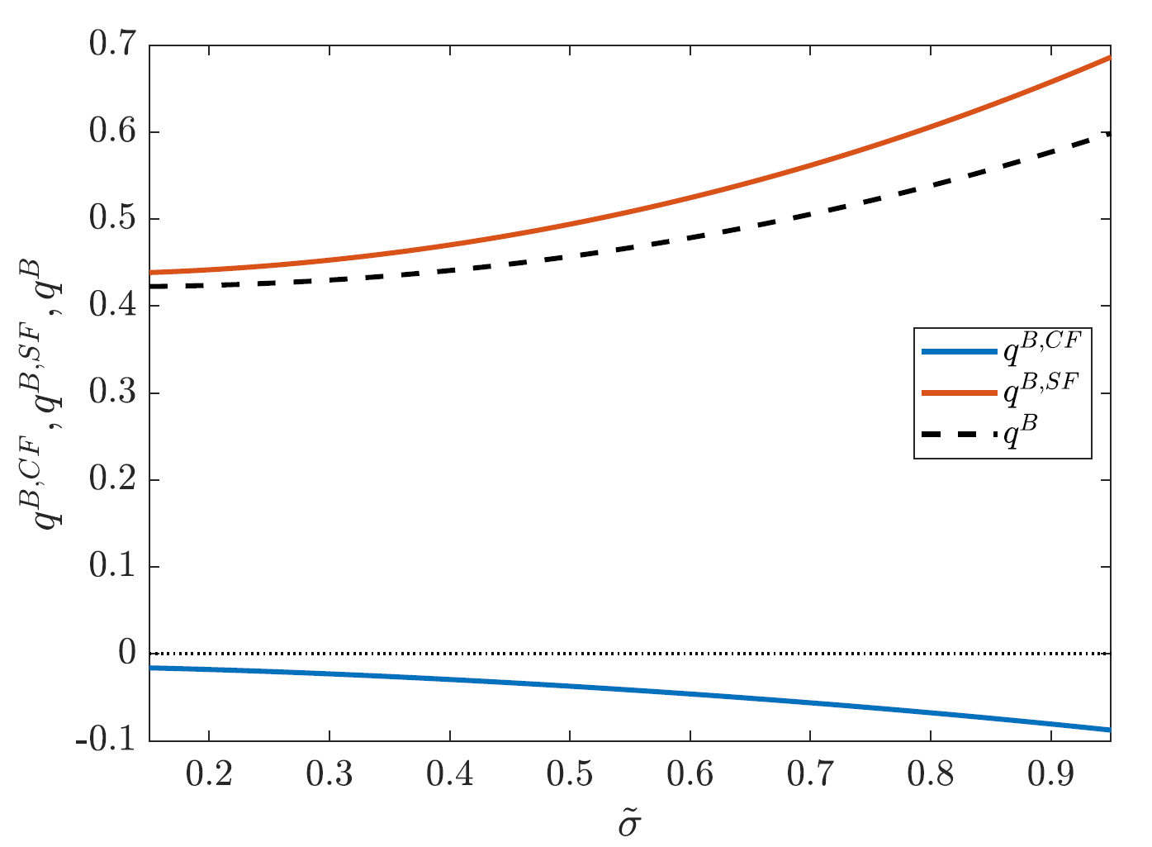
Safe Asset – Service flow >> Cash flow
Asset Price = E[PV(cash flows, primary surplus $sK_{t}$)] + E[PV(service flows)]

Slide 28
What is Quasi-SDF $ξ_{t}^{∗∗}=∫ξ_{t}^{i}η_{t}^{i}di$?
Buy and Hold Perspective:
Expected bond return (for log utility) = $ρ$ $+ γ𝔼[g_{c}]− \frac{1}{2}γ(γ+1)\{Var_{t}\left[g_{c}\right]+Var_{t}\left[{\tilde{g}}_{c}\right]\}+risk premium−convience yield$
Dynamic Trading Perspective:
Expected bond return = $ρ$ $+ γ𝔼[g_{c}]− \frac{1}{2}γ(γ+1)\{Var_{t}\left[g_{c}\right]\}+ riskpremium−\{Var_{t}\left[{\tilde{g}}_{c}\right]+convience yield\}$
$\underset{\text{total} \left(\text{net}\right) \text{wealth}}{\underbrace{q_{t}^{K}K_{t}+q_{t}^{B}K_{t}}}=𝔼_{t}[\int_{t}^{∞}{\underset{\frac{ξ_{s}^{∗∗}}{ξ_{t}^{∗∗}}}{\underbrace{\frac{∫ξ_{s}^{i}η_{s}^{i}di}{∫ξ_{t}^{i}η_{t}^{i}di}}}C_{s}ds}]$
Risk-free rate $r^{f}=$
Idiosyncratic consumption growth risk
Discount rate
Risk-free rate $r^{f∗∗}=$
“Service Flow”
Discount rate

Slide 29
Two Debt Valuation Puzzles = Bubble Test
Properties of US primary surpluses
Average surplus $≈0$
Procyclical surplus ($>0$ in booms, $<0$ in recessions)
Two valuation puzzles from standard perspective: (Jiang, Lustig, van Nieuwerburgh, Xiaolan, 2019, 2020)
“Public Debt Valuation Puzzle”
Empirical: $E\left[PV_{ξ}\left(surpluses\right)\right]<0$, yet $\frac{ℬ}{℘}>0$
Our model: bubble/service flow component overturns results
“Gov. Debt Risk Premium Puzzle”
Debt should be positive $β$ asset, but market don’t price it this way
Our model: can be rationalized with countercyclical bubble/service flow

Slide 30
Bond Issuance Rate ${\check{μ}}^{ℬ}⇒$ Fiscal Policy/Tax $s$, Bubble ($r$ vs. $g$)
Recall
Gov. Budget constraint ${\check{μ}}_{t}^{ℬ}ℬ_{t}^{N}+℘_{t}^{N}\underset{s_{t}^{N}≔}{\underbrace{\left(τ_{t}^{N}p_{t}^{n}aκ_{t}^{N}−\frac{1}{2}ℊ_{t}\right)}K_{t}}=0$
Real risk-free rate $r^{f}=\underset{\begin{aligned}growth \\ rate\end{aligned}}{\underbrace{μ^{K}}}−{\check{μ}}^{ℬ}$
${\check{μ}}^{ℬ}≥0⇒s≤0$ and $r^{f}<μ^{K}$ primary deficit $∀t$ $⇒$ Bubble
“Mine the Bubble” as long as $\frac{ℬ_{t}^{A}}{℘_{t}^{A}}>0$
${\check{μ}}^{ℬ}<0⇒s>0$ and $r^{f}>μ^{K}$ primary surplus $∀t$ $⇒$ No Bubble, but service flow
$\frac{ℬ_{t}^{A}}{℘_{t}^{A}}=𝔼_{t}\left[PV_{r^{f}}\left(sK_{t}\right)\right]$

Slide 31
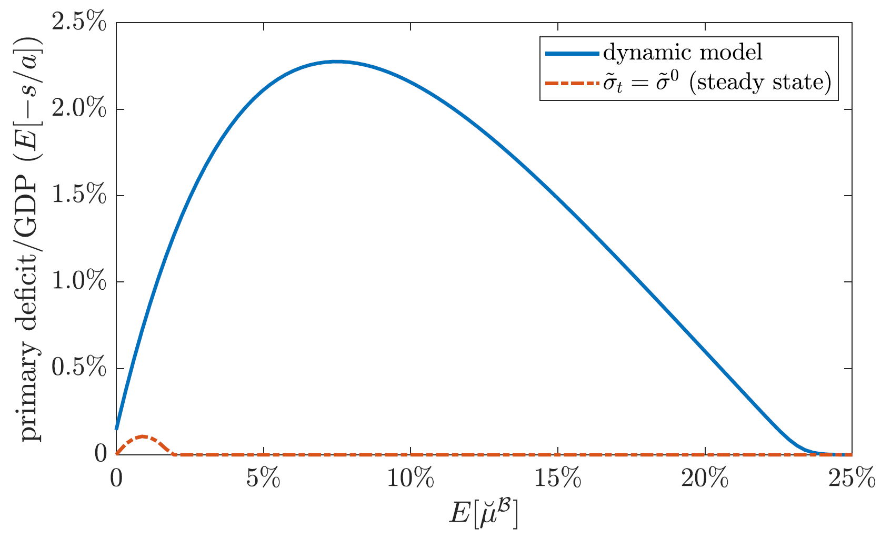
Fiscal Sustainability given Exorbitant Privilege: Debt Laffer Curve
Issue bonds at a faster rate ${\check{μ}}^{B}$ (esp. in recessions)
$⇒$ tax precautionary self insurance $⇒$ tax rate
$⇒$real value of bonds, $\frac{ℬ}{℘}$, $⇒$ “tax base”
Less so in recession due to flight-to-safety
Sizeable revenue only if
Gov. debt has negative $β$
Calibration with $β<0$
Small Laffer curve w/o stochastic idio risk

Slide 32
Service Flow Term, Convenience Yield, Ponzi Scheme
Service flow
Convenience yield: relaxes collateral constraint or CIA constraint (money)
Traditional measure: BAA-US Treasury spread
Here: Partially completing markets through retrading
Low interest rate (cash flow) asset can be issued by everyone Hence, corporate-Treasury spread = 0
Ponzi scheme is not feasibly for everyone No Ponzi constraint may be binding
Who can run a Ponzi scheme/issue bubbles? exorbitant privilege … assigned by equilibrium selection
Likely to government, private entities are subject to solvency constraint
… still there is a Debt Laffer Curve

Slide 33
Roadmap
Motivation, Safe Asset: Intuition and Definition
Two Country Model Setup
Symmetric Benchmark
World Government (Bond) $⇒$ “Safe Asset Pricing”
Constant Idiosyncratic Risk $⇒$ Gov. Bonds Perfect Substitutes $⇒$ Asymmetric Permanent Exorbitant Privilege
Risk Shock and its Transition $⇒$ Insurance of $S$ by $N$ in the long-run
Time-varying Idiosyncratic Risk ${\tilde{σ}}_{t}∈\left\{{\tilde{σ}}^{L},{\tilde{σ}}^{H}\right\}$ $⇒$ Flight-to-Safety Exorbitant Privilege and $β^{N}<β^{S}$ $⇒$ EMDE Costly Stimulus Policy
Future: “Battle for the Bubble” + Exchange Rate Policy with Sticky Prices

Slide 34
Government Bonds Perfect Substitutes $⇒$ G-Bond Portfolio
For a given debt issuance ${\check{μ}}_{t}^{ℬ^{I}}=μ_{t}^{ℬ^{I}}−i_{t}^{I}$ the country’s primary surplus $s_{t}^{I}$ (and tax rate $τ_{t}^{I}$) is determined by country’s government budget constraint.
For simplicity consider the case where both ${\check{μ}}_{t}^{ℬ^{N}}$ and ${\check{μ}}_{t}^{ℬ^{S}}$ are constant.
Lemma: ${\check{μ}}_{t}^{ℬ^{N}}={\check{μ}}_{t}^{ℬ^{S}}$, since otherwise one bond has zero value.
Real returns on both bonds must be the same, i.e. if bond dilution is higher $μ_{t}^{ℬ^{I}}$, country has to offer higher bond interest rate $i_{t}^{I}$
Citizens in both countries are indifferent between both country’s gov. bonds.
$⇒$ Portfolio choice reduces to capital vs. gov bond portfolio: $θ_{t}^{K}$ vs. $(1−θ_{t}^{K})$
Aside: less strict if there is a home bias in bond holdings
Share of one country in the bond portfolio $θ^{N}$ is constant
In symmetric setting $θ^{N}=\text{½}$

Slide 35
Optimal Choices & Market Clearing
Consumption Goods market
$c_{t}=:ρn_{t}⇒C_{t}=ρ\underset{N_{t}}{\underbrace{\left(q_{t}^{K}K_{t}+ℬ_{t}^{N}/℘_{t}^{N}+ℬ_{t}^{S}/℘_{t}^{S}\right)}}=ap^{n}K_{t}^{N}+ap^{s}K_{t}^{S}−ℊK_{t}$
Portfolio Capital market
For country $N$
$1−θ_{t}^{ℬ^{A},\tilde{i}}−θ_{t}^{ℬ^{B},\tilde{i}}=\frac{q_{t}^{K}K_{t}^{A}}{N_{t}^{A}}=:\frac{κ^{A}}{η_{t}^{A}}\left(1−θ_{t}\right)$
For country $S$
…
Solve for various $θ_{t}$s using for all $\tilde{i}$ $\underset{\frac{a^{A}}{q_{t}^{K}}−\frac{τ^{A}a^{A}}{q_{t}^{K}}+μ^{K}+μ_{t}^{q^{K}}}{\underbrace{\frac{𝔼_{t}\left[dr_{t}^{K,\tilde{i}}\right]}{dt}}}−\underset{−{\check{μ}}^{ℬ}+μ^{K}+μ_{t}^{ℬ/(℘K)}}{\underbrace{\frac{𝔼_{t}\left[dr_{t}^{ℬ}\right]}{dt}}}=\underset{\left(1−θ_{t}^{ℬ^{A},\tilde{i}}−θ_{t}^{ℬ^{B},\tilde{i}}\right)\tilde{σ}}{\underbrace{ { \tilde{σ}}_{t}^{n,\tilde{i}} }}\tilde{σ}$ Risk premium (idio)

Slide 36
Optimal Choices & Market Clearing
Consumption Goods market
$c_{t}=:ρn_{t}⇒C_{t}=ρ\underset{N_{t}}{\underbrace{\left(q_{t}^{K}K_{t}+ℬ_{t}^{N}/℘_{t}^{N}+ℬ_{t}^{S}/℘_{t}^{S}\right)}}=ap^{n}K_{t}^{N}+ap^{s}K_{t}^{S}−ℊK_{t}$
Portfolio Capital market
For country $N$
$1−θ_{t}^{ℬ^{N},\tilde{i}}−θ_{t}^{ℬ^{S},\tilde{i}}=\frac{q_{t}^{K}K_{t}^{N}}{N_{t}^{N}}=:\frac{κ^{N}}{η_{t}^{N}}\left(1−θ_{t}\right)$
For country $S$
…
Solve for various $θ_{t}$s using for all $\tilde{i}$ $\underset{\frac{a^{A}}{q_{t}^{K}}−\frac{τ^{A}a^{A}}{q_{t}^{K}}+μ^{K}+μ_{t}^{q^{K}}}{\underbrace{\frac{𝔼_{t}\left[dr_{t}^{K,\tilde{i}}\right]}{dt}}}−\underset{−{\check{μ}}^{ℬ}+μ^{K}+μ_{t}^{ℬ/(℘K)}}{\underbrace{\frac{𝔼_{t}\left[dr_{t}^{ℬ}\right]}{dt}}}=\underset{\left(1−θ_{t}^{ℬ^{N},\tilde{i}}−θ_{t}^{ℬ^{S},\tilde{i}}\right)\tilde{σ}}{\underbrace{ { \tilde{σ}}_{t}^{n,\tilde{i}} }}\tilde{σ}$ Risk premium (idio)
$θ_{t}$:= fraction of world net worth in nominal claims
$=\frac{ℬ_{t}^{N}/℘_{t}^{N}+ℬ_{t}^{S}/℘_{t}^{S}}{N_{t}}$,
$η_{t}^{N}:=\frac{N_{t}^{N}}{N_{t}}$.
Price of risk

Slide 37
Optimal Choices & Market Clearing
Consumption Goods market
$c_{t}=:ρn_{t}⇒C_{t}=ρ\underset{N_{t}}{\underbrace{\left(q_{t}^{K}K_{t}+ℬ_{t}^{N}/℘_{t}^{N}+ℬ_{t}^{S}/℘_{t}^{S}\right)}}=ap^{n}K_{t}^{N}+ap^{s}K_{t}^{S}−ℊK_{t}$
Portfolio Capital market
For country $N$
$1−θ_{t}^{ℬ^{N},\tilde{i}}−θ_{t}^{ℬ^{S},\tilde{i}}=\frac{q_{t}^{K}K_{t}^{N}}{N_{t}^{N}}=:\frac{κ^{N}}{η_{t}^{N}}\left(1−θ_{t}\right)$
For country $S$
…
Solve for various $θ_{t}$s using for all $\tilde{i}$ $\underset{\frac{a^{N}}{q_{t}^{K}}−\frac{τ^{N}a^{N}}{q_{t}^{K}}+μ^{K}+μ_{t}^{q^{K}}}{\underbrace{\frac{𝔼_{t}\left[dr_{t}^{K,\tilde{i}}\right]}{dt}}}−\underset{−{\check{μ}}^{ℬ}+μ^{K}+μ_{t}^{\frac{ℬ}{℘K}}}{\underbrace{\frac{𝔼_{t}\left[dr_{t}^{ℬ}\right]}{dt}}} = \left(1−θ_{t}^{ℬ^{N},\tilde{i}}−θ_{t}^{ℬ^{S},\tilde{i}}\right){\tilde{σ}}^{2}$
$θ_{t}$:= fraction of world net worth in nominal claims
$=\frac{ℬ_{t}^{N}/℘_{t}^{N}+ℬ_{t}^{S}/℘_{t}^{S}}{N_{t}}$,
$η_{t}^{N}:=\frac{N_{t}^{N}}{N_{t}}$.

Slide 38
Optimal Choices & Market Clearing
Consumption Goods market
$c_{t}=:ρn_{t}⇒C_{t}=ρ\underset{N_{t}}{\underbrace{\left(q_{t}^{K}K_{t}+ℬ_{t}^{N}/℘_{t}^{N}+ℬ_{t}^{S}/℘_{t}^{S}\right)}}=ap^{n}K_{t}^{N}+ap^{s}K_{t}^{S}−ℊK_{t}$
Portfolio Capital market
For country $N$
$1−θ_{t}^{ℬ^{N},\tilde{i}}−θ_{t}^{ℬ^{S},\tilde{i}}=\frac{q_{t}^{K}K_{t}^{N}}{N_{t}^{N}}=:\frac{κ^{N}}{η_{t}^{N}}\left(1−θ_{t}\right)$
For country $S$
…
Solve for various $θ_{t}$s using for all $\tilde{i}$ $\underset{\frac{a^{N}}{q_{t}^{K}}−\frac{τ^{N}a^{N}}{q_{t}^{K}}+μ^{K}+μ_{t}^{q^{K}}}{\underbrace{\frac{𝔼_{t}\left[dr_{t}^{K,\tilde{i}}\right]}{dt}}}−\underset{−{\check{μ}}^{ℬ}+μ^{K}+μ_{t}^{\frac{ℬ}{℘K}}}{\underbrace{\frac{𝔼_{t}\left[dr_{t}^{ℬ}\right]}{dt}}} = \left(1−θ_{t}^{ℬ^{N},\tilde{i}}−θ_{t}^{ℬ^{S},\tilde{i}}\right){\tilde{σ}}^{2}$
$θ_{t}$:= fraction of world net worth in nominal claims
$=\frac{ℬ_{t}^{N}/℘_{t}^{N}+ℬ_{t}^{S}/℘_{t}^{S}}{N_{t}}$,
$η_{t}^{N}:=\frac{N_{t}^{N}}{N_{t}}$.
$$\underset{{\check{μ}}_{t}^{B}:=}{\underbrace{\left(μ_{t}^{ℬ}−i_{t}^{N}\right)}}\frac{ℬ_{t}^{N}}{℘_{t}^{N} K_{t}}+\underset{s_{t}^{A}≔}{\underbrace{\left(τ_{t}^{N}a_{t}^{N}(κ^{N})κ^{N}−\frac{1}{2}ℊ_{t}\right)}}=0$$
$${\check{μ}}_{t}^{B}\underset{\frac{θ_{t}^{N}θ_{t}}{1−θ_{t}}}{\underbrace{\frac{ℬ_{t}^{N}}{℘_{t}^{N} q_{t}^{K}K_{t}}}}−\frac{1}{2q_{t}^{K}}ℊ_{t}=−\frac{τ_{t}^{N}a_{t}^{N}\left(κ^{N}\right)}{q_{t}^{K}}κ^{N}$$

Slide 39
Optimal Choices & Market Clearing
Consumption Goods market
$c_{t}=:ρn_{t}⇒C_{t}=ρ\underset{N_{t}}{\underbrace{\left(q_{t}^{K}K_{t}+ℬ_{t}^{N}/℘_{t}^{N}+ℬ_{t}^{S}/℘_{t}^{S}\right)}}=ap^{n}K_{t}^{N}+ap^{s}K_{t}^{S}−ℊK_{t}$
Portfolio Capital market
For country $N$
$1−θ_{t}^{ℬ^{N},\tilde{i}}−θ_{t}^{ℬ^{S},\tilde{i}}=\frac{q_{t}^{K}K_{t}^{N}}{N_{t}^{N}}=:\frac{κ^{N}}{η_{t}^{N}}\left(1−θ_{t}\right)$
For country $S$
…
Solve for various $θ_{t}$s using for all $\tilde{i}$ $\frac{a^{A}−ℊ_{t}/(2κ_{t}^{N})}{q_{t}^{K}}+(\frac{θ_{t}θ_{t}^{N}/κ^{N}}{1−θ_{t}}+1){\check{μ}}^{ℬ} \underset{μ_{t}^{q^{K}}−μ_{t}^{q^{ℬ}}}{\underbrace{−\frac{μ_{t}^{θ}}{1−θ_{t}}}}=\left(1−θ_{t}^{ℬ^{N},\tilde{i}}−θ_{t}^{ℬ^{S},\tilde{i}}\right){\tilde{σ}}^{2}$ (*)

Slide 40
Equilibrium: 3 Key Equations
$κ$ Capital Share Allocation (static, period-per-period)
$κ=f\left(\begin{matrix}\begin{aligned}\text{production} \text{e}\text{fficency} \\ \text{maximized} \text{at} \\ κ=1/2\end{aligned} & , & \begin{aligned}\text{tax} \text{incentive} \text{tilt} \\ \text{towards} \text{country} \text{with} \\ \text{lower} \text{capital} \text{taxes} \end{aligned}\end{matrix}\right)$.
$\tilde{σ} ↑$ $N$ with higher safe asset share $θ^{N}$
$dη$ Net worth Share Evolution (Forward equation)
$dη_{t}=η_{t}\left(1−η_{t}\right)\left[{\left(\frac{κ_{t}}{η_{t}}\right)}^{2}−{\left(\frac{{1−κ}_{t}}{{1−η}_{t}}\right)}^{2}\right]{\left(1−θ_{t}\right)}^{2}{\tilde{σ}}^{2}dt$= difference in “earned risk premia” Steady state: $dη=0⇒η=κ$
$θ$ Safe Asset Pricing Equation (world) (Backward equation)
$θ_{t}=\left(ℬ_{t}^{N}/℘_{t}^{N}+ℬ_{t}^{S}/℘_{t}^{S}\right)/N_{t}$ “safe asset wealth share”
$ℬ_{t}^{N}/℘_{t}^{N}=𝔼_{t}\left[PV^{∗∗}\left(primary surpluses^{N}\right)\right]+𝔼_{t}[PV^{∗∗}(service flows^{N})]$
Fraction that is part of country $N$’s $θ^{N}$: fixed exogenously (equilibrium selection/market coordination)
$$ρ\frac{κ_{t}^{−1/ε}−{\left(1−κ_{t}\right)}^{−\frac{1}{ε}}}{κ_{t}^{1−1/ε}+{\left(1−κ_{t}\right)}^{1−\frac{1}{ε}}}+\left(\frac{θ_{t}^{N}}{κ_{t}}−\frac{{1−θ}_{t}^{N}}{1−κ_{t}}\right)θ{\check{μ}}_{t}^{ℬ}=0$$
Notes:
Without home bias, the first force always biases \kappa towards 1/2. If a rise in risk drives up safe asset demand for country A bonds, this always (regardless of home bias) improves the fiscal situation of country A (more than for country B) so that capital flows from A to B due to the second force. However, without home bias, the first force implies that terms of trade for country A deteriorate, which dampens the overall effect on \kappa (and ultimately on \eta because \eta moves due to an asymmetric risk allocation). Instead, if there is perfect home bias, demand for apples increases with \eta and this increases the "efficient" \kappa (with regard to productive efficiency) as well (so that terms of trade for country A increase). This mechanism mutes the first force.

Slide 41
Stationary Steady Sate $dη_{t}=0$ – in closed form
Monetary
$q^{K}K_{t}=\underset{1−θ}{\underbrace{\frac{\sqrt{ρ+{\check{μ}}^{ℬ}} }{\tilde{σ}}}}$ $\underset{N_{t}}{\underbrace{\frac{\overline{a}−ℊ}{ρ}K_{t}}}$
$$\frac{ℬ_{t}^{N}}{℘_{t}^{N}}= θ^{N} \underset{θ}{\underbrace{\left(1−\frac{\sqrt{ρ+{\check{μ}}^{ℬ}}}{\tilde{σ}}\right)}} \frac{\overline{a}−ℊ}{ρ}K_{t}$$
$$\frac{ℬ_{t}^{S}}{℘_{t}^{S}}={(1−θ}^{N})\left(1−\frac{\sqrt{ρ+{\check{μ}}^{ℬ}}}{\tilde{σ}}\right)\frac{\overline{a}−ℊ}{ρ}K_{t}$$
$\overline{a}=κp^{n}(κ)a+\left(1−κ\right)p^{s}(κ)a$, where $κ=κ^{N}$, $1−κ=κ^{S}$ and in SS $η=κ$
$ρ$ time preference rate; $r^{f}=ρ+μ^{K}+(1−θ){\tilde{σ}}^{2}$ ;
${\check{μ}}^{ℬ}=μ_{t}^{ℬ^{I}}−i_{t}^{I}$ bond issuance rate beyond interest rate, same in both countries.
Recall:
$N_{t}$= world net worth
$θ$ = fraction of world net worth in nominal claims

Slide 42
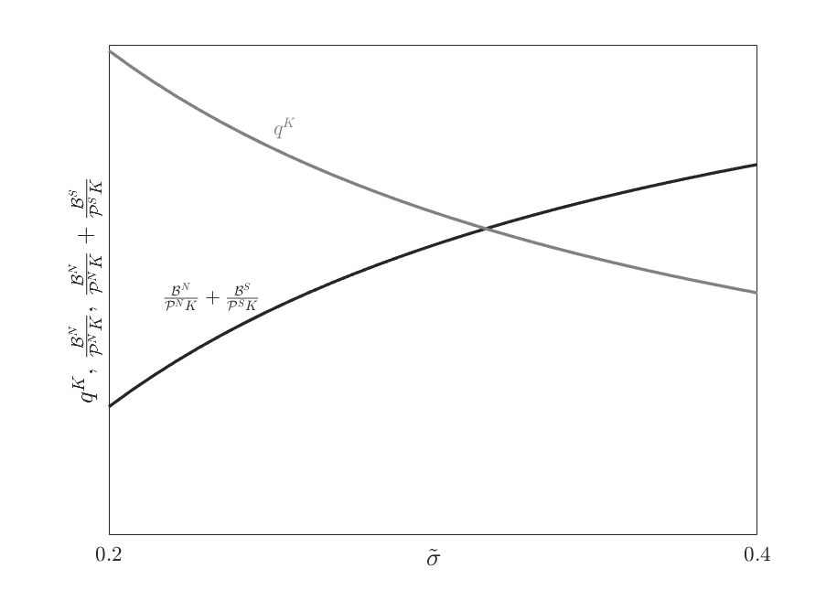
Capital & Bond Price (Steady State) for Different SS $\tilde{σ}$
World
Bond price (real) per unit of $K_{t}$
Price (real) of capital unit

Slide 43
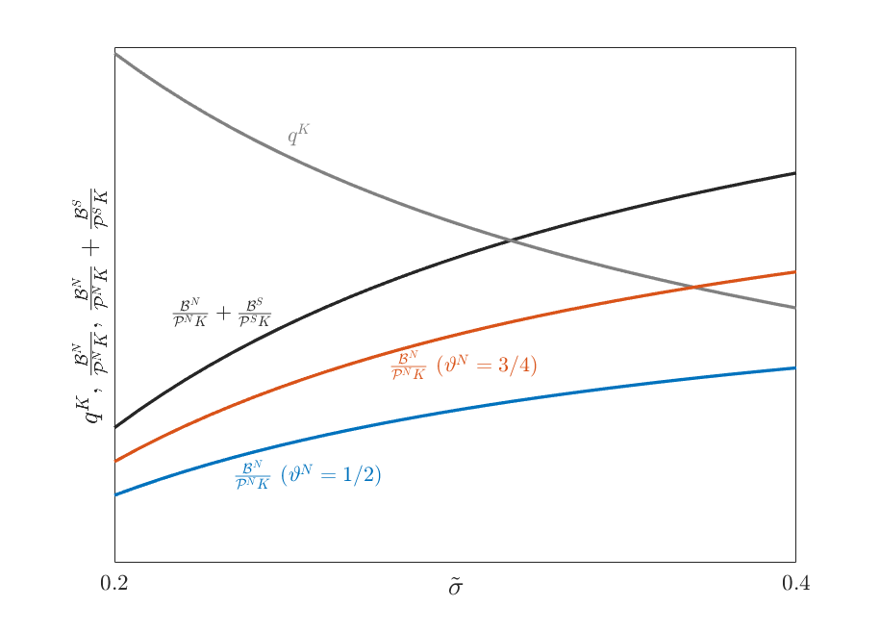
Capital & Bond Price (Steady State) for Different SS $\tilde{σ}$
$θ^{N}=\frac{3}{4}$, $θ^{S}=\frac{1}{4}$
Benchmark: $θ^{N}=\frac{1}{2}=θ^{S}$

Slide 44
Steady State Exorbitant Privilege
Theorem: Country N has a steady state Exorbitant Privilege if $θ^{N}>1/2$, since it can run a Ponzi Scheme on citizens of country S.
Country N’s gov. bond supply > country S’s if $θ^{N}>1/2$.
N-citizens gov bond holding < Country N’s bond supply
S-citizens also hold bubbly safe asset of gov. country S.
$⇒$ Country N can “mine the N-bubble” (safe asset) at the expense of S-citizens.
Proof:
Since $p^{n}<p^{s}$ for $κ>1/2$, $⇒κ=η<θ^{N}$ , i.e. $κ^{S}=η^{S}>θ^{S}$ (wealth>bubble share) (apples are cheaper than bananas) Since portfolio share of bonds $θ^{S}$ is the same for all citizens across the world, $S$-citizens for safe asset/gov. bond exceeds the one issued in country $S$.

Slide 45
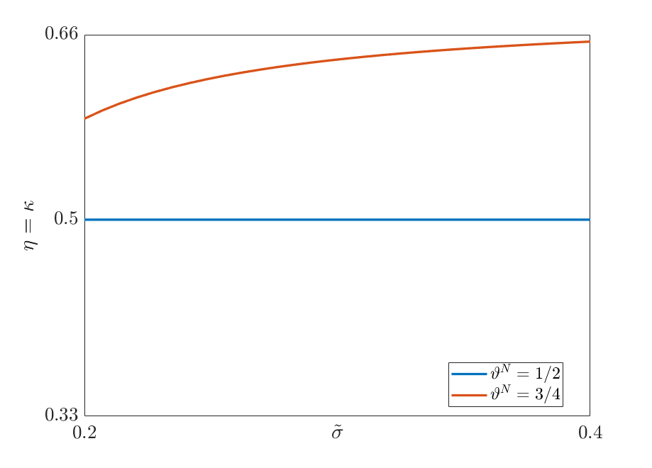
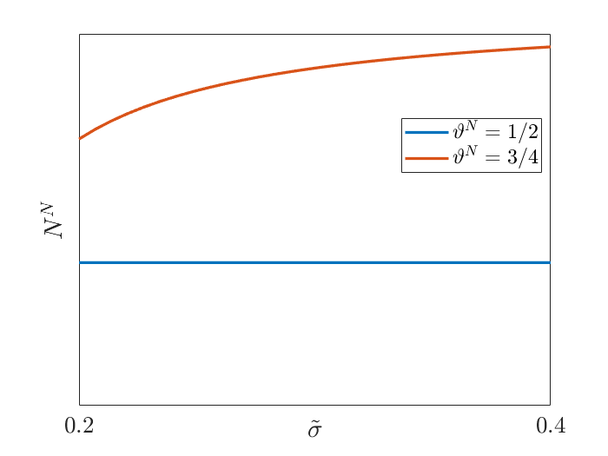
Steady State Capital Share = Net Worth Share for Different $\tilde{σ}$
$θ^{N}=\frac{3}{4}$, $θ^{S}=\frac{1}{4}$ … Country $N$ has higher net worth share and higher total net worth the higher idiodyncratic risk environment
Benchmark: $θ^{N}=\frac{1}{2}=θ^{S}$
net worth share $η$, capital share $κ$
net worth of country $N^{N}$

Slide 46
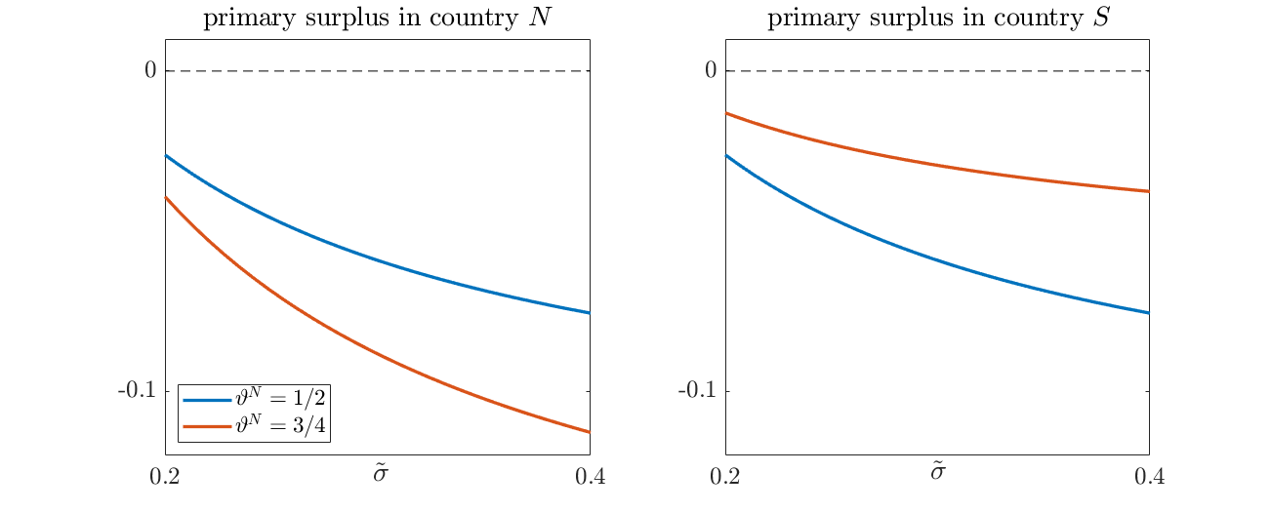
Steady State Gov. Primary Surplus for Different $\tilde{σ}$
$θ^{N}=\frac{3}{4}$, $θ^{S}=\frac{1}{4}$ … Country $N$ fiscal deficit is higher and increases more with the higher idio risk environment
Benchmark: $θ^{N}=\frac{1}{2}=θ^{S}$

Slide 47
Roadmap
Motivation, Safe Asset: Intuition and Definition
Two Country Model Setup
Symmetric Benchmark
World Government (Bond) $⇒$ “Safe Asset Pricing”
Time-invariant Idiosyncratic Risk and $⇒$ Asymmetric Permanent Exorbitant Privilege
${\tilde{σ}}_{t}$-Risk Shock and its Transition $⇒$ Insurance of $S$ by $N$ in the long-run
Time-varying Idiosyncratic Risk ${\tilde{σ}}_{t}∈\left\{{\tilde{σ}}^{L},{\tilde{σ}}^{H}\right\}$ $⇒$ Flight-to-Safety Exorbitant Privilege and $β^{N}<β^{S}$ $⇒$ EMDE Costly Stimulus Policy
Future: “Battle for the Bubble” + Exchange Rate Policy with Sticky Prices

Slide 48
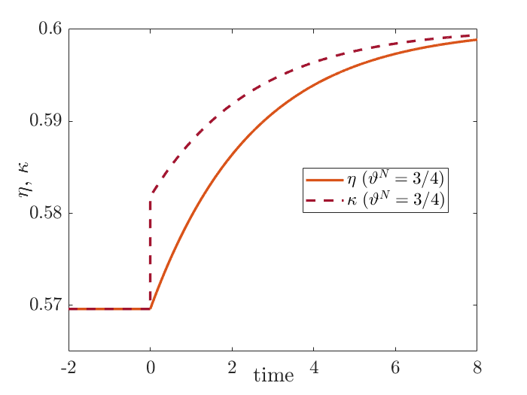
After $\tilde{σ}$-shock: “Poor Insure the Rich”
Unanticipated shock (MIT shock)
Convergence to new steady state with higher $\tilde{σ}$
At shock impact: Insurance in the short-run, since there no impact on $η$ (started at steady state or $η$-derivatives)
After the shock: No insurance of long-run risk Country $N$’s net worth share and net worth grows subsequently
$κ$ jumps at $t=0$
increases afterwards as $N$-citizens risk-bearing capacity rises with $η$

Slide 49
After Capital Control Shock
Country $S$ bans its citizens from holding gov. $N$-bonds.
Theorem: Introduction of capital controls makes - in the short-run $S$-bonds more valuable, so that $θ_{t}^{N}$ falls - over time $S$-bonds depreciate and earn lower return than $N$-bonds, so - $N$-citizens sell them to $S$-citizens (home bias) - $S$-citizens earn lower return on their net worth, $η_{t}$ increases - in the long-run $S$-citizens are poorer.
Proof:
In steady state idio risk must be same in both countries (otherwise $dη≠0$) $⇒θ^{ℬ^{N}}=θ^{ℬ^{S}}$
In the long run $θ_{t}^{N}↘θ^{N}$
$⇒$ $S$-citizens must be poorer.
Notes:
We know that no steady state exists after the capital control shock
.

Slide 50
Roadmap
Motivation, Safe Asset: Intuition and Definition
Two Country Model Setup
Symmetric Benchmark
World Government (Bond) $⇒$ “Safe Asset Pricing”
Constant Idiosyncratic Risk and $⇒$ Asymmetric Permanent Exorbitant Privilege
${\tilde{σ}}_{t}$-Risk Shock and its Transition $⇒$ Insurance of $S$ by $N$ in the long-run
Time-varying Idiosyncratic Risk ${\tilde{σ}}_{t}∈\left\{{\tilde{σ}}^{L},{\tilde{σ}}^{H}\right\}$ $⇒$ Flight-to-Safety Exorbitant Privilege and $β^{N}<β^{S}$ $⇒$ EMDE Costly Stimulus Policy
Future: “Battle for the Bubble” + Exchange Rate Policy with Sticky Prices

Slide 51
Gov. Bonds with Different Risk Profiles
Full Dynamic model
${\tilde{σ}}_{t}$ is time-varying and jumps between ${\tilde{σ}}^{L}$ and ${\tilde{σ}}^{H}$, and jumps are anticipated.
Gov. bonds are different, have different $β$
Asymmetry in level $θ^{N}>θ^{S}$ and in slope $\underset{Δθ^{N}≔}{\underbrace{θ^{N}\left({\tilde{σ}}^{H}\right)−θ^{N}\left({\tilde{σ}}^{L}\right)}}>\underset{Δθ^{S}≔}{\underbrace{θ^{S}\left({\tilde{σ}}^{H}\right)−θ^{S}\left({\tilde{σ}}^{L}\right)}}$
Theorem: “Flight-to-Safety Exorbitant Privilege” If $θ^{N}>1/2$ and $Δθ^{N}>Δθ^{S}$ higher $N$-bond issuance (lower taxes) “on average” or even in both states, $μ^{ℬ^{N}}\left({\tilde{σ}}^{H}\right)>μ^{ℬ^{S}}\left({\tilde{σ}}^{H}\right)$ and $μ^{ℬ^{N}}\left({\tilde{σ}}^{L}\right)>μ^{ℬ^{S}}\left({\tilde{σ}}^{L}\right)$.
Intuition: Beliefs that $θ^{N}$ rises in high-risk environment $⇒β^{N}$ more negative and $β^{S}$ less negative enables gov. $N$ to issue more bonds (lower taxes) all the time.

Slide 52
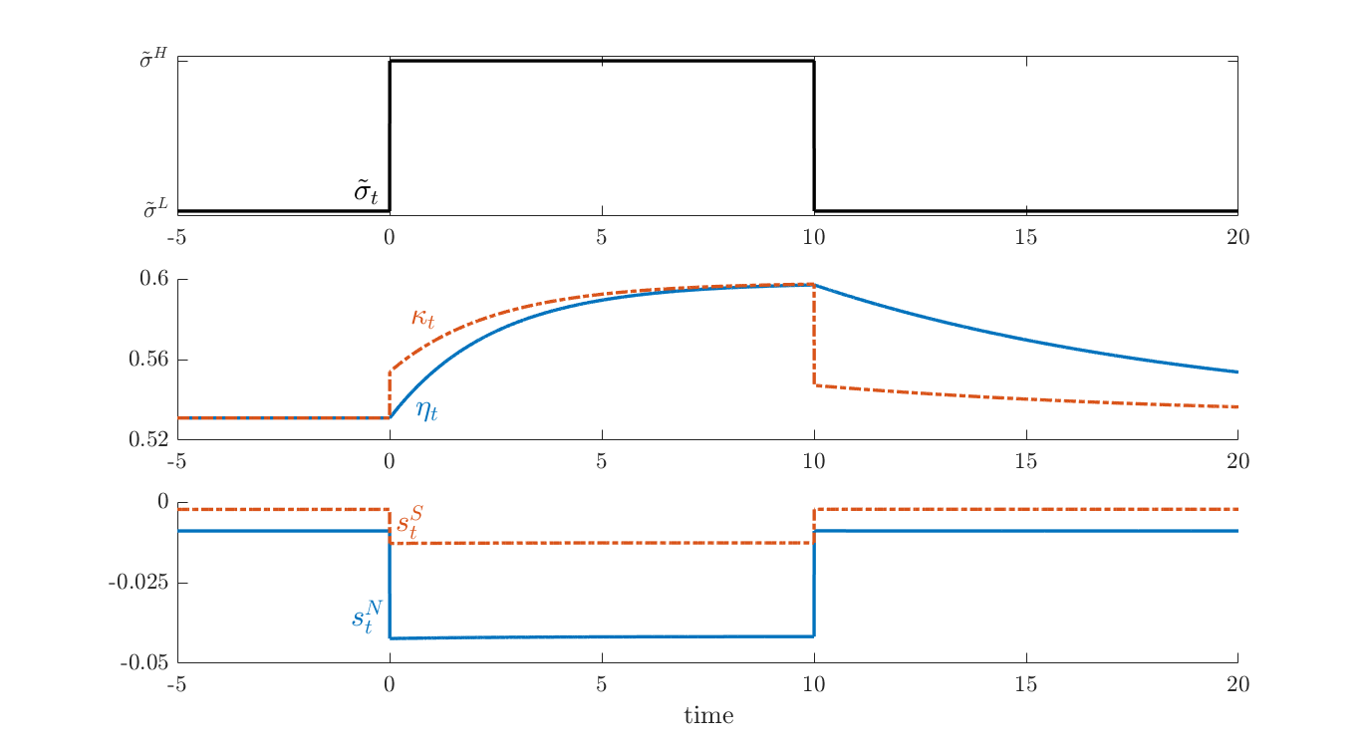
Full Model: $\tilde{σ}$-realization: 2 Exorbitant Privileges
X
Start at ${\tilde{σ}}^{L}$-SS
$μ_{t}^{B^{N}}−i_{t}^{N}>μ_{t}^{B^{S}}−i_{t}^{S}$ for all $t$
Notes:
country N runs a lower primary surplus at all times and also its surplus falls by much more in high-risk states (in fact, also the \mu^B-i instrument is always larger in this example but this is not shown as it would require a separate panel). Numbers are not meaningful, qualitative relationships are.

Slide 53
Country $S$’s Countercyclical Stimulus Policy is Costly
Suppose country $S$ would like to run fiscal stimulus in high-risk environment ${\tilde{σ}}^{H}$ as opposed to following $N$’s ${\check{μ}}_{t}^{ℬ^{N}}$.
Result: Country $S$ can enjoy a fiscal stimulus policy in high-risk environment ${\tilde{σ}}^{H}$ only at the expense of significantly raising taxes in low-risk environment.
Intuition: ${\check{μ}}_{t}^{ℬ^{N}}({\tilde{σ}}^{H})↑$, i.e. issuing more $S$-bonds at state ${\tilde{σ}}^{H}$ increases $S$-bonds $β^{S}$, (lowering its safety). To keep $S$-bond attractive relative to $N$-bond, ${\check{μ}}_{t}^{ℬ^{N}}({\tilde{σ}}^{L})↓↓$, $N$-bond issuance has to drop significantly in low risk environment.

Slide 54
“Battle for the Bubble”
So far, we took $θ^{N}$ and $Δθ^{N}$as given
Equilibrium Selection:
Suppose $θ^{N}$ and $Δθ^{N}$is given at certain values from $T$ onwards. Let $T→∞$
$⇒$ Bubble share selection is not state-dependent both countries have to run fiscal policies that produce (in a suitable sense) “on average” the same $μ^{ℬ}$ across states.
Now, $θ^{N}(\tilde{σ})$ is an equilibrium outcome of a game btw government $N$ and $S$.
Outcome depends on
Action space
Bond issuance rate
Macro-prudential policy/financial repression (imposing home bias on gov. bond holdings)
Commitment power

Slide 55
Conclusion – Main Takeaways
Safe Asset = good friend provides “service flow”
Individually: allows self-insurance through retrading
Aggregate: appreciates in bad times (negative $β$)
Safe Asset Exorbitant Privilege makes IMS “unbalanced”
Permanent wealth transfer: Country $N$ can “mine the bubble” held by $S$-citizens
Risk shock $⇒$ “poor insure the rich”
No immediate redistribution, but $N$’s net worth share grows (long-run risk)
“Flight-to-Safety Exorbitant Privilege” (2nd Privilege)
Country $S$ running countercyclical fiscal stimulus is very costly and risk losing its own safe asset status
Extension: Battle for the Bubble depends on policy space and commitment power
Extension: FX intervention with sticky prices + home bias
Contrasting: US vs. Switzerland (currency manipulation or correction?) CH has larger incentive to share privilege
Notes:
“Capital Control shock”
Country $S$ can temporarily boost safe asset share, value of $S$-bonds jump but depreciate subsequently
No steady state

Slide 56
Overview
2 Country Model Setup with Safe Assets
Safe Assets Issuance Exorbitant Privilege
Contrasting Steady States across different Risk Environments
Transition after Risk Shock
Safe Asset Burden due to Exchange Rate Appreciation
Introducing home bias in consumption basket
Introducing price stickiness (and utilization /output gap)
Ceteris Paribus Analysis
Total symmetry, except in one dimension: share of safe asset “exorbitant privilege bubble”

Slide 57
Safe Asset: Issuance Privilege vs. Burden
At normal times: lower $r$ possibly $<g$
At times of elevation risk:
Flight-to-Safety issuance benefits $↑$ interest rate $r ↓$
Exchange rate $↑$ export/import $↓$
What does it depend on?
Fraction on world safe asset share (relative to country size)
(1) price stickiness (form of) (2) home goods bias (3) elasticity of substitution btw. home & foreign goods

Slide 58
FX Interventions: Preview
Safe asset providing country
Holds a common “stock” of foreign bond
Increases its holdings in an elevated risk environment
Is not manipulative but stabilizing, as the country shares privilege/“Bubble mining” revenue (helps to keep interest rate low)
Switzerland has larger incentive to share privilege than US
As it helps to stabilize its output gap more
Conjecture: Buying foreign equity shares adds risk
$β$ of safe asset is less negative

Slide 59
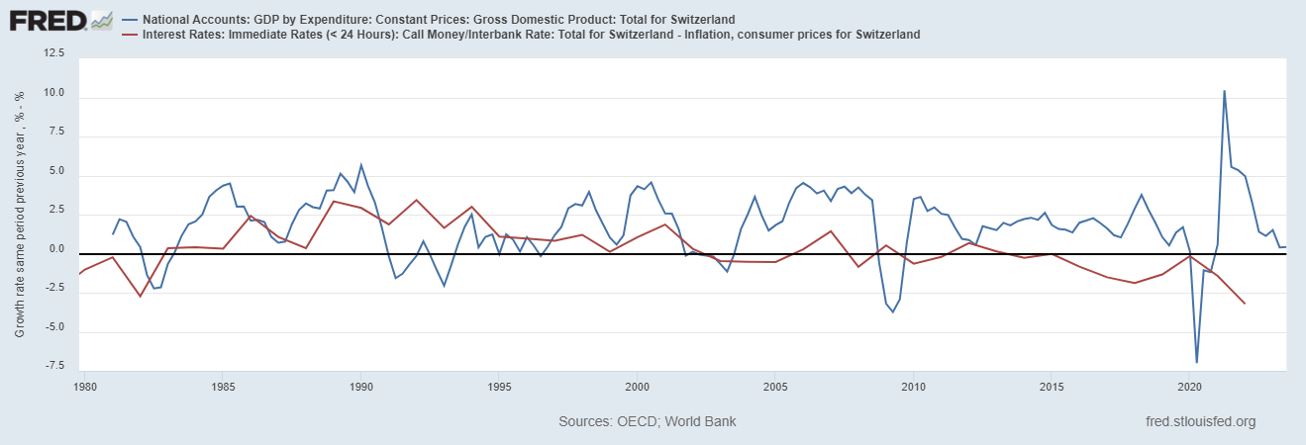
$r$ vs. $g=μ^{K}$ in Switzerland
X

Slide 60
Overview
2 Country Model Setup with Safe Assets
Safe Assets Issuance Exorbitant Privilege
Contrasting Steady States across different Risk Environments
Transition after Risk Shock
Safe Asset Burden due to Exchange Rate Appreciation
Home bias in consumption basket
Price stickiness (and utilization /output gap)

Slide 61
America vs. Switzerland
Both countries are safe asset producers
Size difference … not so relevant
Home consumption bias difference
American can easily only consume US products
Swiss can not so easily

Slide 62
Home Consumption Bias $⇒$ efficient $κ$ closer to $η$
Country $N$’s citizens have preference for $n$uts (over $s$pices)
$c_{t}^{N}={\left({\frac{1+π}{2}{(c}_{t}^{n})}^{\frac{ε−1}{ε}}+{\frac{1−π}{2}{(c}_{t}^{s})}^{\frac{ε−1}{ε}}\right)}^{\frac{ε}{ε−1}}$ with $π$>0
Countries $N$ and $S$ have different consumption basket (numeraire)
$\tilde{σ}$ increase, country $N$ is wealthier due to low-interest safe asset demand …
Recall: capital share $κ=f(efficient, tilt)$
Now, efficient is not simply maximized at $κ=1/2$ , but it depends on net worth share $η$
As country A becomes wealthier, demand for apples rises due to bias (lower banana price only partially offset it.)
In extreme case $π=1$: Country A only likes apples
Efficient capital share = net worth share, $κ=η$
Efficient level shifts upward with increasing $η$, long-run level is determined solely by tilt
Effect of safe asset share on $η$ and $κ$ larger than without home bias
Notes:
"efficient" \kappa depends on \eta (and is increasing in it; for perfect home bias it equals \eta)

Slide 63
Price Stickiness $⇒$Exchange Rate Distortions: Overview
So far, country $N$’s funding costs declined as $\tilde{σ}$ rises $⇒$ Positive effect
With price stickiness, exchange rate matters too higher safe asset demand for country $N$ debt $⇒$ larger demand for $N$ currency $⇒$ A currency appreciates
Strong currency hits export and favors imports
Output gap becomes negative $⇒$ Negative effect

Slide 64
Introducing Price Stickiness
Prices are sticky in producers’ currency
Nut prices are sticky in country $N$, spices prices are sticky in country $S$
Demand effect leads to output gap
(over/under) utilization of capital stock
Contrast two extreme cases:
With perfect home bias (America)
Without home bias (Switzerland)
Notes:
In our discussion we concluded that this may be the case. To see this, the goods are close to perfect substitutes. A higher apple price means that apply demand falls to close to zero. Capital subsidies are then the only remaining source of demand for capital goods in country A. If those are small or if we have net taxes because the government also needs to fund spending, capital demand in A will fall (possibly to zero) due to the exchange rate appreciation.

Slide 65
1. Price Stickiness with Perfect Home Bias (N=America)
Relative price does not matter (no agent consumes both goods) no “marginal rate of substitution = relative price” condition
Irrelevance result: Suppose identical monetary & fiscal policy (same $μ^{B}$ and same $i$). Increase in $\tilde{σ}$ has symmetric aggregate demand effect in both countries. $⇒$ capital utilization in both countries falls by the same amount.
Hence, price stickiness has aggregate global effects (everyone produces/consumes less), No relative effects on the dynamics of wealth and capital shares.
Notes:
Proof: Effects will cancel out in the relevant term in the capital allocation equation “efficient” level of $κ$ in capital allocation condition depends on difference of relative capital utilization across countries, so is unaffected for a symmetric change $⇒$ relative capital demand is the same as in the flexible price model. Note other two key equations are not affected by price stickiness
In our discussion we concluded that this may be the case. To see this, the goods are close to perfect substitutes. A higher apple price means that apply demand falls to close to zero. Capital subsidies are then the only remaining source of demand for capital goods in country A. If those are small or if we have net taxes because the government also needs to fund spending, capital demand in A will fall (possibly to zero) due to the exchange rate appreciation.

Slide 66
2. Price Stickiness without any Home Bias (Switzerland)
Increase in safe asset demand for $N$’s debt $⇒$ $N$’s exchange rate appreciates, apples-to-banana price increases $⇒$ relative demand shift of expenditures btw apples and bananas. $⇒$ degree depends on elasticity of substitution $ε$:
$ε$ is small - close complements: relative expenditure on apples rises $⇒$ on net, benefits $N$-producers relative to $S$-producers $⇒$ capital demand in $N$ rises relative to the flexible price benchmark.
$ε$ is large - close substitutes: relative expenditure on apples falls $⇒$ hurt $N$-producers relative to $S$-producers, $⇒$ capital demand in $N$ falls relative to the flexible price benchmark.
Notes:
In our discussion we concluded that this may be the case. To see this, the goods are close to perfect substitutes. A higher apple price means that apply demand falls to close to zero. Capital subsidies are then the only remaining source of demand for capital goods in country N. If those are small or if we have net taxes because the government also needs to fund spending, capital demand in N will fall (possibly to zero) due to the exchange rate appreciation.

Slide 67
Conclusion – Main Takeaways
Safe Asset = good friend provides “service flow”
Individually: allows self-insurance through retrading
Aggregate: appreciates in bad times (negative $β$)
Safe Asset Exorbitant Privilege makes IMS “unbalanced”
Permanent wealth transfer: Country A can “mine the bubble” held by B-citizens
Risk shock $⇒$ “poor insure the rich”
no immediate redistribution, but A’s net worth share grows (long-run risk)
at times of elevation risk
Flight-to-Safety issuance benefits $↑$ interest rate $r ↓$
Exchange rate $↑$ export/import $↓$
What does it depend on?
Fraction on world safe asset share (relative to country size)
(1) price stickiness (form of) (2) home goods bias low (America vs. Switzerland) (3) elasticity of substitution btw. home & foreign goods high
Rationale for FX intervention: beneficial, but can be loss making for A
Implication for Monetary Policy Framework (added FX target)

Slide 68
Extra Slides

Slide 69
Evolution of $θ_{t}$, $κ_{t}$, and state variable $η_{t}$
Aggregate $κ$-weighted sum of (*) $⇒$ $θ_{t}$ share of global nominal wealth
Difference between (*A) and (*B) $⇒$ $κ_{t}$ capital share of country $A$
… $⇒$ $η_{t}$ net worth share of country $A$
$dη_{t}=η_{t}\left(1−η_{t}\right)\left[{\left(\frac{κ_{t}}{η_{t}}\right)}^{2}−{\left(\frac{{1−κ}_{t}}{{1−η}_{t}}\right)}^{2}\right]{\left(1−θ_{t}\right)}^{2}{\tilde{σ}}^{2}dt$
Steady state $dη_{t}=0$ $⇒$ $η=κ$ and solves
$$ρ\frac{\overline{a}′(κ_{t})}{\overline{a}(κ_{t})}+\left(\frac{θ_{t}^{A}}{κ_{t}}−\frac{{1−θ}_{t}^{A}}{1−κ_{t}}\right)θ{\check{μ}}_{t}^{ℬ}=0$$
Terms of trade
Tax (in the background)
Difference in “earned risk premia”
Leverage
citizens $A$
Leverage
citizens $B$

Slide 70
Asset Pricing with Safe Assets
Standard asset pricing with bubbles: Buy and Hold Perspective
$$price=\underset{=−∞ }{\underbrace{𝔼[PV_{ξ}\left(cash flow\right)]}}+\underset{=∞}{\underbrace{bubble}}$$
Bubble if $r<g$ (due to precautionary motive)
Effectively prices a buy-and-hold strategy
But in incomplete markets, agents trade
Alternative approach: Dynamic Trading Perspective
Value agents’ actual portfolio strategies, then aggregate
Discounts at higher effective rate $r^{∗∗}>g$
$$price=\underset{>−∞ }{\underbrace{𝔼[PV_{ξ^{∗∗}}\left(cash flow\right)]}}+\underset{<−∞ }{\underbrace{𝔼[PV_{ξ^{∗∗}}\left(service flow\right)]}}$$
Note: SDF $ξ^{∗∗}$= “representative agent” discount rate $≠m$ (Reis 2022)

Slide 71
Related Literature 1
FTPL literature: Leeper, Sims, Woodford, Cochrane, …
Cui Bassetto (2018), Sims (2020), Angeletos et al. (2020), Obstfeld Rogoff (1983), …
\Friction | OLG | Incomplete Markets + idiosyncratic risk
Risk | deterministic | endowment risk borrowing constraint | return risk
Only money | Samuelson | Bewley
 |  |  | “I Theory without I”
With capital | Diamond | Aiyagari
Risk tied up with
Individual capital
Brunnermeier-Sannikov (AER PP 2016)
Angeletos (2006)

Slide 72
Distribution of “Seigniorage”
Proportionally to bond/money holdings
No real effects, only nominal
Proportionally to capital holdings
Bond/Money return decreases with $dB_{t}$ (change in debt level/money supply)
Capital return increases
Pushes citizens to hold more capital
Proportionally to net worth
Fraction of seigniorage goes to capital - same as 2.
Rest of seigniorage goes to money holders - same as 1.
Per capita
No real effects: people simply borrow against the transfers they expect to receive

Slide 73
How to Defend Bubbly Safe-asset Status
Bubble/Ponzi scheme bursts
Bubble/Ponzi scheme jumps to another asset/Ponzi scheme
a) Domestic asset, e.g. crypto asset
b) Foreign asset/gov. bond
Ponzi scheme:
Rollover existing short-term debt with growing new (short-term) debt
Which needs to be rolled over again.
Bubble:
Issue long-term asset, whose value exceeds fundamental value (of e.g. zero)

