Slide 1
Modern Macro, Money, and
International Finance
Princeton Initiative 2023
Heterogenous Agents Real Model
Markus K. Brunnermeier
Princeton University

Slide 2
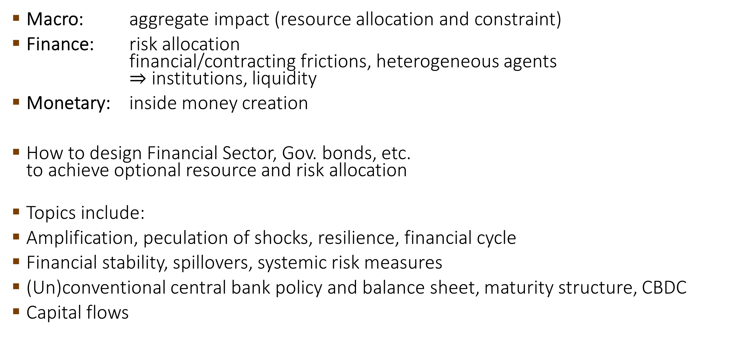
What is Macro-Finance?
Macro: aggregate impact (resource allocation and constraint)
Finance: risk allocation
financial/contracting frictions, heterogeneous agents
$⇒$ institutions, liquidity
Monetary: inside money creation
How to design Financial Sector, Gov. bonds, etc.
to achieve optional resource and risk allocation
Topics include:
Amplification, peculation of shocks, resilience, financial cycle
Financial stability, spillovers, systemic risk measures
(Un)conventional central bank policy and balance sheet, maturity structure, CBDC
Capital flows

Slide 3
Macro-Finance & Related Fields
FINANCE
Public
Finance
Corporate
Finance
MACRO
DD81, AG
Lucas
HT
KM97
BGG99
Asset
Pricing
BruSan, HK
Aiyagari
HANK
Safe
Asset
Merton
FF
I-Theory
of Money
Woodford
Intermediary
Finance
KW
MONETARY

Slide 4
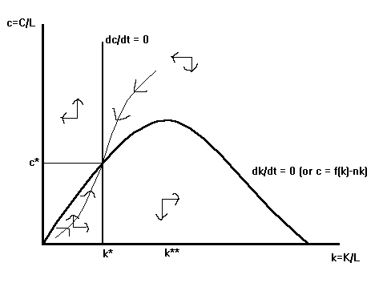
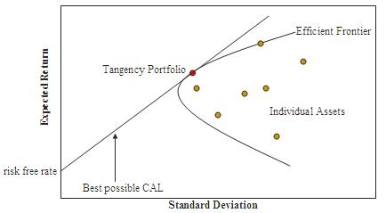
History of macro and finance
Verbal Reasoning (qualitative)
Fisher, Keynes, …
Macro
  Growth theory
    Dynamic (cts. time)
    Deterministic
  Introduce stochastic
    Discrete time
      Brock-Mirman,
      Stokey-Lucas
      DSGE models
Finance
  Portfolio theory
    Static
    Stochastic
  Introduce dynamics
    Continuous time
      Options Black Scholes
      Term structure CIR
      Agency theory Sannikov
Cts. time macro with financial frictions

Slide 5
Heterogeneous Agents
Lending-borrowing/insuring since agents are different
Friction p_{s}MRS_{s} different even after transactions
Wealth distribution matters! (net worth of subgroups)
Financial sector is not a veil
Poor-rich
Productive
Less patient
Less risk averse
More optimistic
Rich-poor
Less productive
More patient
More risk averse
More pessimistic
Limited direct lending
due to frictions

Slide 6

Financial Frictions and Distortions
Belief distortions
  Match “belief surveys”
Incomplete markets
  “natural” leverage constraint (BruSan)
  Costly state verification (BGG)
+ Leverage constraints
(no “liquidity creation”)
  Exogenous limit (Bewley/Ayagari)
  Collateral constraints
    Next period’s price $Rb_{t}≤q_{t+1}k_{t}$ (KM)
    Next periods volatility (VaR, JG)
    Current price
Search Friction (DGP)
state 2
state 1
Debt limit
can depend on prices/volatility

Slide 7
Risk premia, price of risk
Risk premia = price of risk * (endogenous + exogenous risk)
  Exogenous risk – shock from outside
  Endogenous risk
    Amplification: adverse feedback loops
    Multiple equilibria: Run, Sudden Stops
Non-linearities are key for financial stability
  Around vs. away from steady state

Slide 8
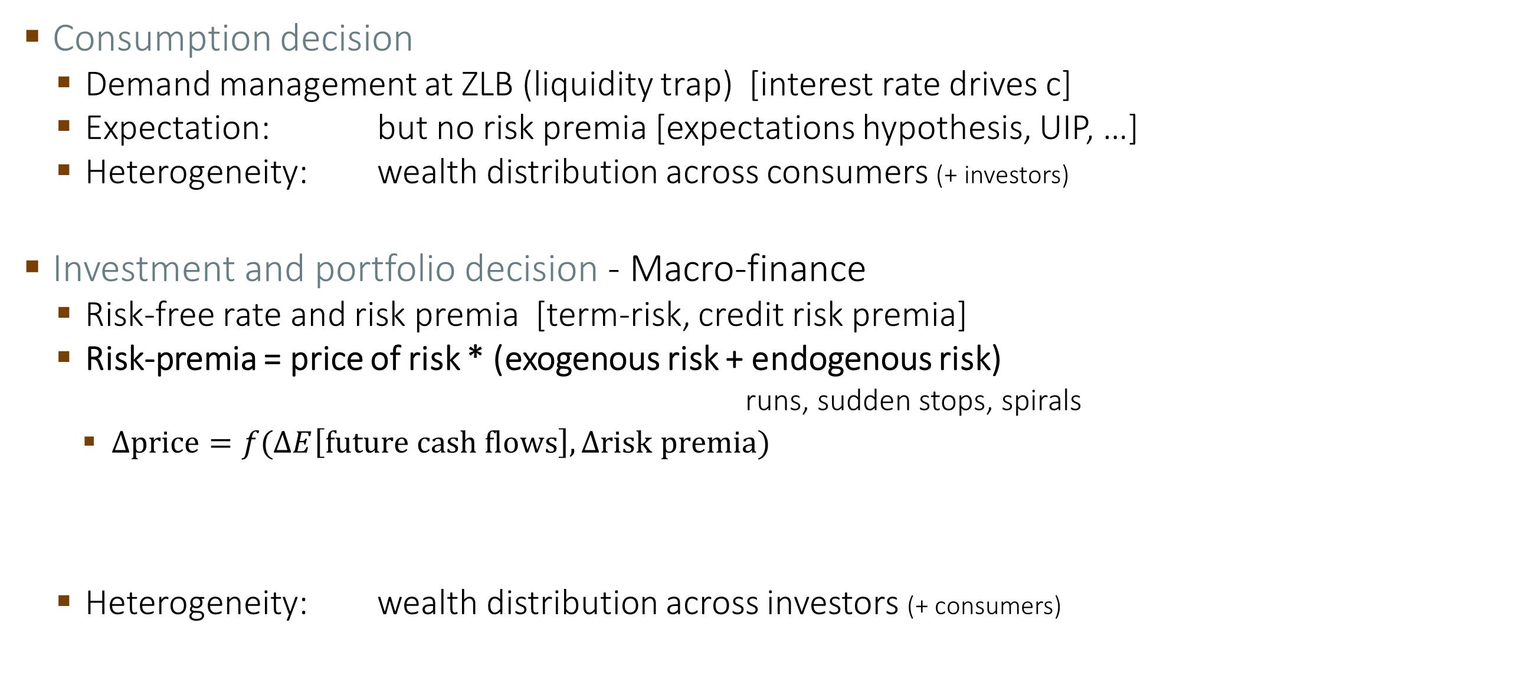
Macro: Consumer vs. Finance Focused
Consumption decision
  Demand management at ZLB (liquidity trap) [interest rate drives c]
  Expectation: but no risk premia [expectations hypothesis, UIP, …]
  Heterogeneity: wealth distribution across consumers (+ investors)
Investment and portfolio decision - Macro-finance
  Risk-free rate and risk premia [term-risk, credit risk premia]
  Risk-premia = price of risk * (exogenous risk + endogenous risk)
    runs, sudden stops, spirals
    $Δ\text{price}=f(ΔE\left[\text{future} \text{cash} \text{flows}\right], Δrisk premia)$
  Heterogeneity: wealth distribution across investors (+ consumers)
Non-linearities

Slide 9

Resilience Management
Push barrier/tipping point further away
- ex-ante investment
  Buffers, reserves, (specific) redundancies
  No overheating of the economy
    Like moving ahead without keeping tipping point at a distance
    Sahm Rule: if $u<u^{∗}$, then unemployment jumps (after a shock)
Agility: react earlier to turn around ($≠$rigidity)
  (Re)action (of CB) in timely fashion
    ex-post discretion vs. ex-ante rule (automatic algo)
  Expectations of others: Re-re-actions
Tipping point/R-barrier
Tipping point/R-barrier
Large shock vs. a sequence of shocks

Slide 10
Persistence & Resilience
Even in standard real business cycle models,
temporary adverse shocks can have long-lasting effects
Due to feedback effects, persistence is much
stronger in models with financial frictions
  Bernanke & Gertler (1989)
  Carlstrom & Fuerst (1997)
Negative shocks to net worth exacerbate
frictions and lead to lower capital,
investment and net worth in future periods

Slide 11
Persistence Leads to Dynamic Amplification
Static amplification occurs because fire-sales of capital
from productive sector to less productive sector depress asset prices
  Importance of market liquidity of physical capital
Dynamic amplification occurs because a
temporary shock translates into a
persistent decline in output and asset prices
  Forward grow net worth via retained earnings
  Backward asset pricing
  Kiyotaki Moore (1997)
  Bernanke Gertler Gilchrist (1999)

Slide 12
“Single Shock Critique”
Critique: After the shock all agents in the economy know that the economy will deterministically return to the steady state.
  Length of slump is deterministic (and commonly known)
    No safety cushion needed
  In reality an adverse shock may be followed by additional adverse shocks
    Build-up extra safety cushion for an additional shock in a crisis
Impulse response vs. volatility dynamics

Slide 13
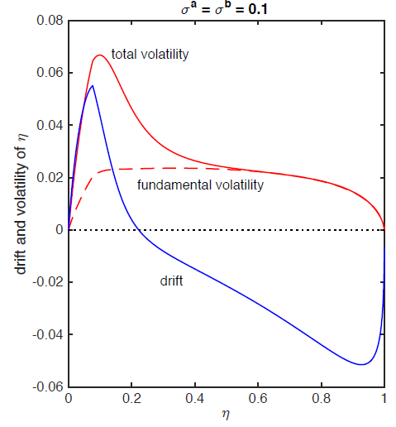
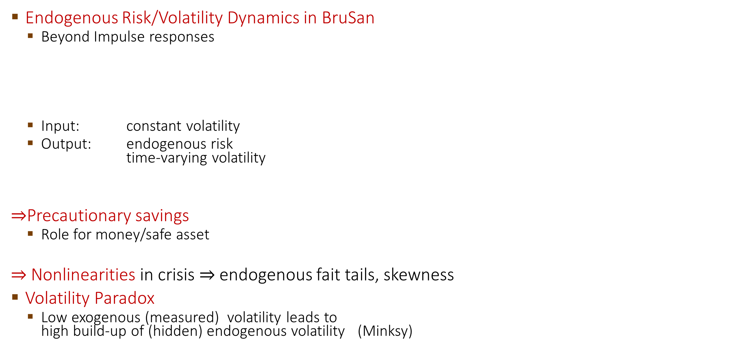
Endogenous Volatility & Volatility Paradox
Endogenous Risk/Volatility Dynamics in BruSan
  Beyond Impulse responses
  Input: constant volatility
  Output: endogenous risk
  time-varying volatility
$⇒$Precautionary savings
  Role for money/safe asset
$⇒$Nonlinearities in crisis $⇒$ endogenous fait tails, skewness
Volatility Paradox
  Low exogenous (measured) volatility leads to
  high build-up of (hidden) endogenous volatility (Minksy)
Stochastic steady state

Slide 14
Fan chart: Distributional Impulse Response Function
Difference with and without a shock

Slide 15
Objectives and Instruments
STABILITY
Price stability
Monetary policy
  Short-term interest
  Policy rule
  (terms structure)
Financial stability
Macroprudential
policy
  Reserve requirements
  Capital/liquidity requirements
  Collateral policy Margins/haircuts
  Capital controls
Fiscal debt sustainability
Fiscalpolicy
  Taxes/subsidies
inter-
action
inter-
action

Slide 16
Cts.-time Macro: Macro-Finance vs HANK
Agents: | Heterogenous investor focus - Net worth distribution (often discrete) | Heterogenous consumer focus - Net worth distribution (often cts.)
Tradition: | Finance (Merton) Portfolio and consumption choice | DSGE (Woodford) Consumption choice
 | Full/global dynamical system focused on non-linearities away from steady state (crisis …) Length of recession is stochastic | Transition dynamics back to steady state Zero probability shock Length of recession is deterministic
Money due to: | Risk & financial frictions | Price stickiness
Risk: | Risk & financial frictions | No aggregate risk (in HANK paper)
Price of risk: | Idiosyncratic & aggregate risk
Assets: | Capital, money, bonds with different risk profile Risk-return trade-off Liquidity-return trade-off Flight to safety | All assets are risk-free No risk-return trade-off Liquidity-return trade-off

Slide 17
Course Overview
Real Macro-Finance Models with Heterogeneous Agents
A Simple Real Macro-finance Model
Endogenous (Price of) Risk Dynamics
A Model with Jumps due to Sudden Stops/Runs
Money Models
A Simple Money Model
Cashless vs. Cash Economy and “The I Theory of Money”
Welfare Analysis & Optimal Policy
  Fiscal, Monetary, and Macroprudential Policy
International Macro-Finance Models
International Financial Architecture
Digital Money

Slide 18



Simple Two Sector Model: Basak Cuoco (1998)
Expert sector Household sector
A
L
A
L
Capital
$$q_{t}K_{t}$$
Debt
Loans
Net worth
$$q_{t}K_{t}−N_{t}$$
$$N_{t}$$
See Lecture Notes, Chapter 2 or
Handbook of Macroeconomics 2017, Chapter 18

Slide 19

Financial Frictions and Distortions
Belief distortions
  Match “belief surveys”
Incomplete markets
  “natural” leverage constraint (BruSan)
  Costly state verification (BGG)
+ Leverage constraints
(no “liquidity creation”)
  Exogenous limit (Bewley/Ayagari)
  Collateral constraints
    Next period’s price (KM)
    $Rb_{t}≤q_{t+1}k_{t}$
    Next periods volatility (VaR, JG)
    Current price
Search Friction (DGP)
state 2
state 1
Debt limit
can depend on prices/volatility

Slide 20


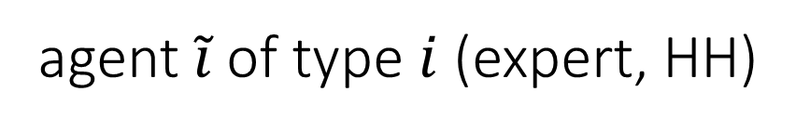
Two Sector Model Setup
Expert sector
Output: $y_{t}^{e}=ak_{t}^{e}$
Consumption rate: $c_{t}^{e}$
Investment rate: $ι_{t}^{e}$
$$\frac{dk_{t}^{e,\tilde{i}}}{k_{t}^{e,\tilde{i}}}=\left(Φ\left(ι_{t}^{e,\tilde{i}}\right)−δ\right)dt+σdZ_{t}$$
$E_{0}[\int_{0}^{∞}{e^{−ρt}\frac{{{(c}_{t}^{e})}^{1−γ}}{1−γ}dt]}$
Friction: Can only issue
Risk-free debt
Equity, but most hold $χ_{t}≥\underline{α}$
Household sector
Output: ${\underline{y}}_{t}=\underline{a}{\underline{k}}_{t}$
Consumption rate: $c_{t}^{h}$
Investment rate: $ι_{t}$
$$\frac{dk_{t}^{\tilde{i}}}{k_{t}^{\tilde{i}}}=\left(Φ\left({\underline{ι}}_{t}\right)−\underline{δ}\right)dt+σdZ_{t}+\tilde{σ}d{\tilde{Z}}_{t}^{\tilde{i}}$$
agent $\tilde{i}$ of type $i$ (expert, HH)

Slide 21
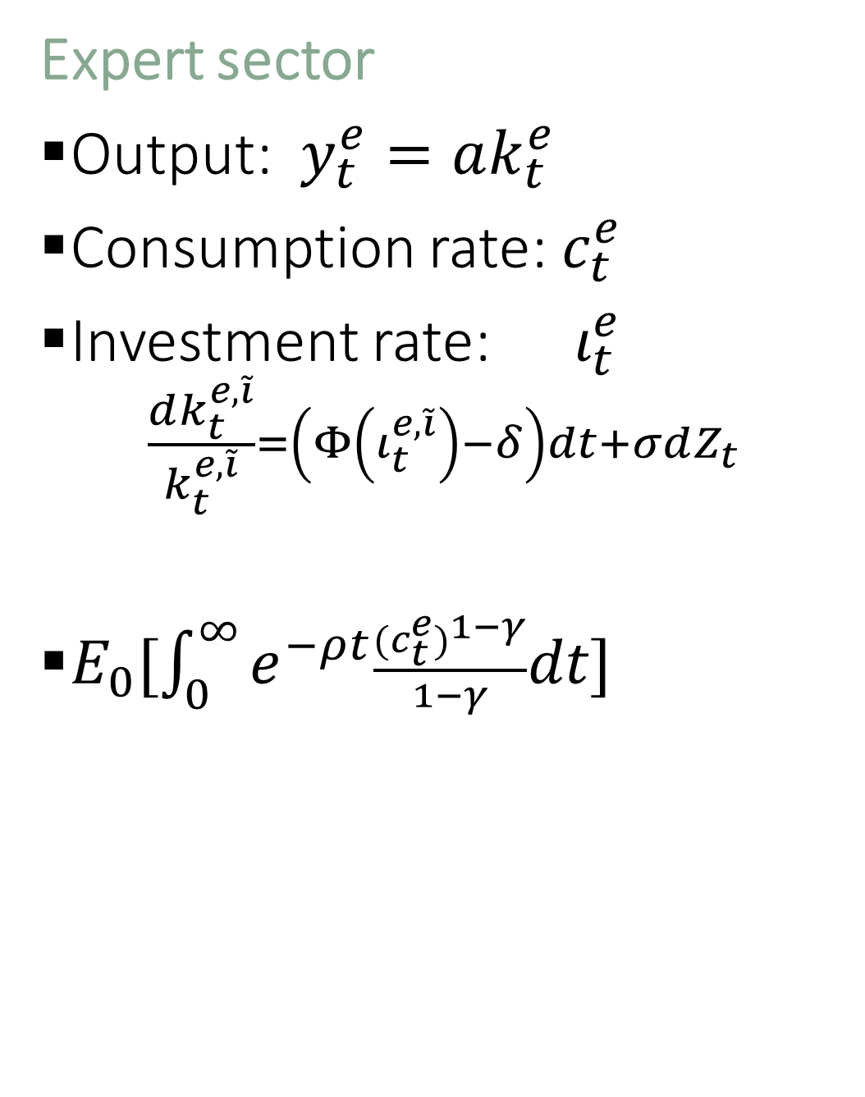

Two Sector Model Setup
Expert sector
Output: $y_{t}^{e}=ak_{t}^{e}$
Consumption rate: $c_{t}^{e}$
Investment rate: $ι_{t}^{e}$
$$\frac{dk_{t}^{e,\tilde{i}}}{k_{t}^{e,\tilde{i}}}=\left(Φ\left(ι_{t}^{e,\tilde{i}}\right)−δ\right)dt+σdZ_{t}$$
$E_{0}[\int_{0}^{∞}{e^{−ρt}\frac{{{(c}_{t}^{e})}^{1−γ}}{1−γ}dt]}$
Friction: Can only issue
Risk-free debt
Equity, but most hold $χ_{t}≥\underline{α}$
Household sector
Output: ${\underline{y}}_{t}=\underline{a}{\underline{k}}_{t}$
Consumption rate: $c_{t}^{h}$
Investment rate: $ι_{t}$
$$\frac{dk_{t}^{\tilde{i}}}{k_{t}^{\tilde{i}}}=\left(Φ\left({\underline{ι}}_{t}\right)−\underline{δ}\right)dt+σdZ_{t}+\tilde{σ}d{\tilde{Z}}_{t}^{\tilde{i}}$$
$E_{0}[\int_{0}^{∞}{e^{−ρt}\frac{{(c_{t}^{h})}^{1−γ}}{1−γ}dt]}$
Log-utility in Basak Cuoco 1998

Slide 22
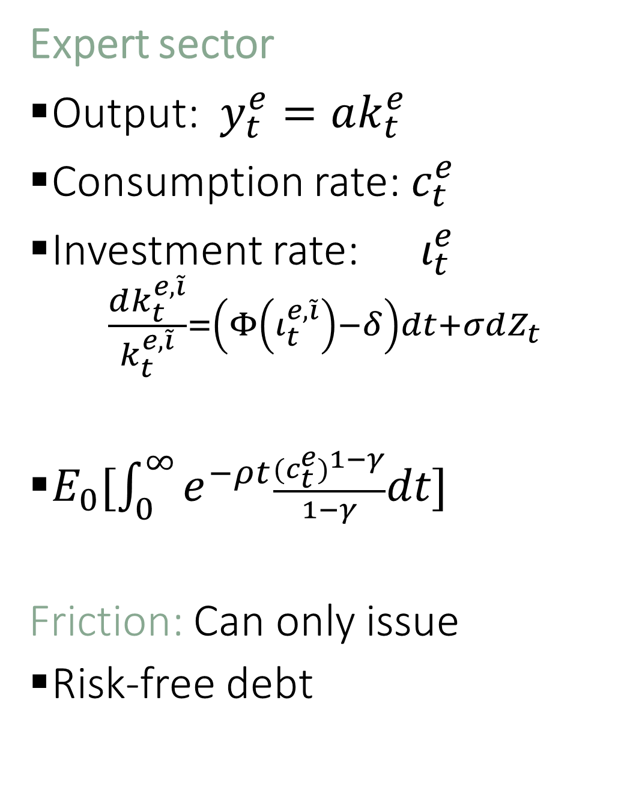
Two Sector Model Setup
Expert sector
Output: $y_{t}^{e}=ak_{t}^{e}$
Consumption rate: $c_{t}^{e}$
Investment rate: $ι_{t}^{e}$
$$\frac{dk_{t}^{e,\tilde{i}}}{k_{t}^{e,\tilde{i}}}=\left(Φ\left(ι_{t}^{e,\tilde{i}}\right)−δ\right)dt+σdZ_{t}$$
$E_{0}[\int_{0}^{∞}{e^{−ρt}\frac{{{(c}_{t}^{e})}^{1−γ}}{1−γ}dt]}$
Friction: Can only issue
Risk-free debt
Equity, but most hold $χ_{t}≥\underline{α}$
Household sector
Output: ${\underline{y}}_{t}=\underline{a}{\underline{k}}_{t}$
Consumption rate: $c_{t}^{h}$
Investment rate: $ι_{t}$
$$\frac{dk_{t}^{\tilde{i}}}{k_{t}^{\tilde{i}}}=\left(Φ\left({\underline{ι}}_{t}\right)−\underline{δ}\right)dt+σdZ_{t}+\tilde{σ}d{\tilde{Z}}_{t}^{\tilde{i}}$$
$E_{0}[\int_{0}^{∞}{e^{−ρt}\frac{{(c_{t}^{h})}^{1−γ}}{1−γ}dt]}$

Slide 23








The Big Picture
allocation of
physical assets … risk
amplification
output capital price of risk $ς$
growth
consumption + investment
net worth
distribution
value function
$$κ=1$$
A
L
$$χ=1$$
accumu-
lation
Debt
Outside
equity
volatility
$$A(κ)$$
$$K$$
$$Φ\left(ι\right)−δ$$
Forward equation
$$ι$$
drift
drift
precautionary
$$η$$
volatility
Backward equation
with expectations

Slide 24
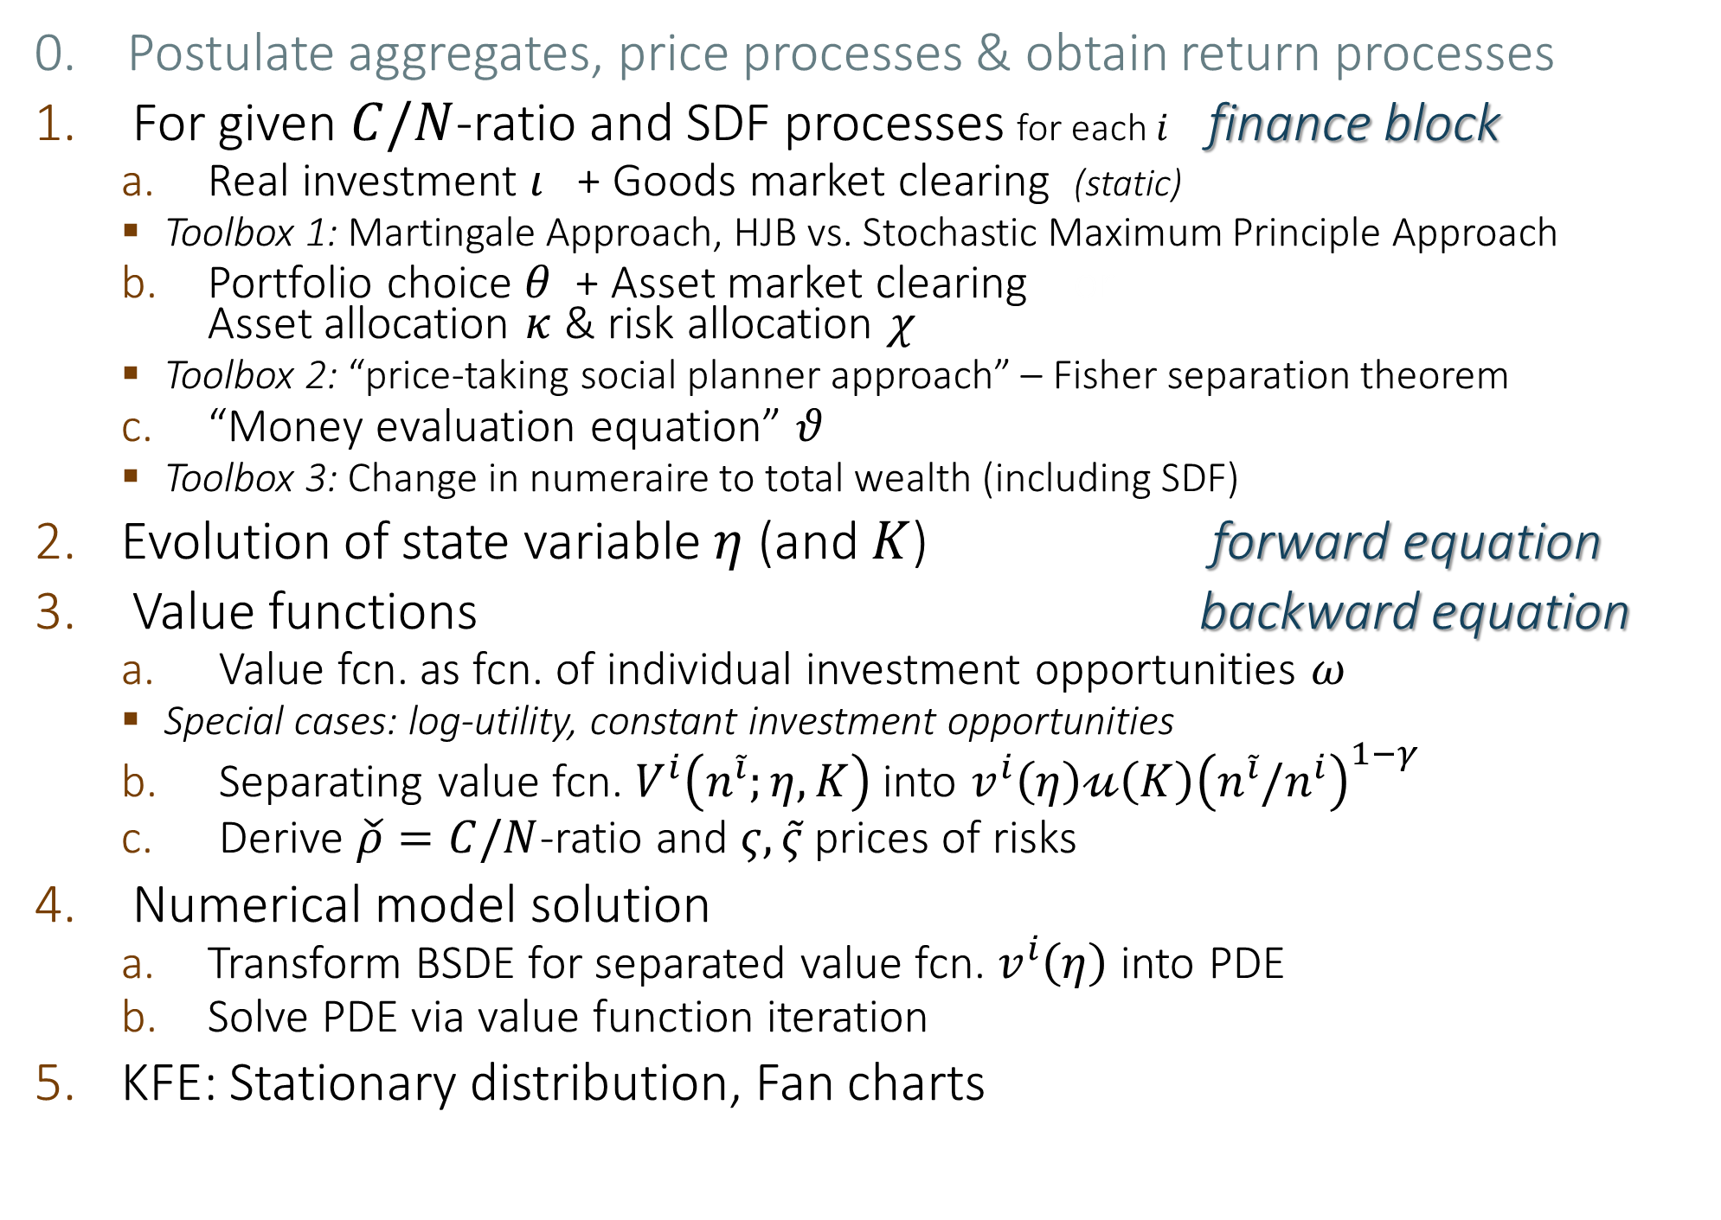
Solving MacroModels Step-by-Step
0. Postulate aggregates, price processes & obtain return processes
For given $C/N$-ratio and SDF processes for each $i$ finance block
  Real investment $ι$ + Goods market clearing (static)
    Toolbox 1: Martingale Approach, HJB vs. Stochastic Maximum Principle Approach
  Portfolio choice $θ$ + Asset market clearing or
  Asset allocation $κ$ & risk allocation $χ$
    Toolbox 2: “price-taking social planner approach” – Fisher separation theorem
  “Money evaluation equation” $θ$
    Toolbox 3: Change in numeraire to total wealth (including SDF)
Evolution of state variable $η$ (and $K$) forward equation
Value functions backward equation
  Value fcn. as fcn. of individual investment opportunities $ω$
    Special cases: log-utility, constant investment opportunities
  Separating value fcn. $V^{i}\left(n^{\tilde{i}};η,K\right)$ into $v^{i}\left(η\right)𝓊\left(K\right){\left(n^{\tilde{i}}/n^{i}\right)}^{1−γ}$
  Derive $\check{ρ}=C/N$-ratio and $ς,\tilde{ς}$ prices of risks
Numerical model solution
  Transform BSDE for separated value fcn. $v^{i}\left(η\right)$ into PDE
  Solve PDE via value function iteration
KFE: Stationary distribution, Fan charts
Log-utility

Slide 25
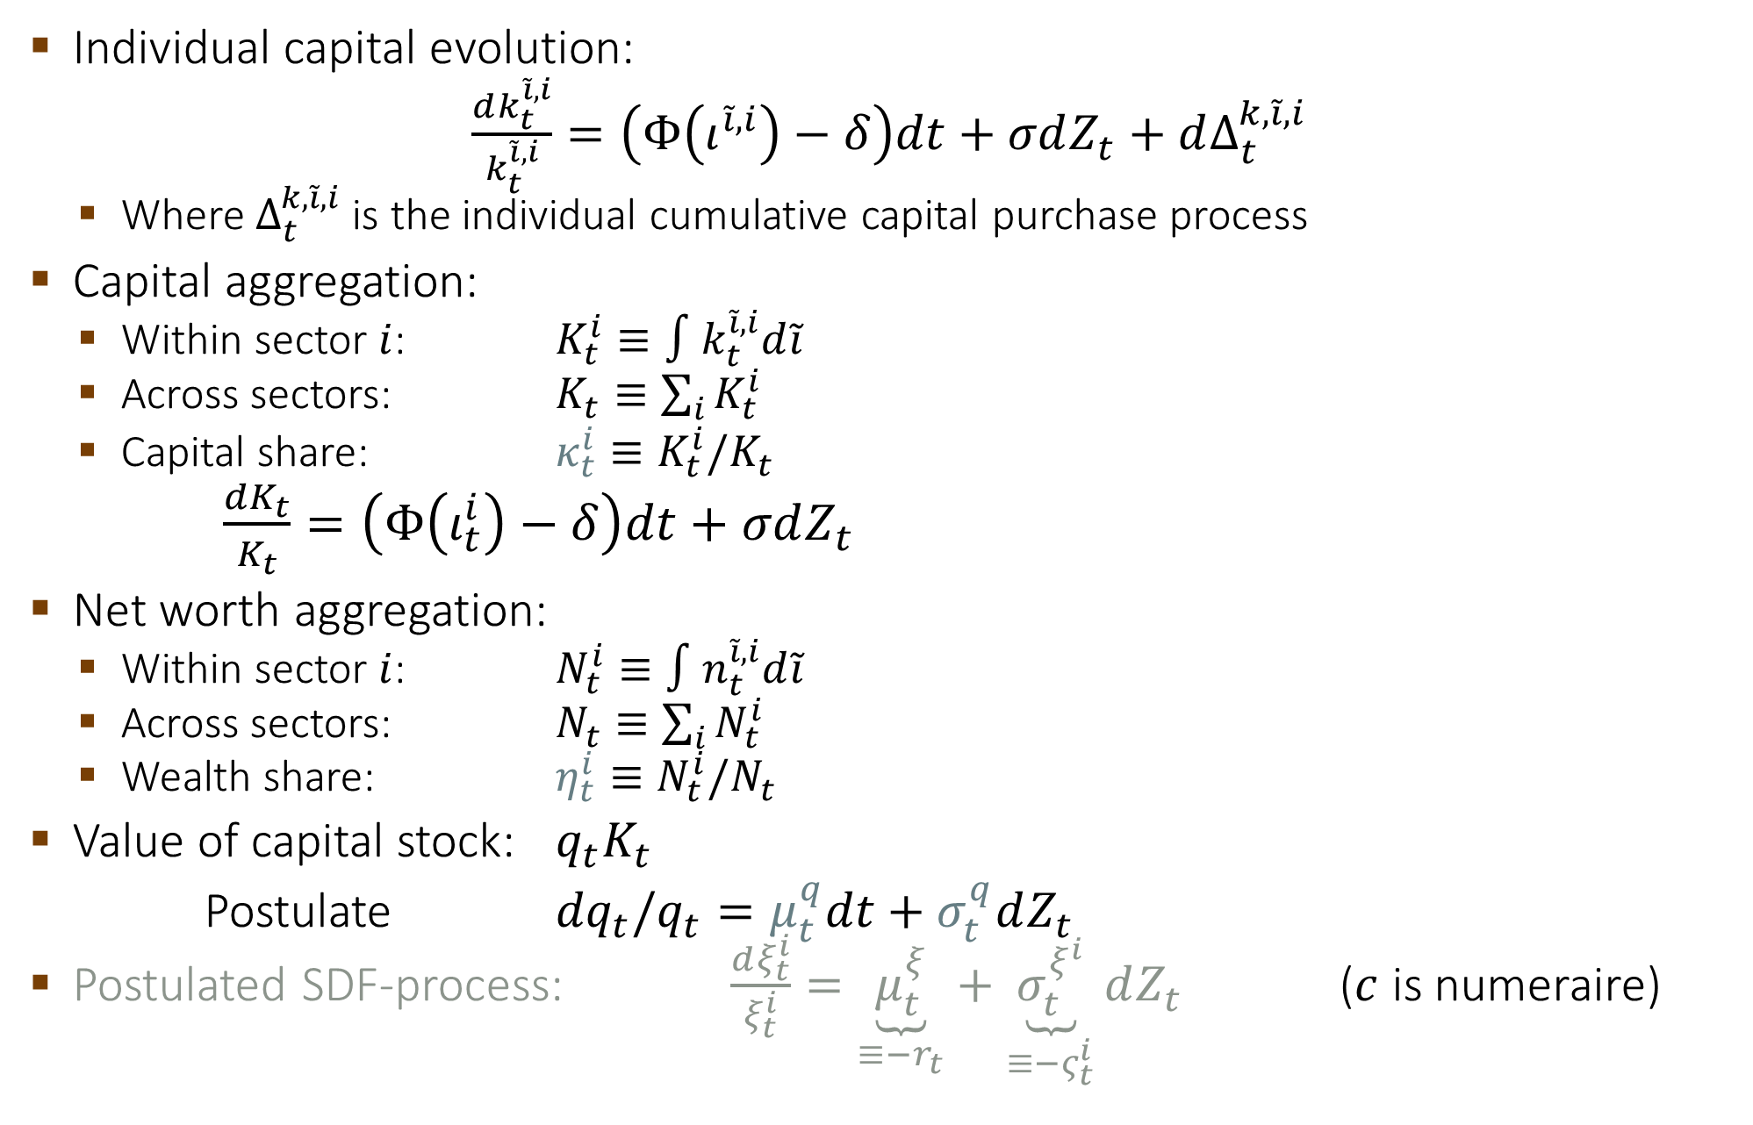
0. Postulate Aggregates and Processes
Individual capital evolution:
$\frac{dk_{t}^{\tilde{i},i}}{k_{t}^{\tilde{i},i}}=\left(Φ\left(ι^{\tilde{i},i}\right)−δ\right)dt+σdZ_{t}+dΔ_{t}^{k,\tilde{i},i}$
  Where$Δ_{t}^{k,\tilde{i},i}$ is the individual cumulative capital purchase process
Capital aggregation:
  Within sector $i$: $K_{t}^{i}≡∫k_{t}^{\tilde{i},i}d\tilde{i}$
  Across sectors: $K_{t}≡\sum_{i}{K_{t}^{i}}$
  Capital share: $κ_{t}^{i}≡K_{t}^{i}/K_{t}$
  $\frac{dK_{t}}{K_{t}}=\left(Φ\left(ι_{t}^{i}\right)−δ\right)dt+σdZ_{t}$
Net worth aggregation:
  Within sector $i$: $N_{t}^{i}≡∫n_{t}^{\tilde{i},i}d\tilde{i}$
  Across sectors: $N_{t}≡\sum_{i}{N_{t}^{i}}$
  Wealth share: $η_{t}^{i}≡N_{t}^{i}/N_{t}$
Value of capital stock: $q_{t}K_{t}$
Postulate ${dq}_{t}/q_{t}=μ_{t}^{q}dt+σ_{t}^{q}dZ_{t}$
Postulated SDF-process: $\frac{dξ_{t}^{i}}{ξ_{t}^{i}}=\underset{≡−r_{t}}{\underbrace{μ_{t}^{ξ}}}+\underset{≡−ς_{t}^{i}}{\underbrace{σ_{t}^{ξ^{i}}}}dZ_{t}$ ($c$ is numeraire)
Same Brownian
Notes:
Answer a)

Slide 26
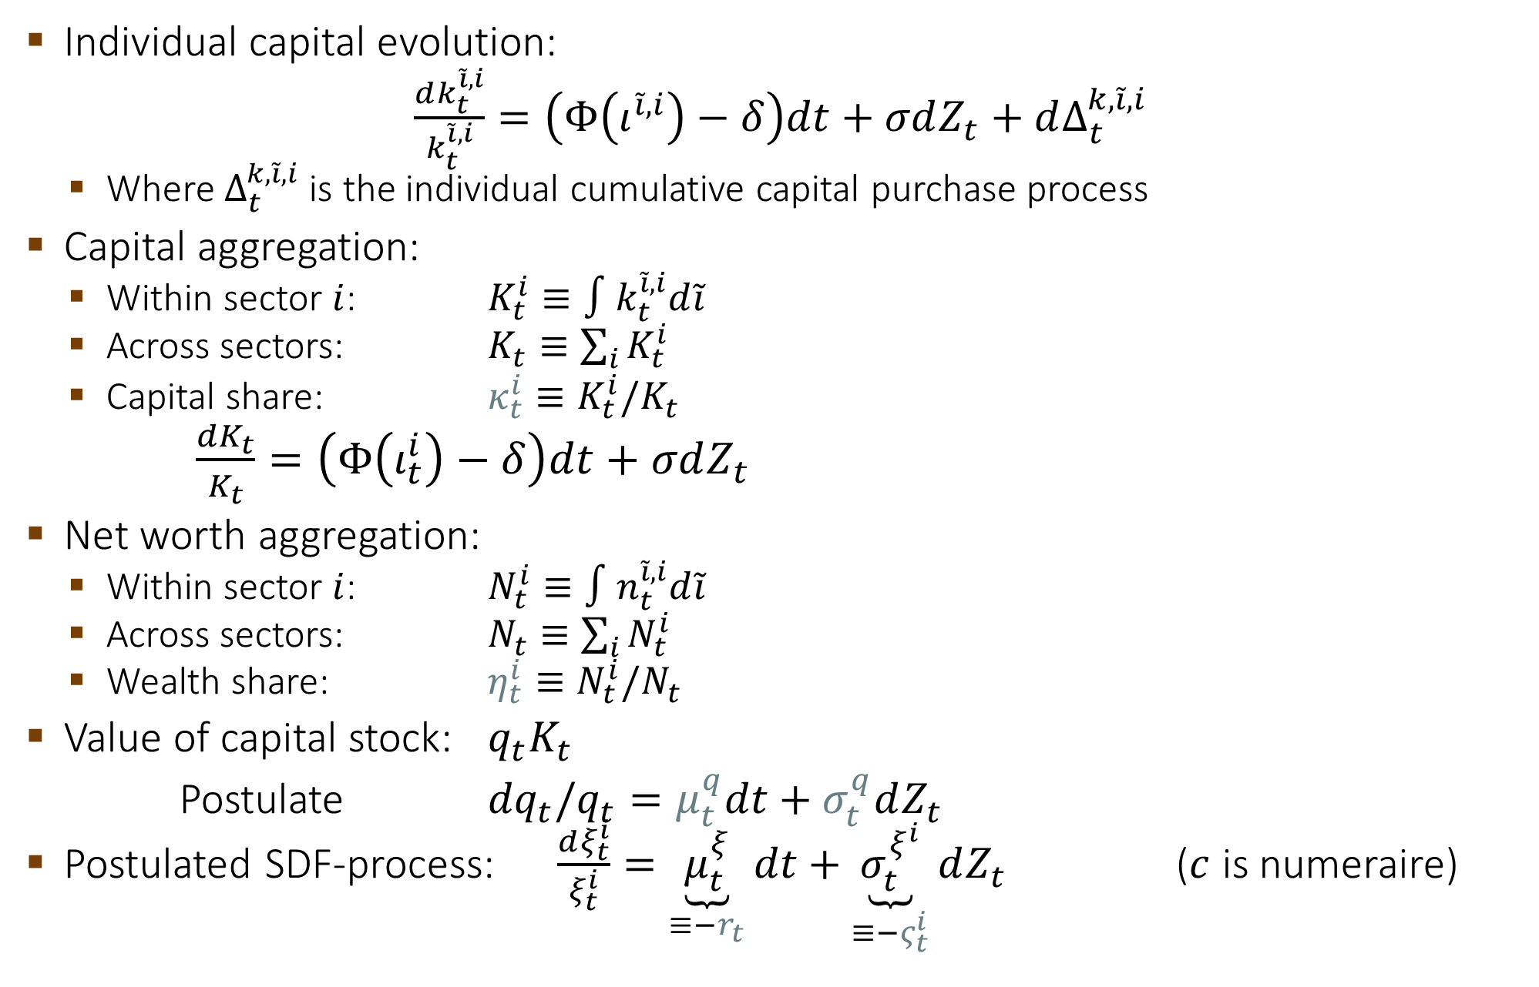
0. Postulate Aggregates and Processes
Individual capital evolution:
$\frac{dk_{t}^{\tilde{i},i}}{k_{t}^{\tilde{i},i}}=\left(Φ\left(ι^{\tilde{i},i}\right)−δ\right)dt+σdZ_{t}+dΔ_{t}^{k,\tilde{i},i}$
  Where$Δ_{t}^{k,\tilde{i},i}$ is the individual cumulative capital purchase process
Capital aggregation:
  Within sector $i$: $K_{t}^{i}≡∫k_{t}^{\tilde{i},i}d\tilde{i}$
  Across sectors: $K_{t}≡\sum_{i}{K_{t}^{i}}$
  Capital share: $κ_{t}^{i}≡K_{t}^{i}/K_{t}$
  $\frac{dK_{t}}{K_{t}}=\left(Φ\left(ι_{t}^{i}\right)−δ\right)dt+σdZ_{t}$
Net worth aggregation:
  Within sector $i$: $N_{t}^{i}≡∫n_{t}^{\tilde{i},i}d\tilde{i}$
  Across sectors: $N_{t}≡\sum_{i}{N_{t}^{i}}$
  Wealth share: $η_{t}^{i}≡N_{t}^{i}/N_{t}$
Value of capital stock: $q_{t}K_{t}$
Postulate ${dq}_{t}/q_{t}=μ_{t}^{q}dt+σ_{t}^{q}dZ_{t}$
Postulated SDF-process: $\frac{dξ_{t}^{i}}{ξ_{t}^{i}}=\underset{≡−r_{t}}{\underbrace{μ_{t}^{ξ}}}dt+\underset{≡−ς_{t}^{i}}{\underbrace{σ_{t}^{ξ^{i}}}}dZ_{t}$ ($c$ is numeraire)
Notes:
Answer a)

Slide 27
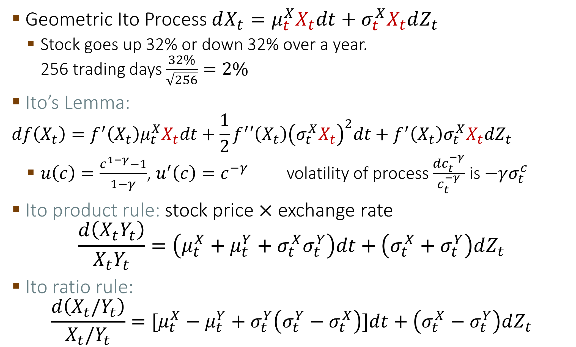
Basics of Ito Calculus
Geometric Ito Process $dX_{t}=μ_{t}^{X}X_{t}dt+σ_{t}^{X}X_{t}dZ_{t}$
  Stock goes up 32% or down 32% over a year.
  256 trading days $\frac{32\%}{\sqrt{256}}=2\%$
Ito’s Lemma:
$$df\left(X_{t}\right)=f^{′}\left(X_{t}\right)μ_{t}^{X}X_{t}dt+\frac{1}{2}f^{′}′\left(X_{t}\right){\left(σ_{t}^{X}X_{t}\right)}^{2}dt+f^{′}\left(X_{t}\right)σ_{t}^{X}X_{t}dZ_{t}$$
  $u\left(c\right)=\frac{c^{1−γ}−1}{1−γ}$, $u^{′}\left(c\right)=c^{−γ}$ volatility of process $\frac{dc_{t}^{−γ}}{c_{t}^{−γ}}$ is $−γσ_{t}^{c}$
Ito product rule: stock price $×$ exchange rate
$$\frac{d\left(X_{t}Y_{t}\right)}{X_{t}Y_{t}}=\left(μ_{t}^{X}+μ_{t}^{Y}+σ_{t}^{X}σ_{t}^{Y}\right)dt+\left(σ_{t}^{X}+σ_{t}^{Y}\right)dZ_{t}$$
Ito ratio rule:
$$\frac{d\left(X_{t}/Y_{t}\right)}{X_{t}/Y_{t}}=[μ_{t}^{X}−μ_{t}^{Y}+σ_{t}^{Y}\left(σ_{t}^{Y}−σ_{t}^{X}\right)]dt+\left(σ_{t}^{X}−σ_{t}^{Y}\right)dZ_{t}$$

Slide 28
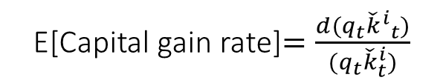
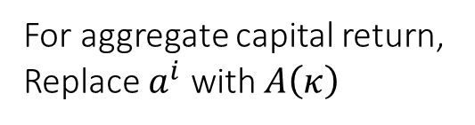
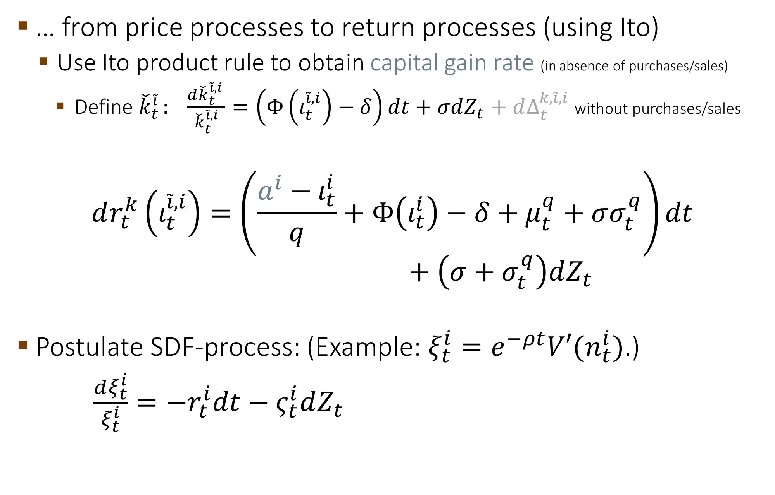
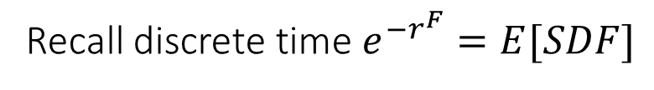
0. Postulate Aggregates and Processes
… from price processes to return processes (using Ito)
  Use Ito product rule to obtain capital gain rate (in absence of purchases/sales)
    Define ${\check{k}}_{t}^{\tilde{i} }: \frac{d{\check{k}}_{t}^{\tilde{i},i }}{{\check{k}}_{t}^{\tilde{i},i}}=\left(Φ\left(ι_{t}^{\tilde{i},i}\right)−δ\right)dt+σdZ_{t}+dΔ_{t}^{k,\tilde{i},i}$ without purchases/sales
$$dr_{t}^{k}\left(ι_{t}^{\tilde{i},i}\right)=\left(\frac{a^{i}−ι_{t}^{i}}{q}+Φ\left(ι_{t}^{i}\right)−δ+μ_{t}^{q}+σσ_{t}^{q}\right)dt$$
$$+ \left(σ+σ_{t}^{q}\right)dZ_{t}$$
Postulate SDF-process: (Example: $ξ_{t}^{i}=e^{−ρt}V′(n_{t}^{i})$.)
$\frac{dξ_{t}^{i}}{ξ_{t}^{i}}=−r_{t}^{i}dt−ς_{t}^{i}dZ_{t}$
Dividend yield
E[Capital gain rate]$=\frac{d(q_{t}{{\check{k}}^{i}}_{t})}{(q_{t}{\check{k}}_{t}^{i})}$
For aggregate capital return,
Replace $a^{i}$ with $A\left(κ\right)$
Price of risk
Recall discrete time $e^{−r^{F}}=E[SDF]$

Slide 29
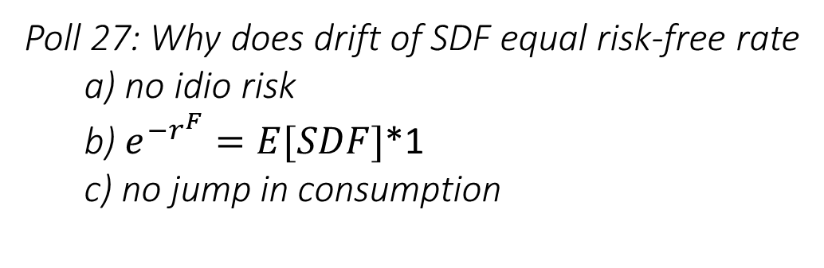
0. Postulate Aggregates and Processes
… from price processes to return processes (using Ito)
  Use Ito product rule to obtain capital gain rate (in absence of purchases/sales)
    Define ${\check{k}}_{t}^{\tilde{i} }: \frac{d{\check{k}}_{t}^{\tilde{i},i }}{{\check{k}}_{t}^{\tilde{i},i}}=\left(Φ\left(ι_{t}^{\tilde{i},i}\right)−δ\right)dt+σdZ_{t}+dΔ_{t}^{k,\tilde{i},i}$ without purchases/sales
$$dr_{t}^{k}\left(ι_{t}^{\tilde{i},i}\right)=\left(\frac{a^{i}−ι_{t}^{i}}{q}+Φ\left(ι_{t}^{i}\right)−δ+μ_{t}^{q}+σσ_{t}^{q}\right)dt$$
$$+ \left(σ+σ_{t}^{q}\right)dZ_{t}$$
Postulate SDF-process: (Example: $ξ_{t}^{i}=e^{−ρt}V′(n_{t}^{i})$.)
$\frac{dξ_{t}^{i}}{ξ_{t}^{i}}=−r_{t}^{i}dt−ς_{t}^{i}dZ_{t}$
Dividend yield
E[Capital gain rate]$=\frac{d(q_{t}{{\check{k}}^{i}}_{t})}{(q_{t}{\check{k}}_{t}^{i})}$
For aggregate capital return,
Replace $a^{i}$ with $A\left(κ\right)$
Poll 29: Why does drift of SDF equal risk-free rate
a) no idio risk
b) $e^{−r^{F}}=E[SDF]$*1
c) no jump in consumption
Price of risk
Recall discrete time $e^{−r^{F}}=E[SDF]$

Slide 30
The Big Picture
allocation of
physical assets … risk
amplification
output capital price of risk $ς$
growth
consumption + investment
net worth
distribution
value function
$$κ=1$$
A
L
$$χ=1$$
accumu-
lation
Debt
Outside
equity
volatility
$$A(κ)$$
$$K$$
$$Φ\left(ι\right)−δ$$
Forward equation
$$ι$$
drift
drift
precautionary
$$η$$
volatility
Backward equation
with expectations

Slide 31
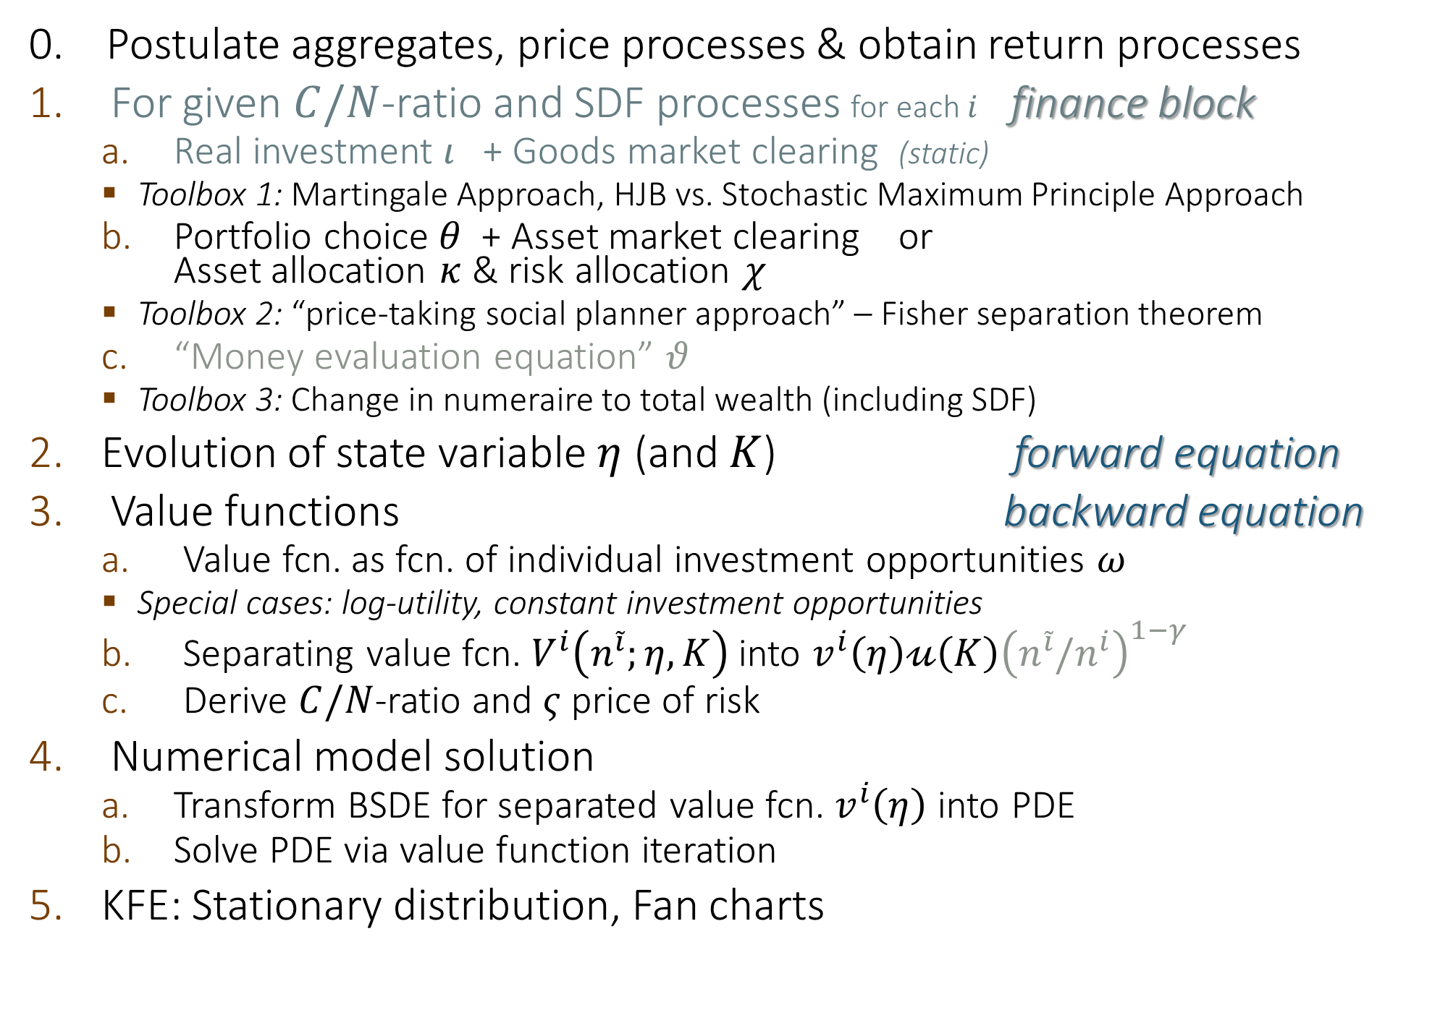
Solving MacroModels Step-by-Step
0. Postulate aggregates, price processes & obtain return processes
For given $C/N$-ratio and SDF processes for each $i$ finance block
  Real investment $ι$ + Goods market clearing (static)
    Toolbox 1: Martingale Approach, HJB vs. Stochastic Maximum Principle Approach
  Portfolio choice $θ$ + Asset market clearing or
  Asset allocation $κ$ & risk allocation $χ$
    Toolbox 2: “price-taking social planner approach” – Fisher separation theorem
  “Money evaluation equation” $θ$
    Toolbox 3: Change in numeraire to total wealth (including SDF)
Evolution of state variable $η$ (and $K$) forward equation
Value functions backward equation
  Value fcn. as fcn. of individual investment opportunities $ω$
    Special cases: log-utility, constant investment opportunities
  Separating value fcn. $V^{i}\left(n^{\tilde{i}};η,K\right)$ into $v^{i}\left(η\right)𝓊\left(K\right){\left(n^{\tilde{i}}/n^{i}\right)}^{1−γ}$
  Derive $C/N$-ratio and $ς$ price of risk
Numerical model solution
  Transform BSDE for separated value fcn. $v^{i}\left(η\right)$ into PDE
  Solve PDE via value function iteration
KFE: Stationary distribution, Fan charts
Log-utility

Slide 32

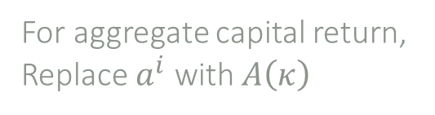
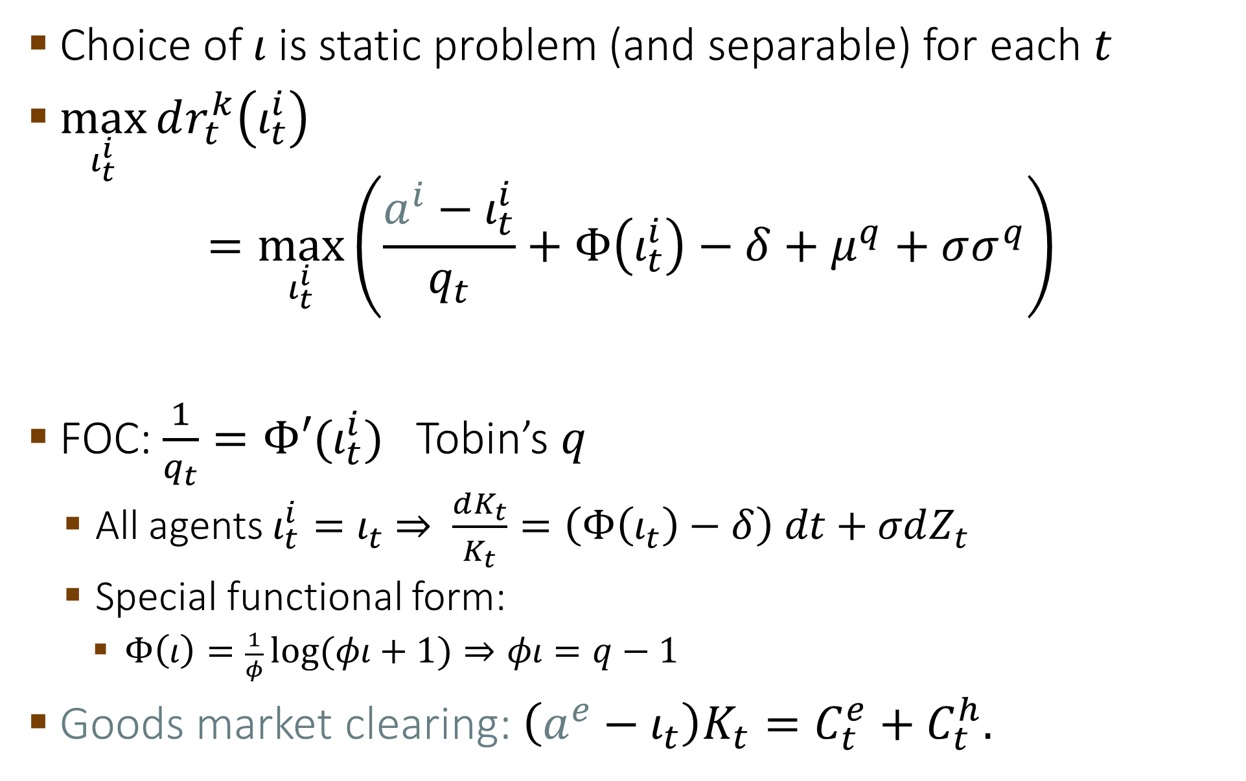
1a. Individual Agent Choice of $ι$, $θ$, $c$
Choice of $ι$ is static problem (and separable) for each $t$
$\max_{ι_{t}^{i}}{dr_{t}^{k}\left(ι_{t}^{i}\right)}$
$$=\max_{ι_{t}^{i}}\left(\frac{a^{i}−ι_{t}^{i}}{q_{t}}+Φ\left(ι_{t}^{i}\right)−δ+μ^{q}+σσ^{q}\right)$$
FOC: $\frac{1}{q_{t}}=Φ′(ι_{t}^{i})$ Tobin’s $q$
  All agents $ι_{t}^{i}=ι_{t}$ $⇒$ $\frac{dK_{t}}{K_{t}}=\left(Φ\left(ι_{t}\right)−δ\right) dt+σdZ_{t}$
  Special functional form:
    $Φ\left(ι\right)=\frac{1}{φ}\log{(φι+1)}⇒φι=q−1$
Goods market clearing: $\left(a^{e}−ι_{t}\right)K_{t}=C_{t}^{e}+C_{t}^{h}.$
Dividend yield
Capital gains $d(q_{t}K_{t})/(q_{t}K_{t})$ rate
For aggregate capital return,
Replace $a^{i}$ with $A\left(κ\right)$

Slide 33
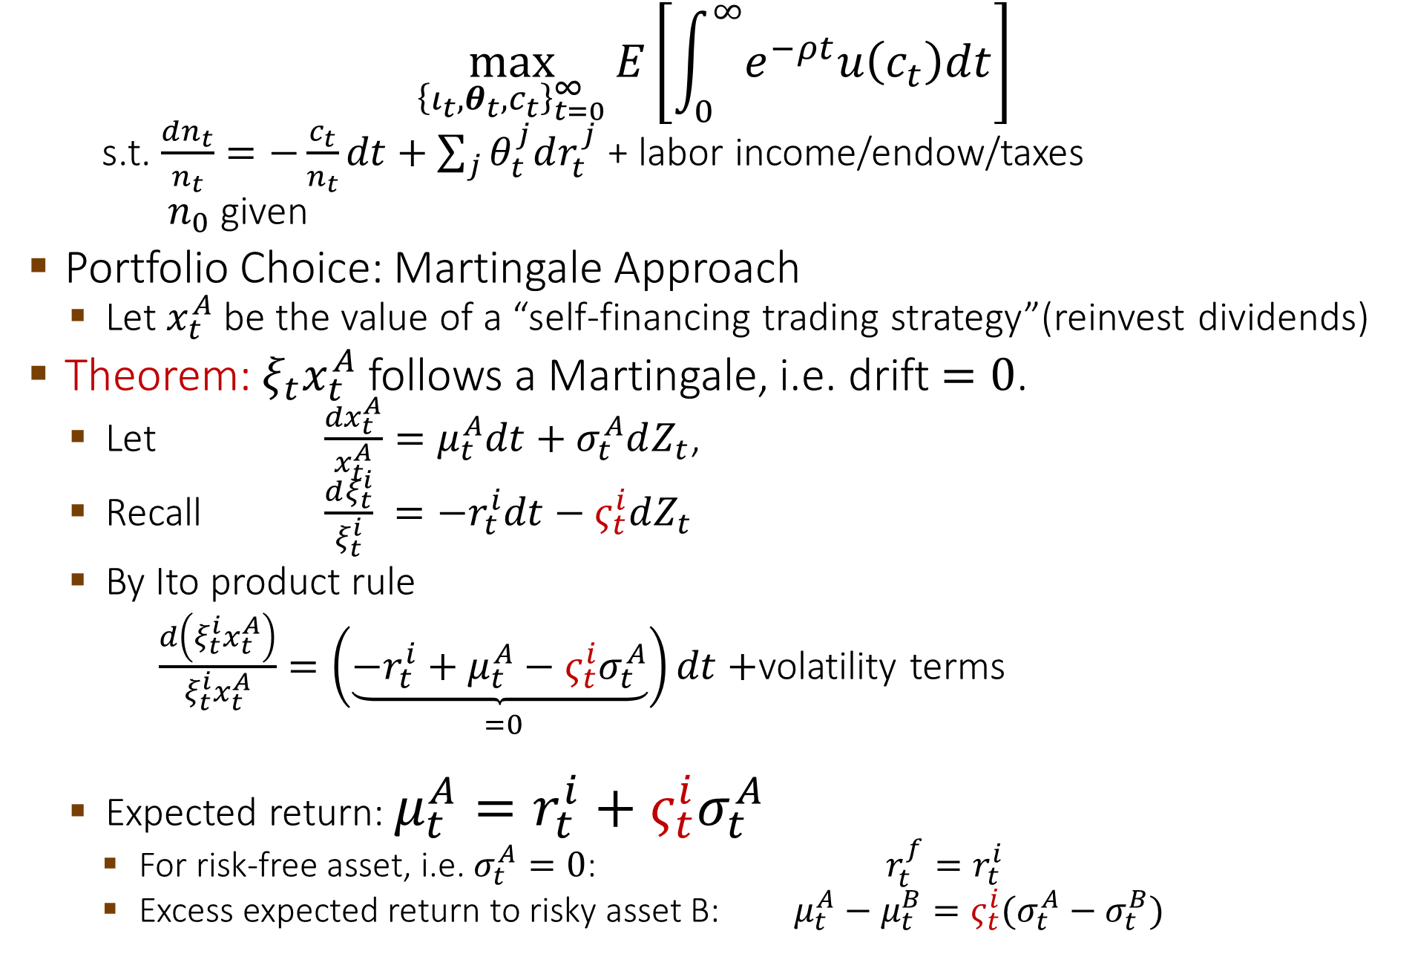
1a. Method 3: Martingale Approach – Cts. Time
$$\max_{{\left\{ι_{t},θ_{t},c_{t}\right\}}_{t=0}^{∞}}{E\left[\int_{0}^{∞}{e^{−ρt}u\left(c_{t}\right)dt}\right]}$$
  s.t. $\frac{dn_{t}}{n_{t}}=−\frac{c_{t}}{n_{t}}dt+\sum_{j}{θ_{t}^{j}dr_{t}^{j}}$ + labor income/endow/taxes
  $n_{0}$ given
Portfolio Choice: Martingale Approach
  Let $x_{t}^{A}$ be the value of a “self-financing trading strategy”(reinvest dividends)
Theorem: $ξ_{t}x_{t}^{A}$ follows a Martingale, i.e. drift $=0$.
  Let $\frac{{dx}_{t}^{A}}{x_{t}^{A}}=μ_{t}^{A}dt+σ_{t}^{A}dZ_{t}$,
  Recall $\frac{dξ_{t}^{i}}{ξ_{t}^{i}} =−r_{t}^{i}dt−ς_{t}^{i}dZ_{t}$
  By Ito product rule
  $\frac{d\left(ξ_{t}^{i}x_{t}^{A}\right)}{ξ_{t}^{i}x_{t}^{A}}=\underset{=0 }{\left(\underbrace{−r_{t}^{i}+μ_{t}^{A}−{ς_{t}^{i}σ}_{t}^{A}}\right)dt}+$volatility terms
  Expected return: $μ_{t}^{A}=r_{t}^{i}+{ς_{t}^{i}σ}_{t}^{A}$
    For risk-free asset, i.e. $σ_{t}^{A}=0$: $r_{t}^{f}=r_{t}^{i}$
    Excess expected return to risky asset B: $μ_{t}^{A}−μ_{t}^{B}={ς_{t}^{i}(σ}_{t}^{A}−σ_{t}^{B})$

Slide 34

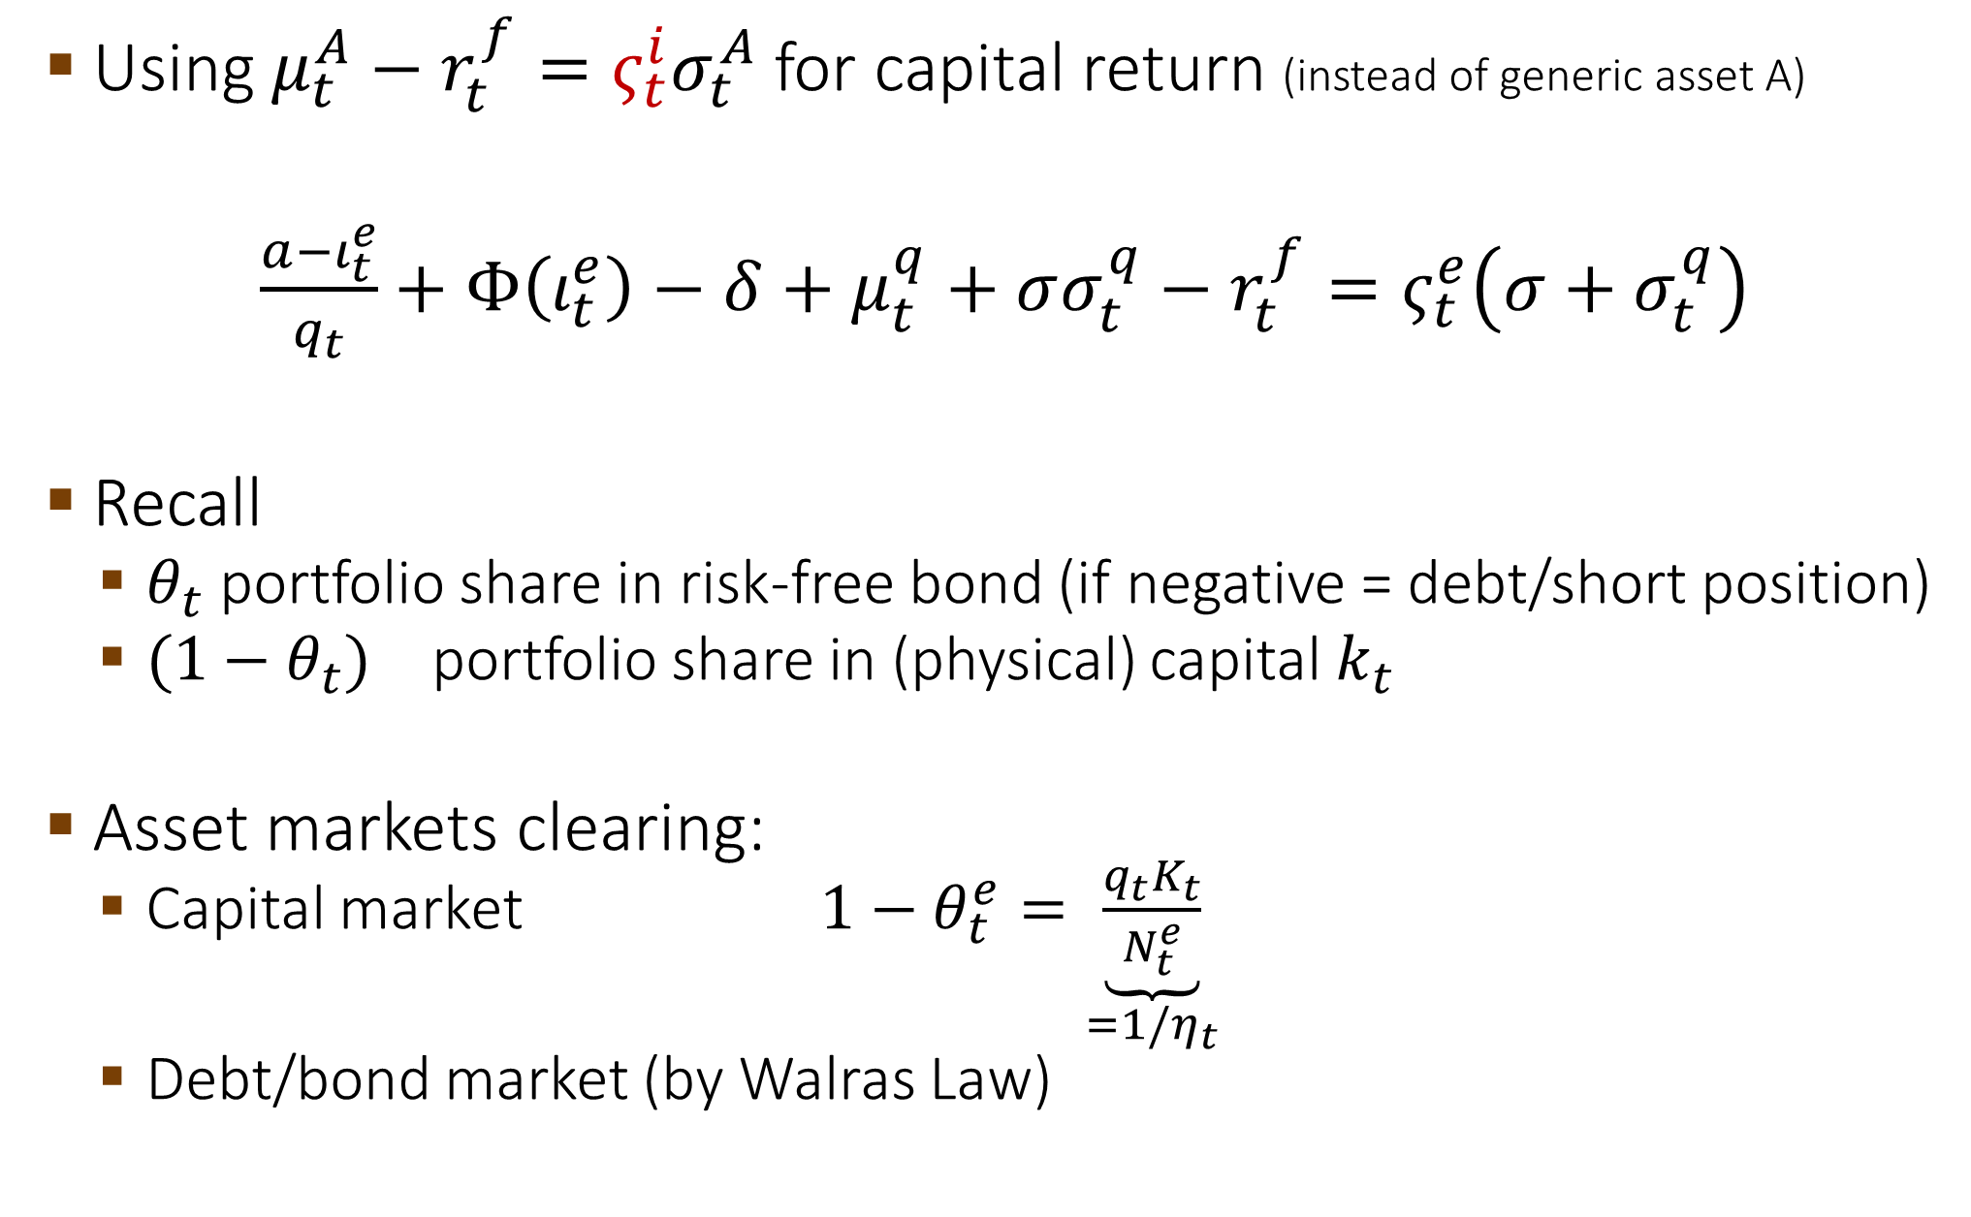
1a. Optimal Portfolio Choice - back to our model
Using $μ_{t}^{A}−r_{t}^{f}={ς_{t}^{i}σ}_{t}^{A}$ for capital return (instead of generic asset A)
ut equity issuance
$\frac{a−ι_{t}^{e}}{q_{t}}+Φ\left(ι_{t}^{e}\right)−δ+μ_{t}^{q}+σσ_{t}^{q}−r_{t}^{f}=ς_{t}^{e}\left(σ+σ_{t}^{q}\right)$
Recall
  $θ_{t}$ portfolio share in risk-free bond (if negative = debt/short position)
  $(1−θ_{t})$ portfolio share in (physical) capital $k_{t}$
Asset markets clearing:
  Capital market $1−θ_{t}^{e}=\underset{=1{/η}_{t}}{\underbrace{\frac{q_{t}K_{t}}{N_{t}^{e}}}}$
  Debt/bond market (by Walras Law)
Dividend yield
Capital gains $d(q_{t}K_{t})/(q_{t}K_{t})$ rate

Slide 35
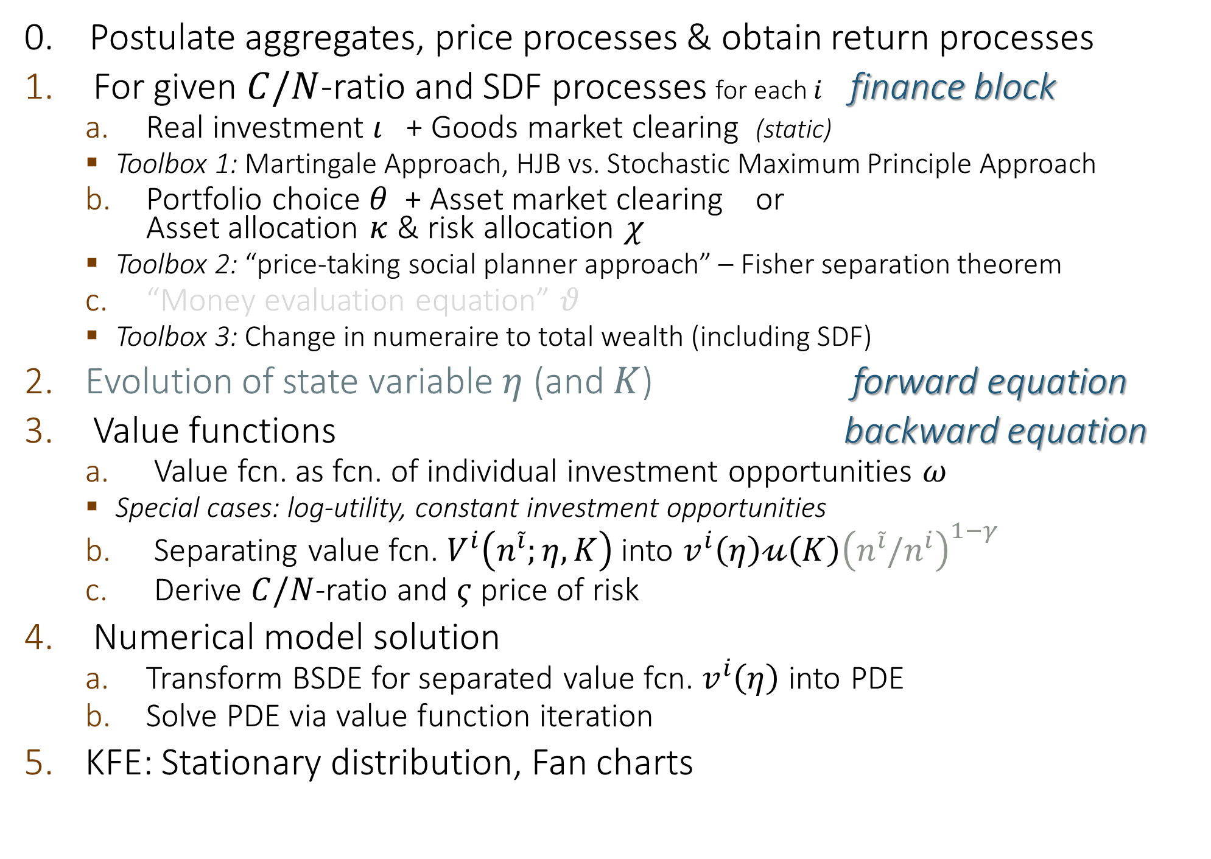
Solving MacroModels Step-by-Step
0. Postulate aggregates, price processes & obtain return processes
For given $C/N$-ratio and SDF processes for each $i$ finance block
  Real investment $ι$ + Goods market clearing (static)
    Toolbox 1: Martingale Approach, HJB vs. Stochastic Maximum Principle Approach
  Portfolio choice $θ$ + Asset market clearing or
  Asset allocation $κ$ & risk allocation $χ$
    Toolbox 2: “price-taking social planner approach” – Fisher separation theorem
  “Money evaluation equation” $θ$
    Toolbox 3: Change in numeraire to total wealth (including SDF)
Evolution of state variable $η$ (and $K$) forward equation
Value functions backward equation
  Value fcn. as fcn. of individual investment opportunities $ω$
    Special cases: log-utility, constant investment opportunities
  Separating value fcn. $V^{i}\left(n^{\tilde{i}};η,K\right)$ into $v^{i}\left(η\right)𝓊\left(K\right){\left(n^{\tilde{i}}/n^{i}\right)}^{1−γ}$
  Derive $C/N$-ratio and $ς$ price of risk
Numerical model solution
  Transform BSDE for separated value fcn. $v^{i}\left(η\right)$ into PDE
  Solve PDE via value function iteration
KFE: Stationary distribution, Fan charts
Log-utility

Slide 36
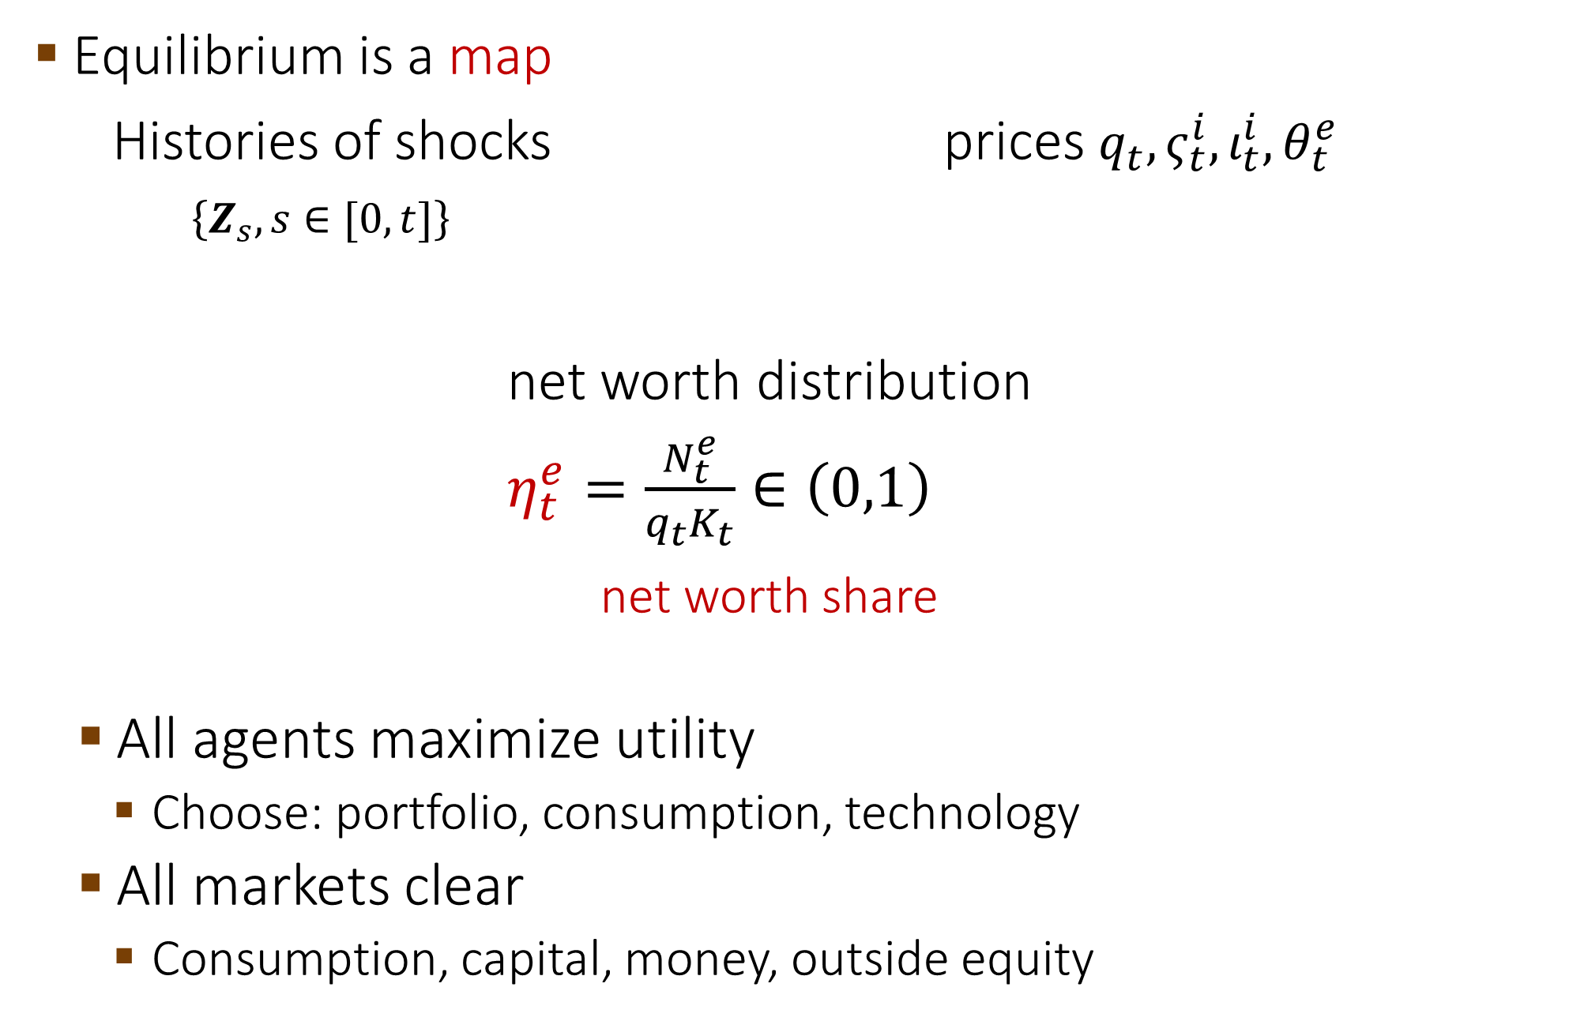
2. GE: Markov States and Equilibria
Equilibrium is a map
Histories of shocks prices $q_{t}, ς_{t}^{i}, ι_{t}^{i},θ_{t}^{e}$
$\left\{Z_{s}, s∈[0,t]\right\}$
net worth distribution
$η_{t}^{e}=\frac{N_{t}^{e}}{q_{t}K_{t}}∈\left(0,1\right)$
net worth share
  All agents maximize utility
    Choose: portfolio, consumption, technology
  All markets clear
    Consumption, capital, money, outside equity

Slide 37
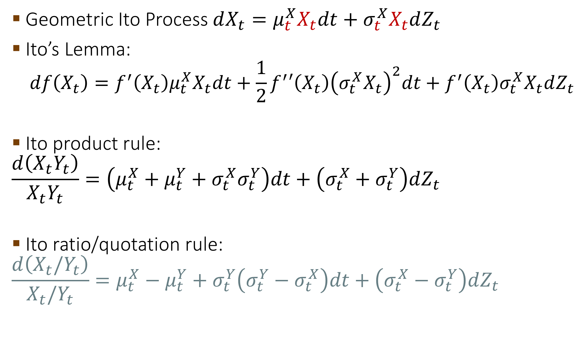
Recall: Basics of Ito Calculus
Geometric Ito Process $dX_{t}=μ_{t}^{X}X_{t}dt+σ_{t}^{X}X_{t}dZ_{t}$
Ito’s Lemma:
$$df\left(X_{t}\right)=f^{′}\left(X_{t}\right)μ_{t}^{X}X_{t}dt+\frac{1}{2}f^{′}′\left(X_{t}\right){\left(σ_{t}^{X}X_{t}\right)}^{2}dt+f^{′}\left(X_{t}\right)σ_{t}^{X}X_{t}dZ_{t}$$
Ito product rule:
$$\frac{d\left(X_{t}Y_{t}\right)}{X_{t}Y_{t}}=\left(μ_{t}^{X}+μ_{t}^{Y}+σ_{t}^{X}σ_{t}^{Y}\right)dt+\left(σ_{t}^{X}+σ_{t}^{Y}\right)dZ_{t}$$
Ito ratio/quotation rule:
$$\frac{d\left(X_{t}/Y_{t}\right)}{X_{t}/Y_{t}}=μ_{t}^{X}−μ_{t}^{Y}+σ_{t}^{Y}\left(σ_{t}^{Y}−σ_{t}^{X}\right)dt+\left(σ_{t}^{X}−σ_{t}^{Y}\right)dZ_{t}$$

Slide 38
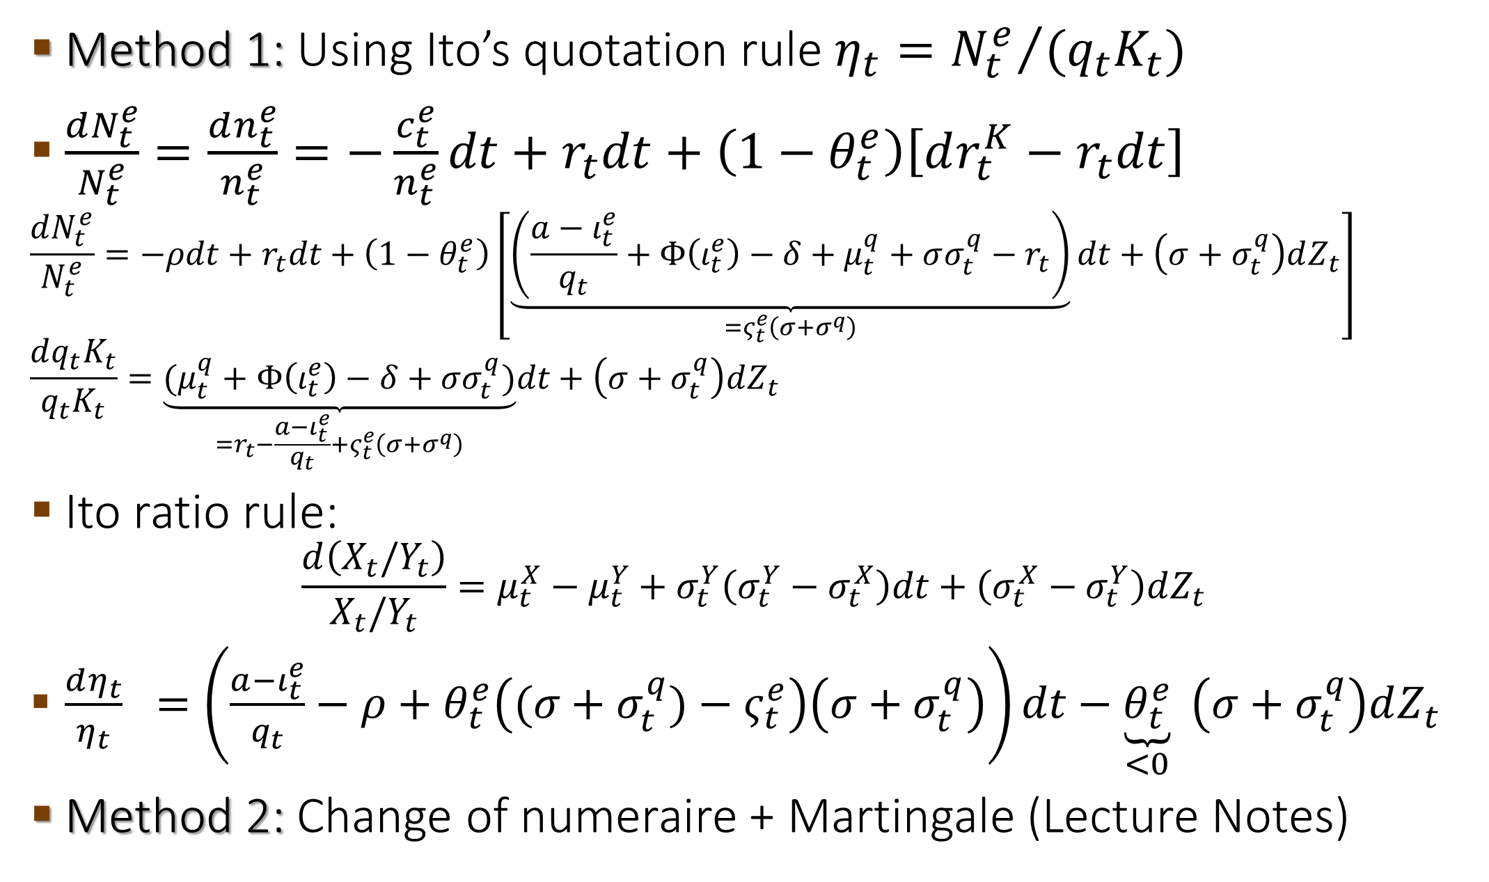
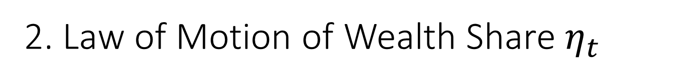
2. Law of Motion of Wealth Share $η_{t}$
Method 1: Using Ito’s quotation rule $η_{t}={N_{t}^{e}}/{(q_{t}K_{t})}$
$\frac{dN_{t}^{e}}{N_{t}^{e}}=\frac{dn_{t}^{e}}{n_{t}^{e}}=−\frac{c_{t}^{e}}{n_{t}^{e}}dt+r_{t}dt+\left(1−θ_{t}^{e}\right)\left[dr_{t}^{K}−r_{t}dt\right]$
$$\frac{dN_{t}^{e}}{N_{t}^{e}}=−ρdt+r_{t}dt+\left(1−θ_{t}^{e}\right)\left[\underset{=ς_{t}^{e}\left(σ+σ^{q}\right)}{\underbrace{\left(\frac{a−ι_{t}^{e}}{q_{t}}+Φ\left(ι_{t}^{e}\right)−δ+μ_{t}^{q}+σσ_{t}^{q}−r_{t}\right)}}dt+\left(σ+σ_{t}^{q}\right)dZ_{t}\right]$$
$$\frac{dq_{t}K_{t}}{q_{t}K_{t}}=\underset{=r_{t}−\frac{a−ι_{t}^{e}}{q_{t}}+ς_{t}^{e}\left(σ+σ^{q}\right)}{\underbrace{(μ_{t}^{q}+Φ\left(ι_{t}^{e}\right)−δ+σσ_{t}^{q})}}dt+\left(σ+σ_{t}^{q}\right)dZ_{t}$$
Ito ratio rule:
$$\frac{d\left(X_{t}/Y_{t}\right)}{X_{t}/Y_{t}}=μ_{t}^{X}−μ_{t}^{Y}+σ_{t}^{Y}\left(σ_{t}^{Y}−σ_{t}^{X}\right)dt+\left(σ_{t}^{X}−σ_{t}^{Y}\right)dZ_{t}$$
$\frac{dη_{t}}{η_{t}} =\left(\frac{a−ι_{t}^{e}}{q_{t}}−ρ+θ_{t}^{e}\left((σ+σ_{t}^{q})−ς_{t}^{e}\right)\left(σ+σ_{t}^{q}\right)\right)dt−\underset{<0}{\underbrace{θ_{t}^{e}}} \left(σ+σ_{t}^{q}\right)dZ_{t}$
Method 2: Change of numeraire + Martingale (Lecture Notes)
Using portfolio
choice equation

Slide 39
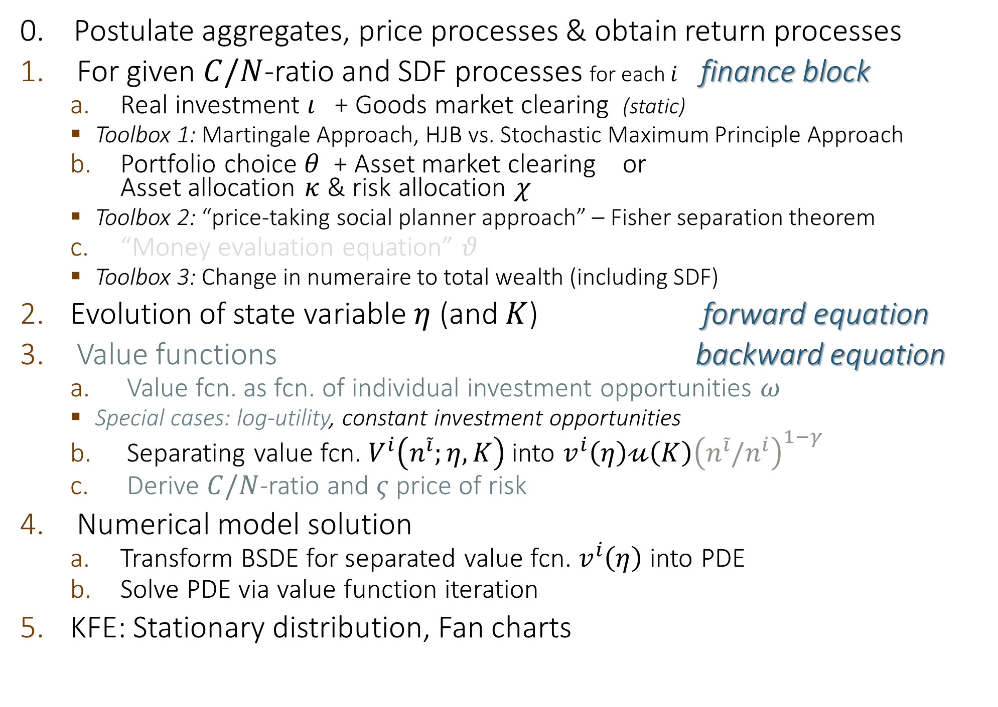
Solving MacroModels Step-by-Step
0. Postulate aggregates, price processes & obtain return processes
For given $C/N$-ratio and SDF processes for each $i$ finance block
  Real investment $ι$ + Goods market clearing (static)
    Toolbox 1: Martingale Approach, HJB vs. Stochastic Maximum Principle Approach
  Portfolio choice $θ$ + Asset market clearing or
  Asset allocation $κ$ & risk allocation $χ$
    Toolbox 2: “price-taking social planner approach” – Fisher separation theorem
  “Money evaluation equation” $θ$
    Toolbox 3: Change in numeraire to total wealth (including SDF)
Evolution of state variable $η$ (and $K$) forward equation
Value functions backward equation
  Value fcn. as fcn. of individual investment opportunities $ω$
    Special cases: log-utility, constant investment opportunities
  Separating value fcn. $V^{i}\left(n^{\tilde{i}};η,K\right)$ into $v^{i}\left(η\right)𝓊\left(K\right){\left(n^{\tilde{i}}/n^{i}\right)}^{1−γ}$
  Derive $C/N$-ratio and $ς$ price of risk
Numerical model solution
  Transform BSDE for separated value fcn. $v^{i}\left(η\right)$ into PDE
  Solve PDE via value function iteration
KFE: Stationary distribution, Fan charts
Log-utility

Slide 40
The Big Picture
allocation of
physical assets … risk
amplification
output capital price of risk $ς$
growth
consumption + investment
net worth
distribution
value function
$$κ=1$$
A
L
$$χ=1$$
accu-
mulation
Debt
Outside
equity
volatility
$$A(κ)$$
$$K$$
$$Φ\left(ι\right)−δ$$
Forward equation
$$ι$$
drift
drift
precautionary
$$η$$
volatility
Backward equation
with expectations

Slide 41
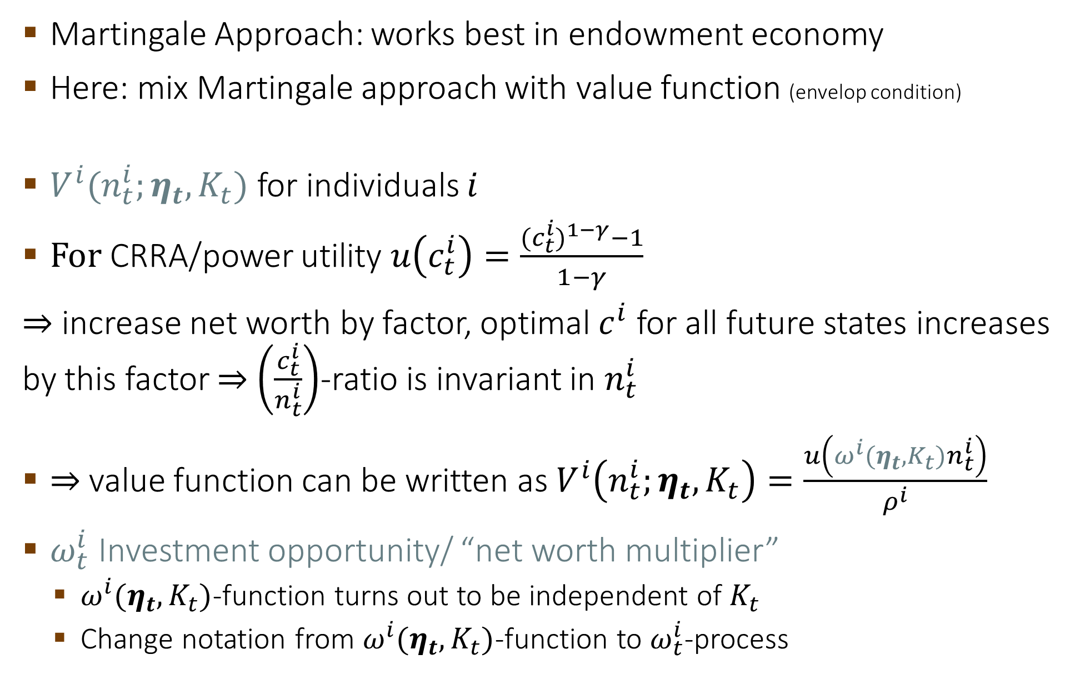
3a. CRRA Value Function
Applies separately for each type of agent
Martingale Approach: works best in endowment economy
Here: mix Martingale approach with value function (envelop condition)
$V^{i}(n_{t}^{i};η_{t},K_{t})$ for individuals $i$
For CRRA/power utility $u\left(c_{t}^{i}\right)=\frac{{(c_{t}^{i})}^{1−γ}−1}{1−γ}$
$⇒$ increase net worth by factor, optimal $c^{i}$ for all future states increases by this factor $⇒$ $\left(\frac{c_{t}^{i}}{n_{t}^{i}}\right)$-ratio is invariant in $n_{t}^{i}$
$⇒$value function can be written as $V^{i}\left(n_{t}^{i};η_{t},K_{t}\right)=\frac{u\left(ω^{i}(η_{t},K_{t})n_{t}^{i}\right)}{ρ^{i}}$
$ω_{t}^{i}$ Investment opportunity/ “net worth multiplier”
  $ω^{i}(η_{t},K_{t})$-function turns out to be independent of $K_{t}$
  Change notation from $ω^{i}(η_{t},K_{t})$-function to $ω_{t}^{i}$-process

Slide 42
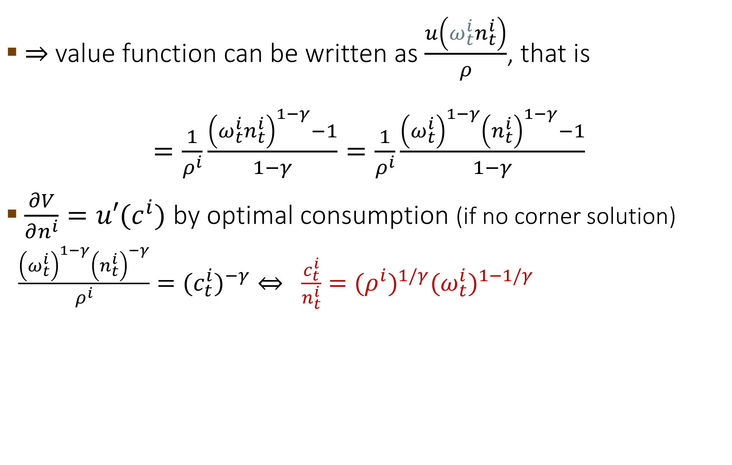
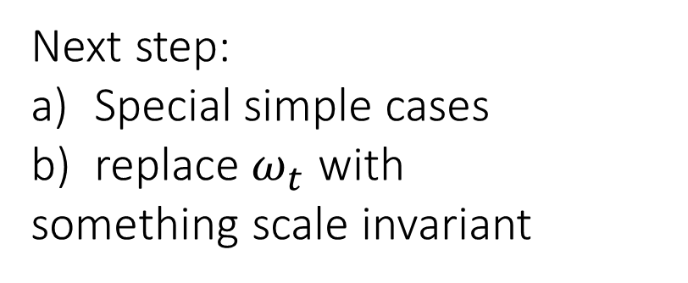
3a. CRRA Value Function: relate to $ω$
$⇒$value function can be written as $\frac{u\left(ω_{t}^{i}n_{t}^{i}\right)}{ρ}$, that is
$=\frac{1}{ρ^{i}}\frac{{\left(ω_{t}^{i}n_{t}^{i}\right)}^{1−γ}−1}{1−γ}=\frac{1}{ρ^{i}}\frac{{\left(ω_{t}^{i}\right)}^{1−γ}{\left(n_{t}^{i}\right)}^{1−γ}−1}{1−γ}$
$\frac{∂V}{∂n^{i}}=u′(c^{i})$ by optimal consumption (if no corner solution)
$\frac{{\left(ω_{t}^{i}\right)}^{1−γ}{\left(n_{t}^{i}\right)}^{−γ}}{ρ^{i}}={{(c}_{t}^{i})}^{−γ}⇔ \frac{c_{t}^{i}}{n_{t}^{i}}={{(ρ}^{i})}^{1/γ}{(ω_{t}^{i})}^{1−1/γ}$
Next step:
Special simple cases
replace $ω_{t}$ with
something scale invariant

Slide 43
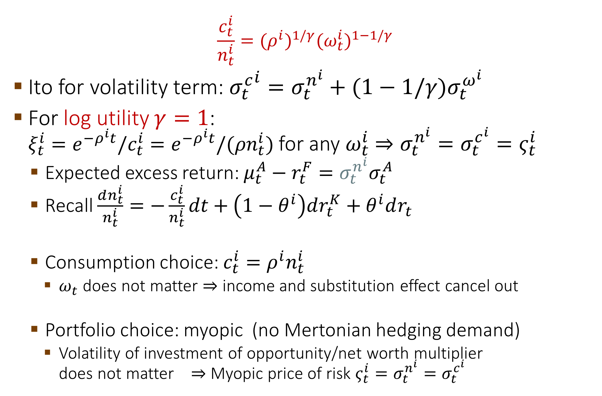
3a. CRRA Value Function: Special Case $\log{−}$utility
$$\frac{c_{t}^{i}}{n_{t}^{i}}={(ρ^{i})}^{1/γ}{(ω_{t}^{i})}^{1−1/γ}$$
Ito for volatility term: ${σ_{t}^{c}}^{i}=σ_{t}^{n^{i}}+(1−1/γ)σ_{t}^{ω^{i}}$
For log utility $γ=1$:
$ξ_{t}^{i}=e^{−ρ^{i}t}/c_{t}^{i}=e^{−ρ^{i}t}/{(ρn}_{t}^{i})$ for any $ω_{t}^{i}$ $⇒σ_{t}^{n^{i}}=σ_{t}^{c^{i}}=ς_{t}^{i}$
  Expected excess return: $μ_{t}^{A}−r_{t}^{F}={σ_{t}^{n^{i}}σ}_{t}^{A}$
  Recall $\frac{dn_{t}^{i}}{n_{t}^{i}}=−\frac{c_{t}^{i}}{n_{t}^{i}}dt+\left(1−θ^{i}\right)dr_{t}^{K}+θ^{i}dr_{t}$
  Consumption choice: $c_{t}^{i}=ρ^{i}n_{t}^{i}$
    $ω_{t}$ does not matter $⇒$ income and substitution effect cancel out
  Portfolio choice: myopic (no Mertonian hedging demand)
    Volatility of investment of opportunity/net worth multiplier
    does not matter $⇒$ Myopic price of risk $ς_{t}^{i}=σ_{t}^{n^{i}}=σ_{t}^{c^{i}}$
Notes:
Answer: d

Slide 44
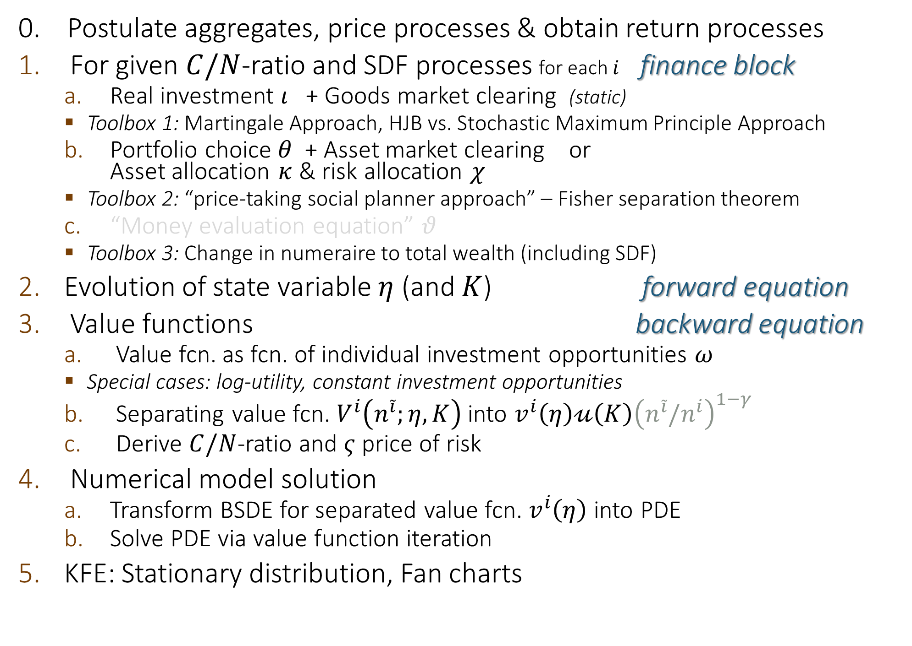
Solving MacroModels Step-by-Step
0. Postulate aggregates, price processes & obtain return processes
For given $C/N$-ratio and SDF processes for each $i$ finance block
  Real investment $ι$ + Goods market clearing (static)
    Toolbox 1: Martingale Approach, HJB vs. Stochastic Maximum Principle Approach
  Portfolio choice $θ$ + Asset market clearing or
  Asset allocation $κ$ & risk allocation $χ$
    Toolbox 2: “price-taking social planner approach” – Fisher separation theorem
  “Money evaluation equation” $θ$
    Toolbox 3: Change in numeraire to total wealth (including SDF)
Evolution of state variable $η$ (and $K$) forward equation
Value functions backward equation
  Value fcn. as fcn. of individual investment opportunities $ω$
    Special cases: log-utility, constant investment opportunities
  Separating value fcn. $V^{i}\left(n^{\tilde{i}};η,K\right)$ into $v^{i}\left(η\right)𝓊\left(K\right){\left(n^{\tilde{i}}/n^{i}\right)}^{1−γ}$
  Derive $C/N$-ratio and $ς$ price of risk
Numerical model solution
  Transform BSDE for separated value fcn. $v^{i}\left(η\right)$ into PDE
  Solve PDE via value function iteration
KFE: Stationary distribution, Fan charts
Log-utility

Slide 45

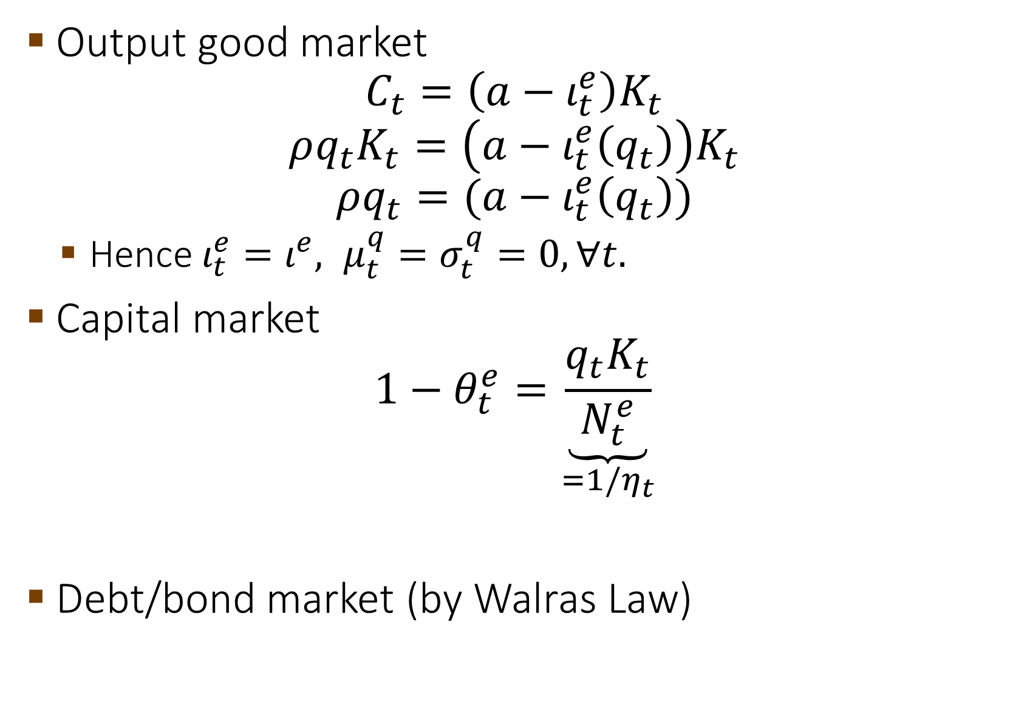
Recall: Market Clearing
Output good market
$C_{t}=\left(a−ι_{t}^{e}\right)K_{t}$
$$ρq_{t}K_{t}=\left(a−ι_{t}^{e}\left(q_{t}\right)\right)K_{t}$$
$$ρq_{t}=(a−ι_{t}^{e}\left(q_{t}\right))$$
  Hence ${ι_{t}^{e}=ι^{e}, μ}_{t}^{q}=σ_{t}^{q}=0,∀t.$
Capital market
$$1−θ_{t}^{e}=\underset{=1{/η}_{t}}{\underbrace{\frac{q_{t}K_{t}}{N_{t}^{e}}}}$$
Debt/bond market (by Walras Law)
$$⇒q_{t}=q, ∀t$$

Slide 46
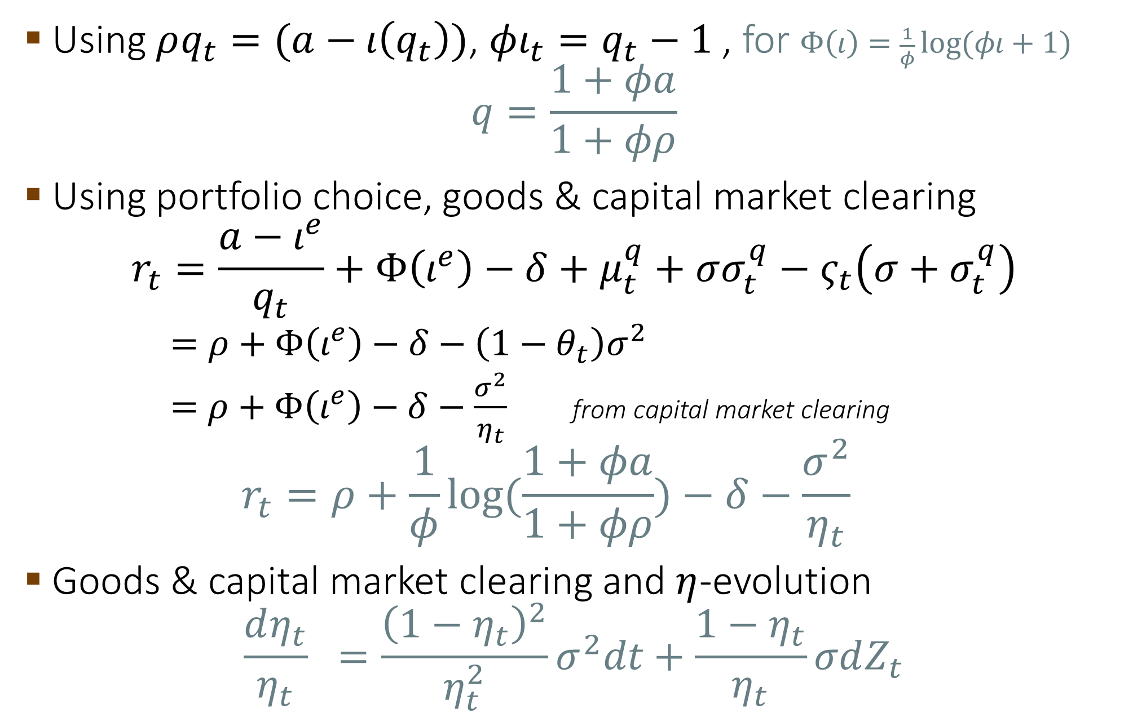
4b. Model Solution
Using $ρq_{t}=(a−ι\left(q_{t}\right))$, $φι_{t}=q_{t}−1$ , for $Φ\left(ι\right)=\frac{1}{φ}\log{(φι+1)}$
$$q=\frac{1+φa}{1+φρ}$$
Using portfolio choice, goods & capital market clearing
$$r_{t}=\frac{a−ι^{e}}{q_{t}}+Φ\left(ι^{e}\right)−δ+μ_{t}^{q}+σσ_{t}^{q}−ς_{t}\left(σ+σ_{t}^{q}\right)$$
  $=ρ+Φ\left(ι^{e}\right)−δ−\left(1−θ_{t}\right)σ^{2}$
  $=$ $ρ+Φ\left(ι^{e}\right)−δ−\frac{σ^{2}}{η_{t}}$ from capital market clearing
  $$r_{t}=ρ+\frac{1}{φ}\log{(\frac{1+φa}{1+φρ})}−δ−\frac{σ^{2}}{η_{t}}$$
Goods & capital market clearing and $η$-evolution
$$\frac{dη_{t}}{η_{t}} =\frac{{\left(1−η_{t}\right)}^{2}}{η_{t}^{2}}σ^{2}dt+\frac{1−η_{t}}{η_{t}}σdZ_{t}$$
risk-free rate

Slide 47
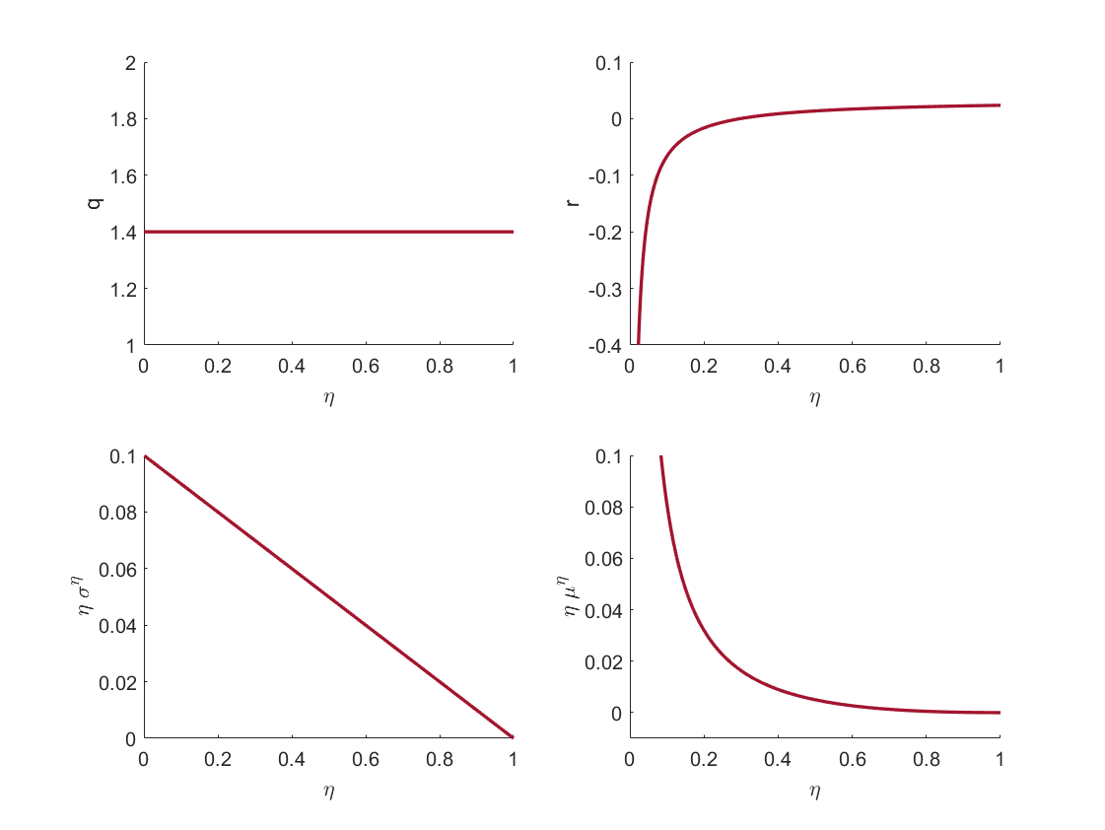
Numerical example
$$a=.11,ρ=5\%,σ=.1,Φ\left(ι\right)=\frac{\log\left(φι+1\right)}{φ},φ=10$$

Slide 48
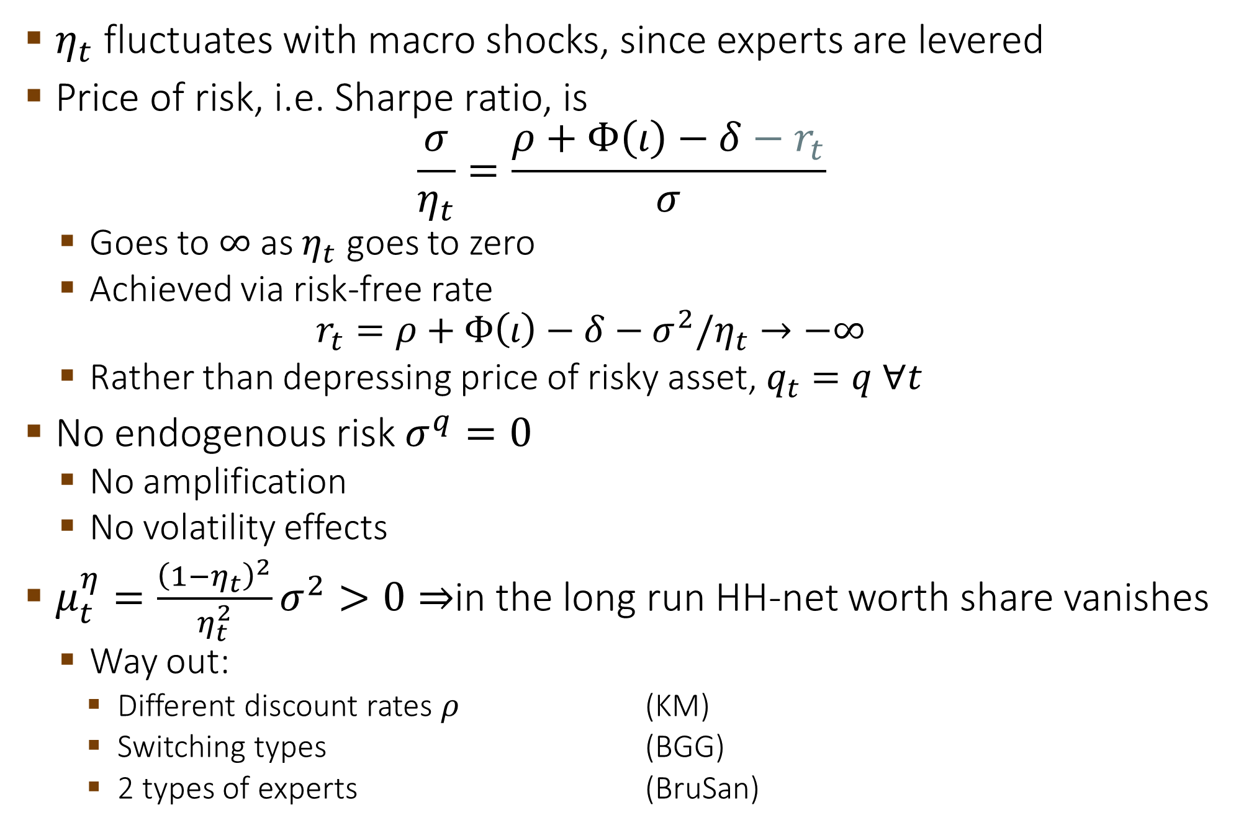
Observation of Basak-Cuoco Model
$η_{t}$ fluctuates with macro shocks, since experts are levered
Price of risk, i.e. Sharpe ratio, is
$$\frac{σ}{η_{t}}=\frac{ρ+Φ\left(ι\right)−δ−r_{t}}{σ}$$
  Goes to $∞$ as $η_{t}$ goes to zero
  Achieved via risk-free rate
  $$r_{t}=ρ+Φ\left(ι\right)−δ−σ^{2}/η_{t}→−∞$$
  Rather than depressing price of risky asset, $q_{t}=q ∀t$
No endogenous risk $σ^{q}=0$
  No amplification
  No volatility effects
$μ_{t}^{η}=\frac{{\left(1−η_{t}\right)}^{2}}{η_{t}^{2}}σ^{2}>0⇒$in the long run HH-net worth share vanishes
  Way out:
    Different discount rates $ρ$ (KM)
    Switching types (BGG)
    2 types of experts (BruSan)

Slide 49
Desired Model Properties
Normal regime: stable around steady state
  Experts are adequately capitalized
  Experts can absorb macro shock
Endogenous risk and price of risk
  Fire-sales, liquidity spirals, fat tails
  Spillovers across assets and agents
  Market and funding liquidity connection
  SDF vs. cash-flow news
Volatility paradox
Financial innovation less stable economy
(“Net worth trap” double-humped stationary distribution)

Slide 50
Modern Macro, Money, and
International Finance
Princeton Initiative 2023
Endogenous Risk Dynamics in
Real Macro Model with Heterogenous Agents
Markus K. Brunnermeier
Princeton University

Slide 51
Course Overview
Real Macro-Finance Models with Heterogeneous Agents
A Simple Real Macro-finance Model
Endogenous (Price of) Risk Dynamics
A Model with Jumps due to Sudden Stops/Runs
Money Models
A Simple Money Model
Cashless vs. Cash Economy and “The I Theory of Money”
Welfare Analysis & Optimal Policy
  Fiscal, Monetary, and Macroprudential Policy
International Macro-Finance Models
International Financial Architecture
Digital Money

Slide 52
Risk premia, price of risk
Risk premia = price of risk * (endogenous + exogenous risk)
  Exogenous risk – shock from outside
  Endogenous risk
    Amplification: adverse feedback loops
    Multiple equilibria: Run, Sudden Stops
Non-linearities are key for financial stability
  Around vs. away from steady state

Slide 53
Desired Model Properties
Normal regime: stable around steady state
  Experts are adequately capitalized
  Experts can absorb macro shock
Endogenous risk and price of risk
  Fire-sales, liquidity spirals, fat tails
  Spillovers across assets and agents
  Market and funding liquidity connection
  SDF vs. cash-flow news
Volatility paradox
Financial innovation less stable economy
(“Net worth trap” double-humped stationary distribution)

Slide 54
Persistence Leads to Dynamic Amplification
Static amplification occurs because fire-sales of capital
from productive sector to less productive sector depress asset prices
  Importance of market liquidity of physical capital
Dynamic amplification occurs because a
temporary shock translates into a
persistent decline in output and asset prices
  Forward grow net worth via retained earnings
  Backward asset pricing

Slide 55
“Single Shock Critique”
Critique: After the shock all agents in the economy know that the economy will deterministically return to the steady state.
  Length of slump is deterministic (and commonly known)
    No safety cushion needed
  In reality an adverse shock may be followed by additional adverse shocks
    Build-up extra safety cushion for an additional shock in a crisis
Impulse response vs. volatility dynamics

Slide 56
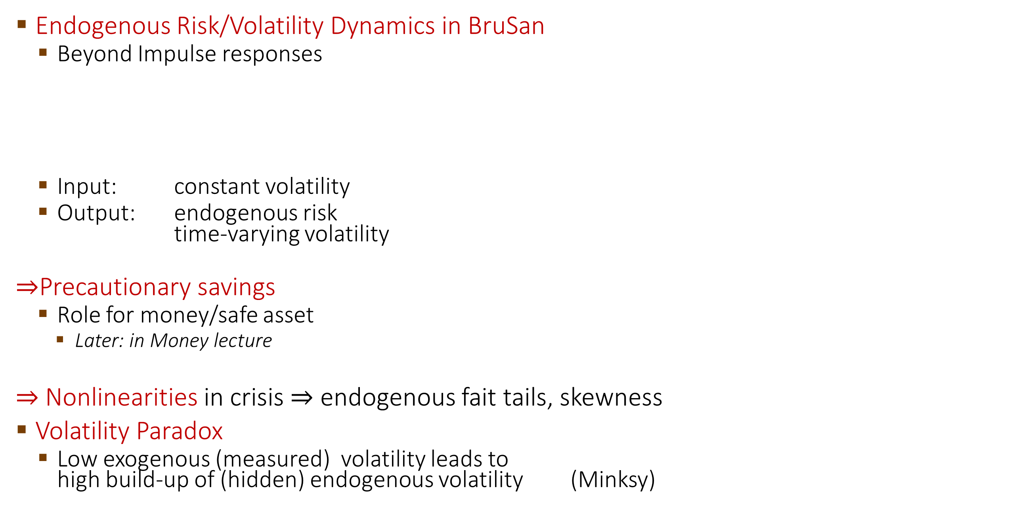
Endogenous Volatility & Volatility Paradox
Endogenous Risk/Volatility Dynamics in BruSan
  Beyond Impulse responses
  Input: constant volatility
  Output: endogenous risk
  time-varying volatility
$⇒$Precautionary savings
  Role for money/safe asset
    Later: in Money lecture
$⇒$Nonlinearities in crisis $⇒$ endogenous fait tails, skewness
Volatility Paradox
  Low exogenous (measured) volatility leads to
  high build-up of (hidden) endogenous volatility (Minksy)
Stochastic steady state

Slide 57
Toolboxes: Technical Innovations
Occasionally binding equity issuance constraint
(in addition to natural borrowing limit due to risk aversion)
Price setting social planner to find capital and risk allocation
Change of numeraire
  Easily incorporate aggregate fluctuations
  To use martingale methods more broadly
Newton Method to solve log-utility numerical example

Slide 58

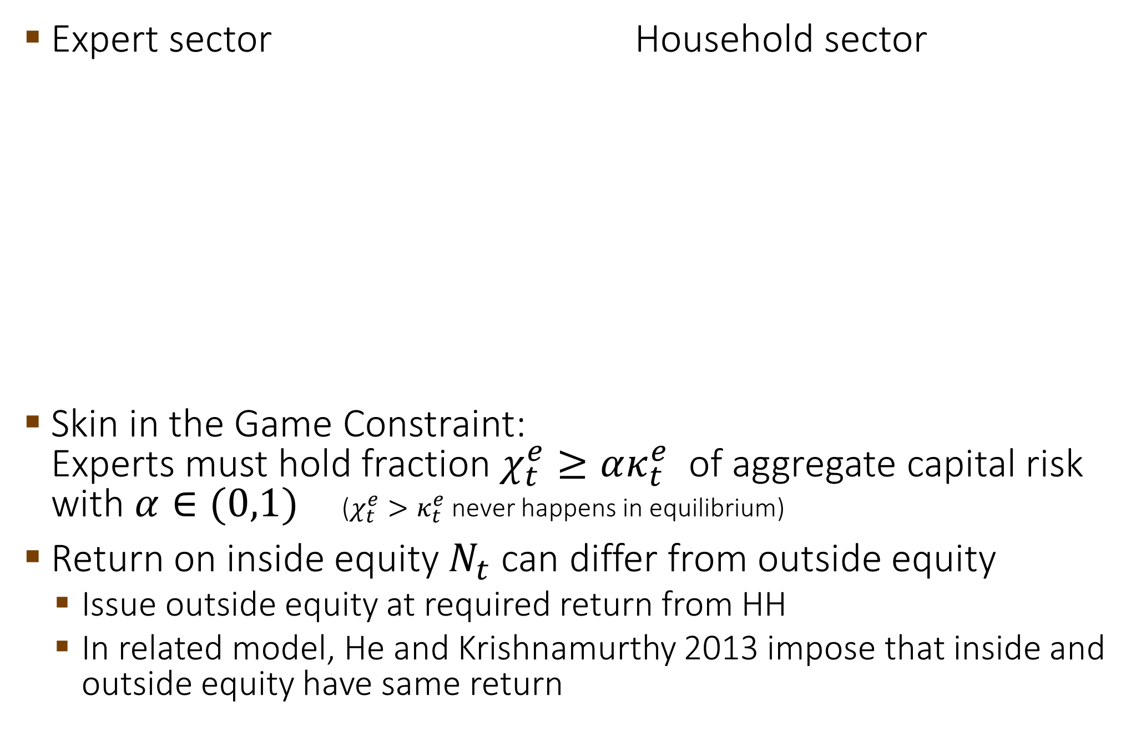
Two Type/Sector Model with Outside Equity
BruSan 2017:
Handbook of Macroeconomics,
Lecture Notes, Chatper 3
Expert sector Household sector
Skin in the Game Constraint:
Experts must hold fraction $χ_{t}^{e}≥ακ_{t}^{e}$ of aggregate capital risk with $α∈(0,1)$ ($χ_{t}^{e}>κ_{t}^{e}$ never happens in equilibrium)
Return on inside equity $N_{t}$ can differ from outside equity
  Issue outside equity at required return from HH
  In related model, He and Krishnamurthy 2013 impose that inside and outside equity have same return
A
L
A
L
Capital
$$κ_{t}^{e}q_{t}K_{t}$$
Debt
Loans
Net worth
$$q_{t}K_{t}−N_{t}^{e}$$
$$N_{t}^{e}$$
Outside equity
Equity
Capital
$$κ_{t}^{h}q_{t}K_{t}$$
$$≥ακ_{t}^{e}$$

Slide 59
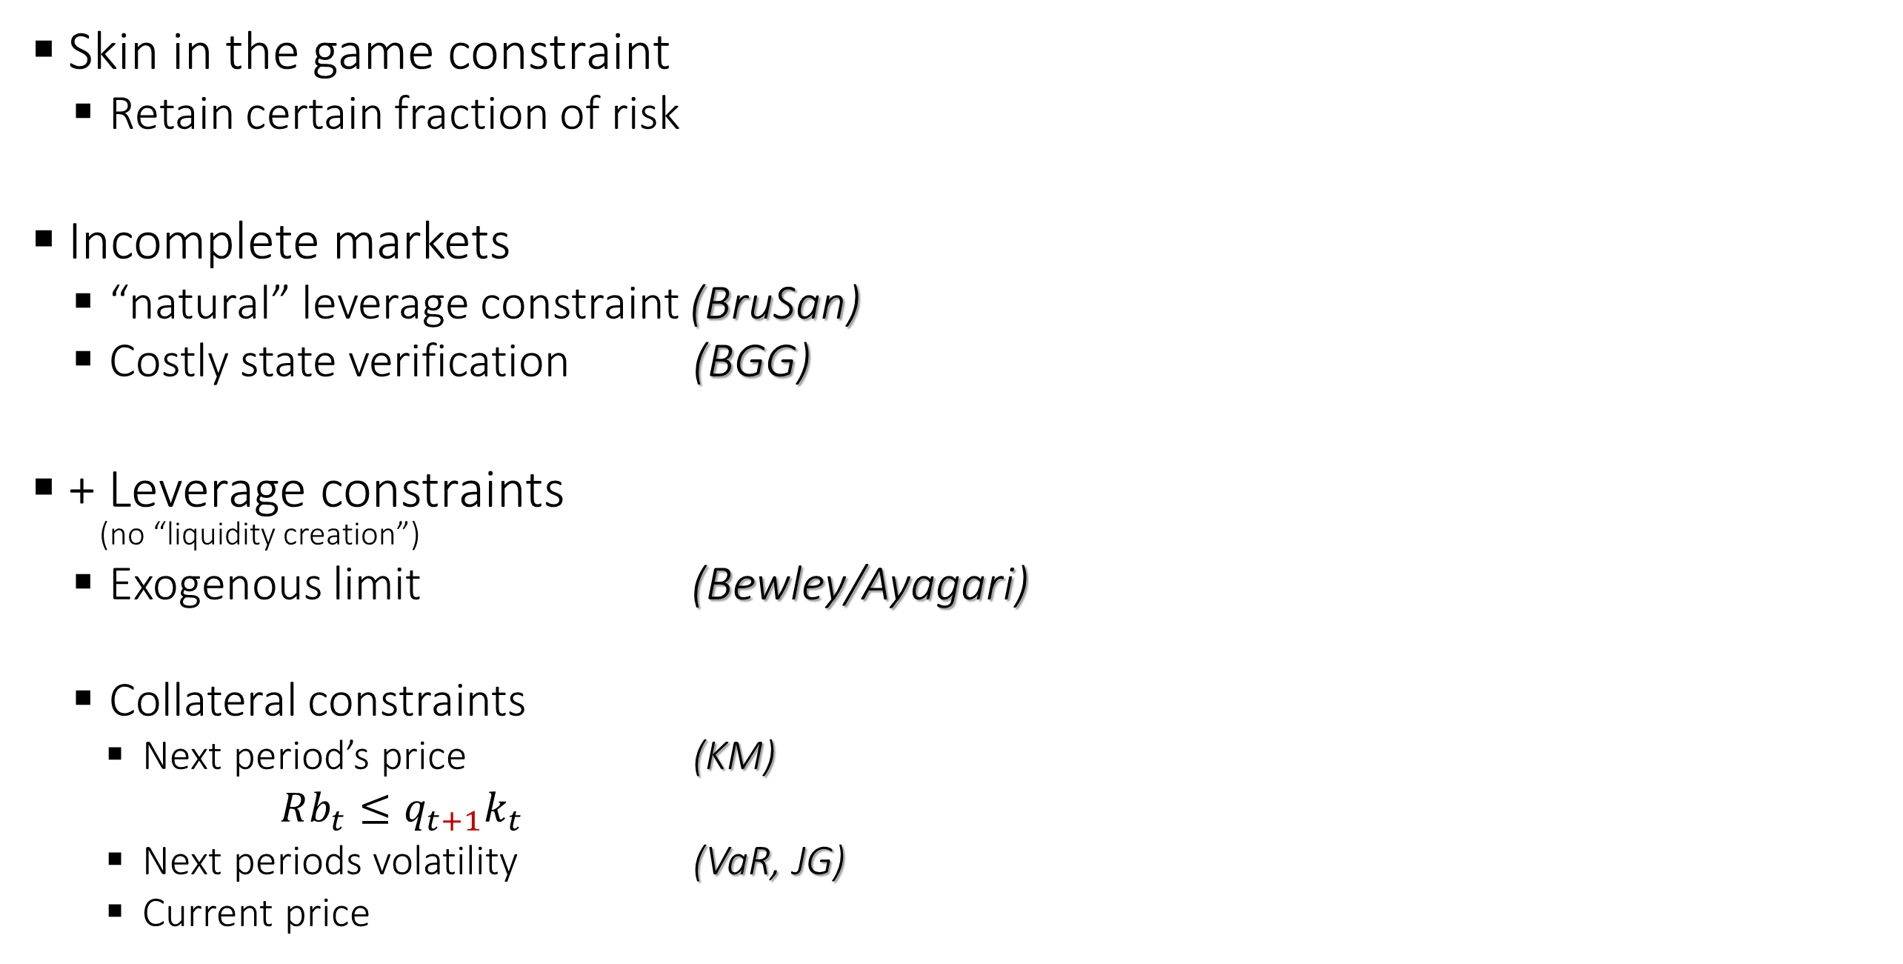
Financial Frictions and Distortions UPDATE!
state 2
Skin in the game constraint
  Retain certain fraction of risk
Incomplete markets
  “natural” leverage constraint (BruSan)
  Costly state verification (BGG)
+ Leverage constraints
(no “liquidity creation”)
  Exogenous limit (Bewley/Ayagari)
  Collateral constraints
    Next period’s price (KM)
    $Rb_{t}≤q_{t+1}k_{t}$
    Next periods volatility (VaR, JG)
    Current price
Occasionally binding
equity constraint
state 1

Slide 60




Two Type Model Setup
Expert sector
Output: $y_{t}^{e}=a^{e}k_{t}^{e}$
Consumption rate: $c_{t}^{e}$
Investment rate: $ι_{t}^{e}$
$\frac{dk_{t}^{\tilde{i},e}}{k_{t}^{\tilde{i},e}}=\left(Φ\left(ι_{t}^{\tilde{i},e}\right)−δ\right)dt+σdZ_{t}+\tilde{σ}d{\tilde{Z}}_{t}^{\tilde{i}}$
$E_{0}[\int_{0}^{∞}{e^{−ρ^{e}t}\frac{{{(c}_{t}^{e})}^{1−γ} }{1−γ}dt]}$
Friction: Can only issue
Risk-free debt
Equity, but most hold $χ_{t}^{e}≥ακ_{t}$
Household sector
Output: $y_{t}^{h}=a^{h}k_{t}^{h}$
Consumption rate:$c_{t}^{h}$
Investment rate: $ι_{t}^{h}$
$$\frac{dk_{t}^{\tilde{i},h}}{k_{t}^{\tilde{i},h}}=\left(Φ\left(ι_{t}^{\tilde{i},h}\right)−δ\right)dt+σdZ_{t}+\tilde{σ}d{\tilde{Z}}_{t}^{\tilde{i}}$$
$E_{0}[\int_{0}^{∞}{e^{−ρ^{h}t}\frac{{{(c}_{t}^{h})}^{1−γ} }{1−γ}dt]}$
$$a^{e}≥a^{h}$$
$$A\left(κ\right)=κ^{e}a^{e}+(1−κ^{e})a^{h}$$
Capital share
of experts
Poll 60: Why is it important that households can hold capital?
a) to capture fire-sales
b) for households to speculate
c) to obtain stationary distribution

Slide 61


Two Type Model Setup
Expert sector
Output: $y_{t}^{e}=a^{e}k_{t}^{e}$
Consumption rate: $c_{t}^{e}$
Investment rate: $ι_{t}^{e}$
$$\frac{dk_{t}^{\tilde{i},e}}{k_{t}^{\tilde{i},e}}=\left(Φ\left(ι_{t}^{\tilde{i},e}\right)−δ\right)dt+σdZ_{t}+dΔ_{t}^{k,e}$$
$E_{0}[\int_{0}^{∞}{e^{−ρ^{e}t}\frac{{{(c}_{t}^{e})}^{1−γ} }{1−γ}dt]}$
Friction: Can only issue
Risk-free debt
Equity, but most hold $χ_{t}^{e}≥ακ_{t}$
Household sector
Output: $y_{t}^{h}=a^{h}k_{t}^{h}$
Consumption rate:$c_{t}^{h}$
Investment rate: $ι_{t}^{h}$
$$\frac{dk_{t}^{\tilde{i},h}}{k_{t}^{\tilde{i},h}}=\left(Φ\left(ι_{t}^{\tilde{i},h}\right)−δ\right)dt+σdZ_{t}+dΔ_{t}^{k,h}$$
$E_{0}[\int_{0}^{∞}{e^{−ρ^{h}t}\frac{{{(c}_{t}^{h})}^{1−γ} }{1−γ}dt]}$
$$a^{e}≥a^{h}$$
Physical capital evolution absent market transactions/fire-sales

Slide 62

Two Type Model Setup
Expert sector
Output: $y_{t}^{e}=a^{e}k_{t}^{e}$
Consumption rate: $c_{t}^{e}$
Investment rate: $ι_{t}^{e}$
$$\frac{dk_{t}^{\tilde{i},e}}{k_{t}^{\tilde{i},e}}=\left(Φ\left(ι_{t}^{\tilde{i},e}\right)−δ\right)dt+σdZ_{t}+dΔ_{t}^{k,e}$$
$E_{0}[\int_{0}^{∞}{e^{−ρ^{e}t}\frac{{{(c}_{t}^{e})}^{1−γ} }{1−γ}dt]}$
Friction: Can only issue
Risk-free debt
Equity, but most hold $χ_{t}^{e}≥ακ_{t}$
Household sector
Output: $y_{t}^{h}=a^{h}k_{t}^{h}$
Consumption rate:$c_{t}^{h}$
Investment rate: $ι_{t}^{h}$
$$\frac{dk_{t}^{\tilde{i},h}}{k_{t}^{\tilde{i},h}}=\left(Φ\left(ι_{t}^{\tilde{i},h}\right)−δ\right)dt+σdZ_{t}+dΔ_{t}^{k,h}$$
  $E_{0}[\int_{0}^{∞}{e^{−ρ^{h}t}\frac{{{(c}_{t}^{h})}^{1−γ} }{1−γ}dt]}$
$$a^{e}≥a^{h}$$
Poll 62: What are the modeling tricks to obtain stationary distribution?
a) switching types
b) agents die, OLG/perpetual youth models (without bequest motive)
c) different preference discount rates

Slide 63



Two Type Model Setup
Expert sector
Output: $y_{t}^{e}=a^{e}k_{t}^{e}$
Consumption rate: $c_{t}^{e}$
Investment rate: $ι_{t}^{e}$
$$\frac{dk_{t}^{\tilde{i},e}}{k_{t}^{\tilde{i},e}}=\left(Φ\left(ι_{t}^{\tilde{i},e}\right)−δ\right)dt+σdZ_{t}+dΔ_{t}^{k,e}$$
$E_{0}[\int_{0}^{∞}{e^{−ρ^{e}t}\frac{{{(c}_{t}^{e})}^{1−γ} }{1−γ}dt]}$
Friction: Can only issue
Risk-free debt
Equity, but most hold $χ_{t}^{e}≥ακ_{t}$
Household sector
Output: $y_{t}^{h}=a^{h}k_{t}^{h}$
Consumption rate:$c_{t}^{h}$
Investment rate: $ι_{t}^{h}$
$$\frac{dk_{t}^{\tilde{i},h}}{k_{t}^{\tilde{i},h}}=\left(Φ\left(ι_{t}^{\tilde{i},h}\right)−δ\right)dt+σdZ_{t}+dΔ_{t}^{k,h}$$
$E_{0}[\int_{0}^{∞}{e^{−ρ^{h}t}\frac{{{(c}_{t}^{h})}^{1−γ} }{1−γ}dt]}$
$$a^{e}≥a^{h}$$
$$ρ^{e}≥ρ^{h}$$

Slide 64


Two Type Model Setup
Expert sector
Output: $y_{t}^{e}=a^{e}k_{t}^{e}$
Consumption rate: $c_{t}^{e}$
Investment rate: $ι_{t}^{e}$
$$\frac{dk_{t}^{\tilde{i},e}}{k_{t}^{\tilde{i},e}}=\left(Φ\left(ι_{t}^{\tilde{i},e}\right)−δ\right)dt+σdZ_{t}+dΔ_{t}^{k,e}$$
$E_{0}[\int_{0}^{∞}{e^{−ρ^{e}t}\frac{{{(c}_{t}^{e})}^{1−γ} }{1−γ}dt]}$
Friction: Can only issue
Risk-free debt
Equity, but must hold $χ_{t}^{e}≥ακ_{t}$
Household sector
Output: $y_{t}^{h}=a^{h}k_{t}^{h}$
Consumption rate:$c_{t}^{h}$
Investment rate: $ι_{t}^{h}$
$$\frac{dk_{t}^{\tilde{i},h}}{k_{t}^{\tilde{i},h}}=\left(Φ\left(ι_{t}^{\tilde{i},h}\right)−δ\right)dt+σdZ_{t}+dΔ_{t}^{k,h}$$
$E_{0}[\int_{0}^{∞}{e^{−ρ^{h}t}\frac{{{(c}_{t}^{h})}^{1−γ} }{1−γ}dt]}$
$$a^{e}≥a^{h}$$
$$ρ^{e}≥ρ^{h}$$

Slide 65

Solving MacroModels Step-by-Step
0. Postulate aggregates, price processes & obtain return processes
For given $C/N$-ratio and SDF processes for each $i$ finance block
  Real investment $ι$ + Goods market clearing (static)
    Toolbox 1: Martingale Approach, HJB vs. Stochastic Maximum Principle Approach
  Portfolio choice $θ$ + Asset market clearing or
  Asset allocation $κ$ & risk allocation $χ$
    Toolbox 2: “price-taking social planner approach” – Fisher separation theorem
  “Money evaluation equation” $θ$
    Toolbox 3: Change in numeraire to total wealth (including SDF)
Evolution of state variable $η$ (and $K$) forward equation
Value functions backward equation
  Value fcn. as fcn. of individual investment opportunities $ω$
    Special cases: log-utility, constant investment opportunities
  Separating value fcn. $V^{i}\left(n^{\tilde{i}};η,K\right)$ into $v^{i}\left(η\right)𝓊\left(K\right){\left(n^{\tilde{i}}/n^{i}\right)}^{1−γ}$
  Derive $C/N$-ratio and $ς$ price of risk
Numerical model solution
  Transform BSDE for separated value fcn. $v^{i}\left(η\right)$ into PDE
  Solve PDE via value function iteration
KFE: Stationary distribution, Fan charts

Slide 66


The Big Picture
allocation of
physical assets … risk
amplification
output capital price of risk $ς$
growth
consumption + investment
net worth
distribution
value function
$$κ$$
$$χ≥\underline{χ}$$
A
L
accu-
mulation
Debt
Outside
equity
volatility
$$A(κ)$$
$$K$$
$$Φ\left(ι\right)−δ$$
Forward equation
$$ι$$
drift
drift
precautionary
$$η$$
volatility
Backward equation
with expectations

Slide 67

2. GE: Markov States and Equilibria
Equilibrium is a map
Histories of shocks prices $q_{t}, ς_{t}^{i}, ι_{t}^{i},θ_{t}^{i}$
$\left\{Z_{s}, s∈[0,t]\right\}$
net worth distribution
$η_{t}^{e}=\frac{N_{t}^{e}}{q_{t}K_{t}}∈\left(0,1\right)$
net worth share
  All agents maximize utility
    Choose: portfolio, consumption, technology
  All markets clear
    Consumption, capital, money, outside equity

Slide 68

2. Law of Motion of Wealth Share $η_{t}$
Method 1: Using Ito’s quotation rule $η_{t}^{i}={N_{t}^{i}}/{(q_{t}K_{t})}$
  Recall
  $\frac{dN_{t}^{i}}{N_{t}^{i}}=r_{t}dt+\underset{risk}{\underbrace{\frac{χ_{t}^{i}}{η_{t}^{i}}(σ+σ_{t}^{q})}}\underset{\begin{aligned}price of \\ risk\end{aligned}}{\underbrace{ς_{t}^{i}}}dt+\frac{χ_{t}^{i}}{η_{t}^{i}}\left(σ+σ_{t}^{q}\right)dZ_{t}−\frac{C_{t}^{i}}{N_{t}^{i}}dt$
  $\frac{dη_{t}^{i}}{η_{t}^{i}} =…+$ + $\frac{χ_{t}^{i}−η_{t}^{i}}{η_{t}^{i}}\left(σ+σ_{t}^{q}\right)dZ_{t}−…$ (lots of algebra)
Method 2: Change of numeraire + Martingale Approach
  New numeraire: Total wealth in the economy, $N_{t}$
  Apply Martingale Approach for value of $i$’s portfolio
    Simple algebra to obtain drift of $η_{t}^{i}$: $μ_{t}^{η^{i}}$
    Note that change of numeraire does not affect ratio $η^{i}$!
Notes:
Is the \kappa needed? Might be old notation.

Slide 69

2. Amplification Formula: Loss Spiral
Recall $σ_{t}^{η^{e}}=\underset{\text{leverage}}{\underbrace{\frac{χ_{t}^{e}−η_{t}^{e}}{η_{t}^{e}}}}(σ+σ_{t}^{q})$
By Ito’s Lemma on $q(η^{e})$ $σ_{t}^{q}=\frac{q^{′}\left(η_{t}^{e}\right)}{q(η_{t}^{e})}η_{t}^{e}σ_{t}^{η^{e}}$
$$σ_{t}^{q}=\underset{elasticity }{\underbrace{\frac{q^{′}(η_{t}^{e})}{q/η_{t}^{e}}}}\frac{χ_{t}^{e}−η_{t}^{e}}{η_{t}^{e}}\left(σ+σ_{t}^{q}\right)$$
Total volatility
$σ+σ_{t}^{q}=\frac{σ}{1−\frac{q^{′}\left(η_{t}^{e}\right)}{q/η_{t}^{e}}\frac{χ_{t}^{e}−η_{t}^{e}}{η_{t}^{e}}}$
Loss spiral
  Market illiquidity (price impact elasticity)

Slide 70

Solving MacroModels Step-by-Step
0. Postulate aggregates, price processes & obtain return processes
For given $C/N$-ratio and SDF processes for each $i$ finance block
  Real investment $ι$ + Goods market clearing (static)
    Toolbox 1: Martingale Approach, HJB vs. Stochastic Maximum Principle Approach
  Portfolio choice $θ$ + Asset market clearing or
  Asset allocation $κ$ & risk allocation $χ$
    Toolbox 2: “price-taking social planner approach” – Fisher separation theorem
  “Money evaluation equation” $θ$
    Toolbox 3: Change in numeraire to total wealth (including SDF)
Evolution of state variable $η$ (and $K$) forward equation
Value functions backward equation
  Value fcn. as fcn. of individual investment opportunities $ω$
    Special cases: log-utility, constant investment opportunities
  Separating value fcn. $V^{i}\left(n^{\tilde{i}};η,K\right)$ into $v^{i}\left(η\right)𝓊\left(K\right){\left(n^{\tilde{i}}/n^{i}\right)}^{1−γ}$
  Derive $C/N$-ratio and $ς$ price of risk
Numerical model solution
  Transform BSDE for separated value fcn. $v^{i}\left(η\right)$ into PDE
  Solve PDE via value function iteration
KFE: Stationary distribution, Fan charts

Slide 71







Solution
Price of capital Amplification
$$κ_{t}^{e}<1$$
$$κ_{t}^{e}=1$$
$$κ_{t}^{e}<1$$
$$κ_{t}^{e}=1$$
Normal region
Normal region
Crisis region
Crisis region
Parameters: $ρ^{e}=.06, ρ^{h}=.05, a^{e}=.11, a^{h}=.03,$
$δ=.05, σ=.1, α=.50, γ=2, φ=10$

Slide 72


Volatility Paradox
Comparative Static w.r.t. $σ=$.01,.05,.1

Slide 73


Risk Sharing via Outside Equity
Comparative Static w.r.t. Risk sharing $α=$ .1,.2, .5
(skin the game constraint)

Slide 74

Market Liquidity
Comparative static w.r.t. $a^{h}=.03,−.03,−.09$

Slide 75

Solving MacroModels Step-by-Step
0. Postulate aggregates, price processes & obtain return processes
For given $C/N$-ratio and SDF processes for each $i$ finance block
  Real investment $ι$ + Goods market clearing (static)
    Toolbox 1: Martingale Approach, HJB vs. Stochastic Maximum Principle Approach
  Portfolio choice $θ$ + Asset market clearing or
  Asset allocation $κ$ & risk allocation $χ$
    Toolbox 2: “price-taking social planner approach” – Fisher separation theorem
  “Money evaluation equation” $θ$
    Toolbox 3: Change in numeraire to total wealth (including SDF)
Evolution of state variable $η$ (and $K$) forward equation
Value functions backward equation
  Value fcn. as fcn. of individual investment opportunities $ω$
    Special cases: log-utility, constant investment opportunities
  Separating value fcn. $V^{i}\left(n^{\tilde{i}};η,K\right)$ into $v^{i}\left(η\right)𝓊\left(K\right){\left(n^{\tilde{i}}/n^{i}\right)}^{1−γ}$
  Derive $C/N$-ratio and $ς$ price of risk
Numerical model solution
  Transform BSDE for separated value fcn. $v^{i}\left(η\right)$ into PDE
  Solve PDE via value function iteration
KFE: Stationary distribution, Fan charts

Slide 76











From $μ^{η^{e}}(η^{e})$ & $σ^{η^{e}}\left(η^{e}\right)$ to Stationary Distribution
Drift and Volatility of $η^{e}$
$$η^{e}=ακ^{e}$$
“Steady state” $η^{∗}$,
HHs’ short-sale constraint of
capital binds, $κ_{t}^{e}=1$
HHs’ short-sale constraint of
capital binds, $κ_{t}^{e}=1$
Case 1a
Case 1b
Case 2a
Case 1a
Case 1b
Case 2a
$$η$$
$$η$$
Experts’ skin in the game
constraint binds, $χ_{t}^{e}=ακ_{t}^{e}$
Experts’ skin in the game
constraint binds, $χ_{t}^{e}=ακ_{t}^{e}$
76

Slide 77

5. Kolmogorov Forward Equation
Given an initial distribution $f\left(η,0\right)=f_{0}\left(η\right),$
the density diffusion follows PDE
$$\frac{∂f\left(η,t\right)}{∂t}=−\frac{∂\left[f\left(η,t\right)μ\left(η\right)\right]}{∂η}+\frac{1}{2}\frac{∂^{2}[f\left(η,t\right)σ^{2}\left(η\right)]}{∂η^{2}}$$
“Kolmogorov Forward Equation” is in physics referred to as “Fokker-Planck Equation”
Corollary: if stationary distribution $f(η)$ exists, it satisfies the ODE
$$0=−\frac{∂\left[f\left(η,t\right)μ\left(η\right)\right]}{∂η}+\frac{1}{2}\frac{∂^{2}[f\left(η,t\right)σ^{2}\left(η\right)] }{∂η^{2}}$$

Slide 78

Solving MacroModels Step-by-Step
0. Postulate aggregates, price processes & obtain return processes
For given $C/N$-ratio and SDF processes for each $i$ finance block
  Real investment $ι$ + Goods market clearing (static)
    Toolbox 1: Martingale Approach, HJB vs. Stochastic Maximum Principle Approach
  Portfolio choice $θ$ + Asset market clearing or
  Asset allocation $κ$ & risk allocation $χ$
    Toolbox 2: “price-taking social planner approach” – Fisher separation theorem
  “Money evaluation equation” $θ$
    Toolbox 3: Change in numeraire to total wealth (including SDF)
Evolution of state variable $η$ (and $K$) forward equation
Value functions backward equation
  Value fcn. as fcn. of individual investment opportunities $ω$
    Special cases: log-utility, constant investment opportunities
  Separating value fcn. $V^{i}\left(n^{\tilde{i}};η,K\right)$ into $v^{i}\left(η\right)𝓊\left(K\right){\left(n^{\tilde{i}}/n^{i}\right)}^{1−γ}$
  Derive $C/N$-ratio and $ς$ price of risk
Numerical model solution
  Transform BSDE for separated value fcn. $v^{i}\left(η\right)$ into PDE
  Solve PDE via value function iteration
KFE: Stationary distribution, Fan charts

Slide 79



5. Stationary Distribution
Stationary distribution of $η^{e}$
$$η^{e}=ακ^{e}$$
Experts’ skin in the game constraint binds $χ_{t}^{e}=ακ_{t}^{e}$
Perfect risk-sharing
region (infeasible)
Poll 79: Is the constraint always (not just occasionally) binding
a) yes
b) no, only for some parameters $ρ^{e}>ρ^{h}$
Notes:
b) Is the correct answer. Experts and households earn the same risk premia as they hold the appropriate amount of risk to exactly balance it. It’s a knife-edge case.

Slide 80


5. Stationary Distribution
Stationary distribution of $η^{e}$
$$η^{e}=ακ^{e}$$
Experts’ skin in the game constraint binds $χ_{t}^{e}=ακ_{t}^{e}$
Perfect risk-sharing
region (infeasible)
Poll 80: What happens for $ρ^{e}=ρ^{h}$
a) experts take over the economy, $η→1$
b) there is a steady state at $η=α$
Notes:
b) Is the correct answer. Experts and households earn the same risk premia as they hold the appropriate amount of risk to exactly balance it. It’s a knife-edge case.

Slide 81


5. Fan chart and distributional impulse response
… the theory to Bank of England’s empirical fan charts
Starts at $η_{0}$, the median of stationary distribution
Simulate a shock at $1\%$ quantile of original Brownian shock ($ⅆZ_{t}=−2.32 dt$) for a period of $Δt=1$.
Converges back to stationary distribution

Slide 82


5. Fan chart and distributional impulse response
Starts at stationary distribution
Simulate a shock at $1\%$ quantile of original Brownian shock ($ⅆZ_{t}=−2.32 dt$) for a period of $Δt=1$.
Converges back to stationary distribution

Slide 83



5. Density Diffusion
Starts at stationary distribution
Simulate a shock at $1\%$ quantile of original Brownian shock ($ⅆZ_{t}=−2.32 dt$) for a period of $Δt=1$.
Converges back to stationary distribution

Slide 84




5.Density Diffusion Movies

Slide 85

5. Distributional Impulse Response
  Difference between path with and without shock
  Difference converges to zero in the long-run
$$σ=0.15$$

Slide 86

Solution for Different Parameters
New parameters

Slide 87
Desired Model Properties
Normal regime: stable around steady state
  Experts are adequately capitalized
  Experts can absorb macro shock
Endogenous risk and price of risk
  Fire-sales, liquidity spirals, fat tails
  Spillovers across assets and agents
  Market and funding liquidity connection
  SDF vs. cash-flow news
Volatility paradox
Financial innovation less stable economy
(“Net worth trap” double-humped stationary distribution)

